Slide 1
A Quick SIP
Efficient description and digitisation workflows for pictorial collections
Jo Ritale, SLV; Kevin Bradley, NLA, Nicki Mackay-Sim, NLA, Brenton Lovett, Streamlining Innovations

Slide 2
A Quick SIP: the session agenda
Background
Approach
Workflow
Findings
Recommendations
Discussion and next steps
Notes:
The presentation will cover the following aspects of the Workflow Analysis report for the Pictures Digitisation and Description Project:
Background
Approach
Workflow
Findings
Recommendations
Next Steps

Slide 3
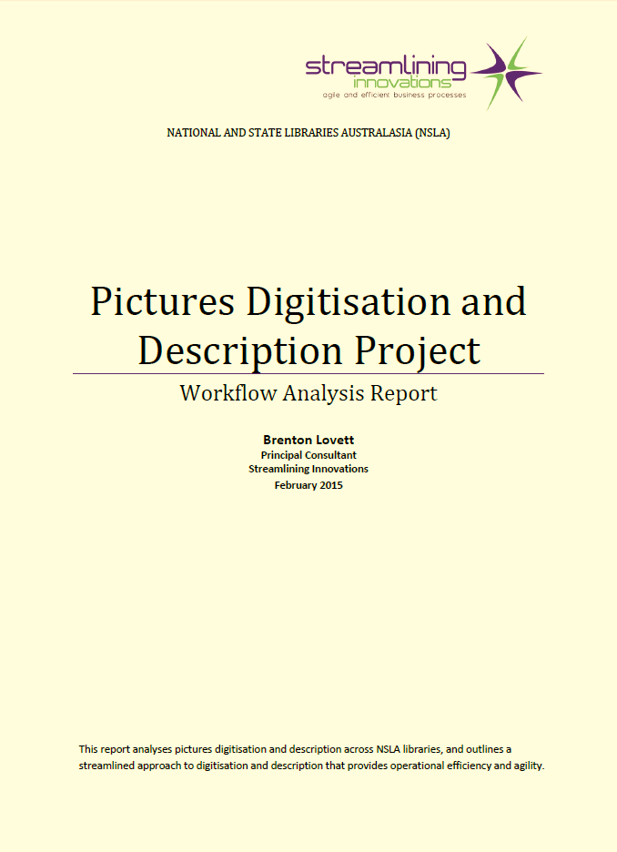
Pictures Digitisation and Description Project
The Workflow Analysis Report

Slide 4
Large Pictures Collection Survey
Conducted in August and September 2012
Very comprehensive – covering all aspects of Pictures collection management
Staffing; structure; collection size & formats; acquisition; accessioning; description; digitisation and delivery
Consistent metrics difficult to achieve

Slide 5
Large Pictures Collection Survey
Development of WP2 – Analysing Pictures Digitisation and Description across NSLA Libraries
One of the first tasks was for Brenton to interrogate the results of survey questions related to description and digitization

Slide 6
How we came to commission this report

Slide 7
Approach
Large Pictorial Collections Survey
Site Visits
Pictures Digitisation Survey
Process Modelling

Slide 8
The Survey Refinement
NSLA libraries’ digitisation projects comparison
varied formats, varied description, varied cataloguing levels, varied preservation requirements
to analyse better the varying results chiefly in terms of activities, speed and throughput [pull apart the ‘work streams’ for Rego, Preservation, Cataloguing, Digitisation, Finalisation]

Slide 9
The Libraries: NLA, SLV, SLSA, LINC Tasmania
‘normal’ - negatives, slides, prints, albums
‘not normal’ panorama collection (Enemark nitrates)
preservation intensive and large - (Fairfax, Rennie Ellis and Mark Strizic)

Slide 10
The Survey Questions
Order – Library, Year of digitisation, Work order, Source format, No. of physical images
Registration – No. of images requiring clearances (rights/cultural), Registration activities, Collection Team Registration hours
-Preservation – No of images requiring Pres treatment, Preservation activities, Preservation team hours
Cataloguing – No. of images already catalogued, medata std, cataloguing level, cataloguing activities, cataloguing team hours
Finalisation – finalisation activities, Collection Team finalisation hours

Slide 11
Approach
Large Pictorial Collections Survey
Site Visits
Pictures Digitisation Survey
Process Modelling

Slide 12
Key Observations from the 2012 Survey
We all have similar approaches
There is no single institution who is “the leader” in the field
Throughput depends on multiple interdependent factors
There is a lack of end-to-end process visibility, process metrics and process automation
We all are equally good, we are equally bad!
The model limits us.

Slide 13
Workflow
Registration
Preservation
Cataloguing
Digitisation
Finalisation
Planning
Rehousing
Metadata Standards
Description Level
Equipment
Discovery
Approval
Prioritisation
Method
Conservation
Notification
Payment
Format
Resolution
Digitise Pictures
Notes:
The Digitise Pictures workflow represents the end-to-end process for registering a digitisation request, undertaking preservation work, cataloguing and digitising items, and undertaking finalisation work to make the items discoverable.
This workflow is consistent across the selected libraries. However, each library has specific business rules and technology support.

Slide 14
Findings
Pictures Digitisation and Description
Activities
Resourcing
Visibility
Metrics
Automation
Notes:
Pictures Digitisation and Description
End-to-end digitisation workflow is consistent across the selected libraries – this implies that Libraries can benefit from common approaches to process improvements.
Planned Digitisation and Client Digitisation Order processes are different – this implies that it is difficult to reallocate resources when demand or priorities change.
End-to-end digitisation throughput depends on multiple interdependent factors – this implies that end-to-end digitisation throughput comparisons must take throughput factors into account, i.e. job registration, preservation, cataloguing, technical digitisation and finalisation requirements.
Activities
Description throughput depends mostly on research undertaken and library-specific rules and systems – this implies that description throughput can be improved by refining description rules and system to ensure alignment with business needs.
Digitisation throughput depends mostly on equipment setup – this implies that digitisation throughput can be improved through intelligent sourcing, i.e. insourcing, outsourcing on premise or outsourcing off premise to ensure efficient digitisation of items with similar characteristics.
Resourcing
Over 50% of the workforce of libraries is made up of volunteers, unpaid students and contract workers – this implies that processes and procedures need to be well documented to ensure consistency.
Pre-description, cataloguing, and insufficient staff/funds are the most significant digitisation inhibitors – this implies that digitisation inhibitors can be mitigated through intelligent resourcing, e.g. assigning volunteers to pre-description activities.
Visibility
There is a lack of end-to-end process visibility – this implies that it is difficult to determine and communicate the status of a Digitisation Request.
Metrics
There is a lack of end-to-end process metrics – this implies that it is difficult to provide reliable estimates for Digitisation Requests.
Automation
There is a lack of end-to-end process automation – this implies that more management resources are required.
Panel to provide additional commentary on the Findings.

Slide 15
Recommendations
Pictures Digitisation and Description
Continual Process Improvement
Business Alignment
Standard Operating Procedures
Strategic Sourcing
Process Metrics
Notes:
Pictures Digitisation and Description
Make the end-to-end digitisation process more visible – this will allow better stakeholder communication with reduced management resources.
Standardise digitisation throughput factors – this will allow more meaningful digitisation throughput comparisons.
Provide automated process support for end-to-end digitisation – this will allow increased end-to-end digitisation throughput with reduced management resources.
Continual Process Improvement
Establish an end-to-end digitisation workflow continual improvement process – this will allow better knowledge exchange and facilitate continual process improvement.
Business Alignment
Review description rules and systems – this will allow increased description throughput, i.e. by ensuring description rules and systems are aligned with business objectives.
Make planned digitisation and client digitisation processes better aligned – this will allow more agile resource allocation and easier reprioritisation.
Review end-to-end digitisation resource planning processes – this will allow increased end-to-end digitisation throughput, i.e. by making better use of available resources.
Strategic Sourcing
Review digitisation sourcing rules – this will allow increased digitisation throughput, i.e. by selecting the most efficient sourcing strategy for a digitisation job.
Standard Operating Procedures
Prepare standard operating procedures for end-to-end digitisation activities – this will allow greater end-to-end digitisation process consistency and easier staff on-boarding.
Process Metrics
Collect standard end-to-end process metrics – this will allow more reliable estimates for Digitisation Request funding and scheduling.
Panel to provide additional commentary on the Recommendations.

Slide 16
Next Steps
Continual Process Improvement - Deming Cycle
Plan
Check
Act
Do
Recommendations
Notes:
Plan-Do-Check-Act (PDCA) is a well-known continual process improvement approach created by Dr W. Edwards Deming. It is also known as the Deming Cycle.
Plan
Define process improvement objectives.
Do
Implement proposed changes.
Check
Measure change outcomes against the objectives.
Act
Standardise the improved process.
Apply the Deming Cycle to the recommendations, i.e. divide the recommendations into a set of Deming Cycles.

Slide 17
How the report informs us
If we want to increase throughput or if we want to increase process efficiency, is there a trade off?

Slide 18
How the report can help improve workflow

Slide 19
What we can do; What can we do?

Slide 20
Discussion
Comments
Nomenclature
Is the terminology OK? Inappropriate? Is it a barrier
Structure
Is the model representative of work area
Relevance
Can others see its use and relevance
What can we do to make it more relevant/useful?
Suggestions on what each individual institution can do
Specific work that individual institutions might do
List of things we wish someone would do (non binding)
Discussion on collaborative work
What we might want to do together

