Slide 1
Take down Examples, cultural Rights
Kerry Blinco A/Assistant Director Digital Initiatives
Northern Territory Library

Slide 2
Take down examples - real life requests…..
Notes:
2

Slide 3
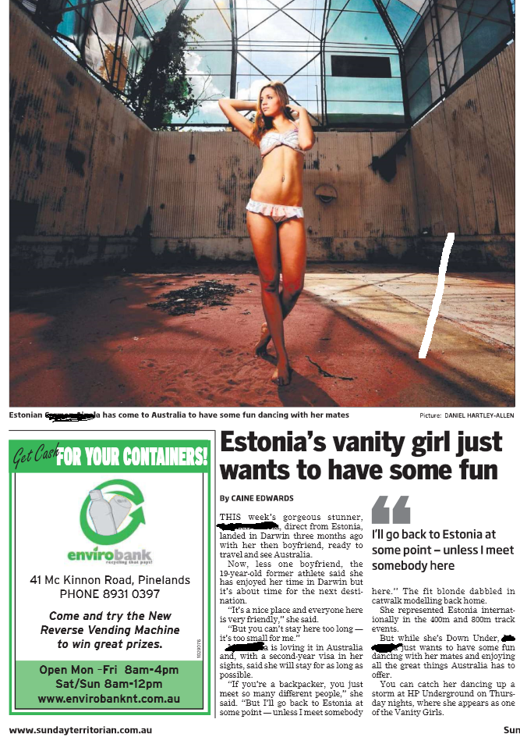
Yes or No?
Dear Sir/Madame,
I found an article of myself which was put together in 2012. Due to the changes of beliefs, moral values and views I am kindly asking You to remove the following page which comes up in Google search:
Quote style quote style quote style quote style…
Name underneath
Notes:
3

Slide 4
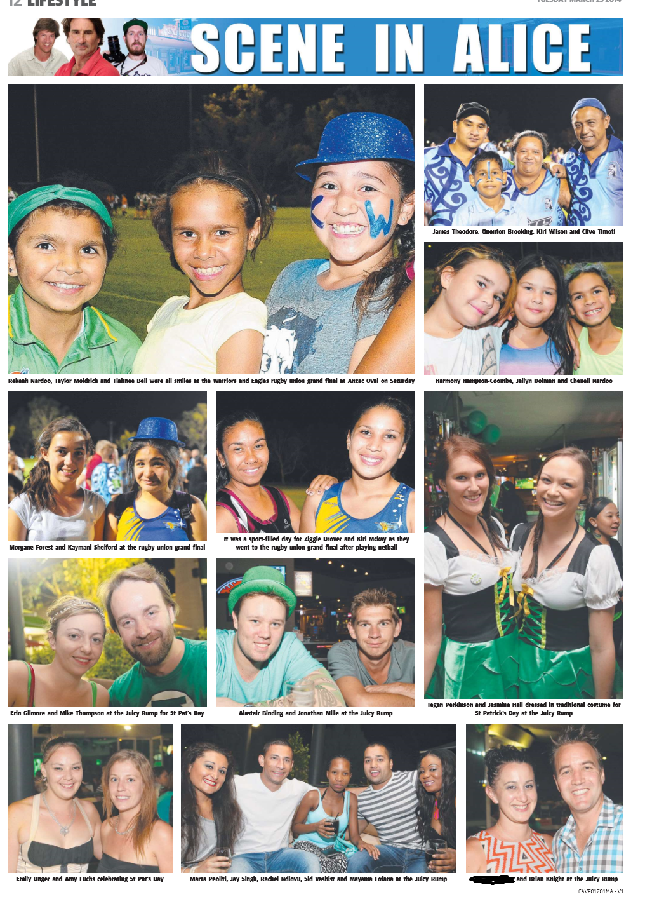
Yes or No?
Request from Brian Knight to remove the page because his employee, apparently has problems with an ex and she wants minimal publicity…
Quote style quote style quote style quote style…
Name underneath
Notes:
4

Slide 5
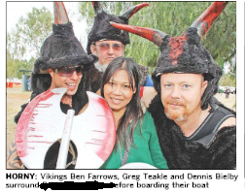
Yes or No?
Couple discovered this page existed after conducting an internet search of her name and are very displeased with the caption title “Horny” and feel it is defaming. The couple are very concerned that if their children or others were to search her name, this defaming reference will be found. Would like any reference to name blacked out and her image blurred
Requested by: the partner of the woman via the Electoral Office of The Hon. Robyn Lambley MLA | Member for Araluen to the Minister for Arts and Museums , Hon Matt Conlan MLA
Quote style quote style quote style quote style…
Name underneath
Notes:
5

Slide 6
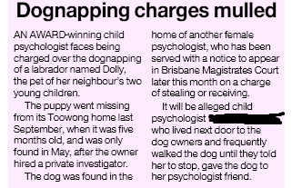
Yes or No?
It has come to our attention that false statements were made by Territory Stories. The website at this address …….is displaying an excerpt from a Courier Mail article which has since been removed by court order. By continuing to host content that has been court ordered to be removed is defamatory and illegal.
daniel.jon.dawson@gmail.com Online Reputation Correction Services http://onlinereputationcorrection.com.au
Quote style quote style quote style quote style…
Name underneath
Notes:
6

Slide 7
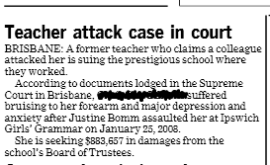
Yes or No?
Escalating series of phone calls and emails from requestor and husband. Eventually in contact with the Department CE.
“As at today the NT PDF containing my name and personal hurt still is appearing online…I look forward to your support of me in this matter (it upsets and frightens me!)
Claim by the requestors husband that the person was suicidal.
Notes:
7

Slide 8
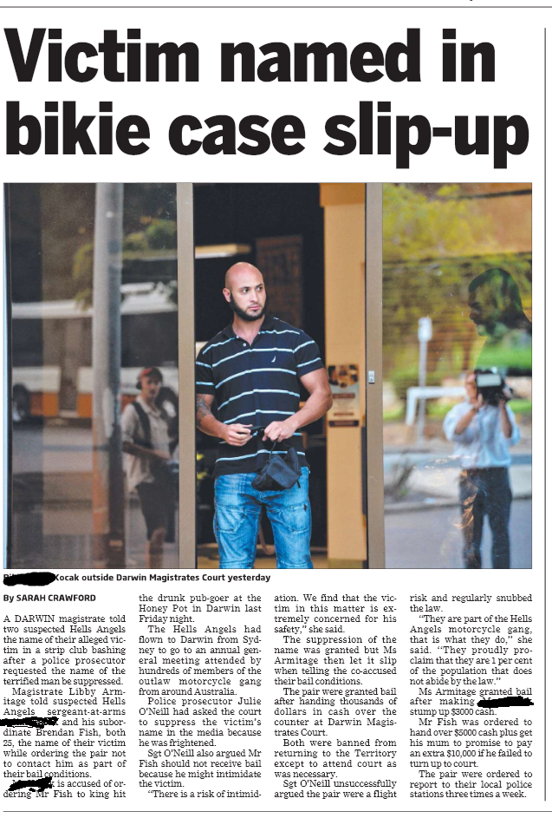
How about this one?
I am writing to kindly request that you remove my name and any other information which identifies me, including any photographs, from your website and being accesible online.
In the past few years, I have made every attempt to move forward in my life and avoid involvement with the mentioned Hells Angels.
Your publication is affecting my personal and professional life in a number of ways, including restricting my job prospects and any hope of career development, as well as damaging my relationships amongst family and friends.
I would like to pursue a new chapter in my life with a clean slate and would greatly appreciate your understanding with this matter.
Quote style quote style quote style quote style…
Name underneath
Notes:
8

Slide 9
So...Yes or No?
Dear Sir/Madame,
I found an article of myself which was put together in 2012. Due to the changes of beliefs, moral values and views I am kindly asking You to remove the following page which comes up in Google search:
Quote style quote style quote style quote style…
Name underneath
Notes:
9

Slide 10
Cultural Rights and Copyright Law
Notes:
10

Slide 11
Cultural Rights and Copyright Law
Copyright/ Moral rights
Indigenous Cultural Intellectual Property
Licensing
Access Controls (Secret, Sacred, Sorrow)
Cultural Warning
Conditions of Use
Metadata
Notes:
11

Slide 12
Copyright / Moral rights
As for any other item
Described as per the applicable law
Notes:
12

Slide 13
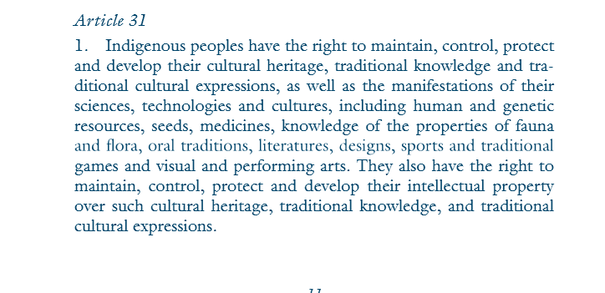
Indigenous Cultural Intellectual Property
The United Nations Declaration on the Rights of Indigenous Peoples.
http://www.un.org/esa/socdev/unpfii/documents/DRIPS_en.pdf
Notes:
13

Slide 14
Indigenous Cultural Intellectual Property
A description of the intellectual property in the material from and Indigenous Intellectual Property perspective
Descriptions such as – Mark Inkamala is the custodian of the story that is illustrated in this painting.
Some information might be codified (eg using AIATSIS Language codes)
Respect not law
Notes:
14

Slide 15
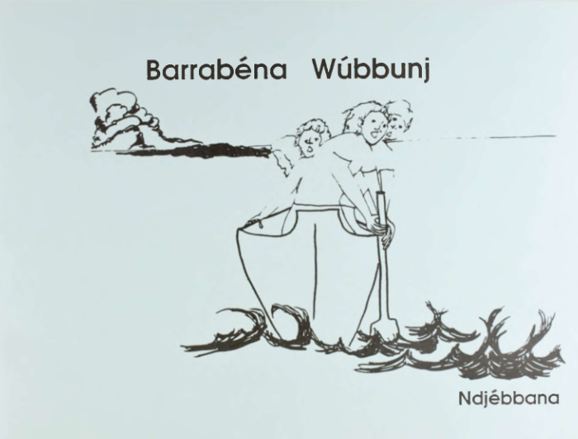
Conditions of Use
Attribution of ICIP
What uses are allowed without obtaining further permission
Who has to be contacted outside this use
Special conditions such as – you can make adaptions but you can’t change the ending of the story as that would be culturally insensitive
Notes:
15

Slide 16
Licensing
The version 4.0 licences do not permit the licences themselves to be varied.
However, they do recognise that in some cases there may be other rights that apply to the material and that the copyright owner may make some special requests, for example, about how the material is to be described or used. Any of these additional requirements will depend for their legal effect on other rights (that is, rights other than copyright).
I think it gives more scope for considering how to use CC licences alongside traditional rights in cultural and creative materials.
Anne Fitzgerald, Creative Commons Australia
Tensions between the uses of ICIP
Creative arts
Growing knowledge
Can standard licensing be used to express ICIP requirements?
Notes:
16

Slide 17
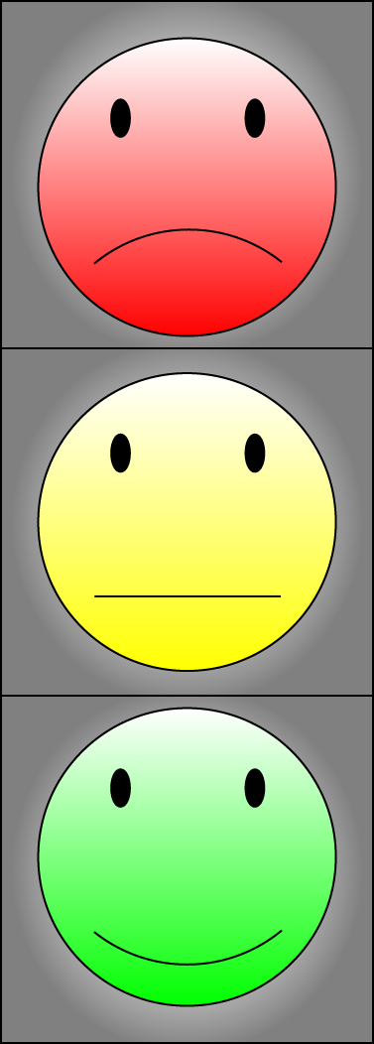
Secret, Sacred Sorrow… an Access Control Issue
“The right of Aboriginal and Torres Strait Islander peoples to determine use and access provisions for heritage materials which reflect Aboriginal and Torres Strait Islander history, culture, language and perspectives.”
Complex and contextual
Need to unpack
Not static – the controls change over time, attitudes change over time
Role based relationships
Access control may not be sufficient
May not be exemptions for Administrators
Work with least difficult materials first - Traffic light approach
Notes:
17

Slide 18
Cultural Warnings
Aboriginal heritage material in our catalogue can be downloaded and used, unless it has been flagged as containing traditional knowledge or sensitive content. In all cases it is recommended that the traditional owners are contacted before any publication, display or reuse of this material to ensure that any intended use is appropriate and respectful. In some cases information regarding the traditional owners of the material is unavailable or unknown, and in these situations we advise that the material is used respectfully and with care to minimize any distress or offence which may be caused to Aboriginal or Torres Strait Islander people or communities. Aboriginal and Torres Strait Islander people are advised that this material may contain the names, images, and voices of people who are now deceased - please use your own discretion when accessing, printing or downloading these materials.
State Library of Western Australia
No one size fits all
Consider language/s of warning
Self censorship
Notes:
18

Slide 19
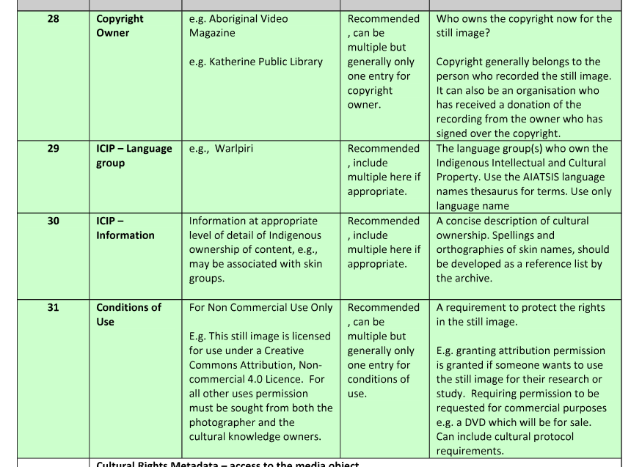
Metadata
Notes:
19

Slide 20
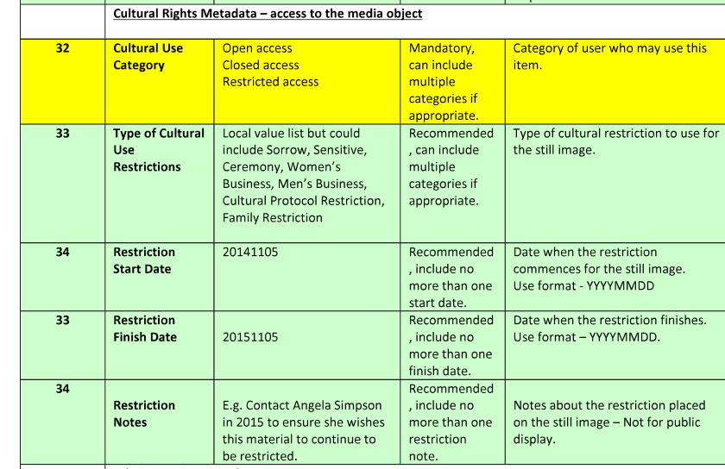
Access Control Metadata
Notes:
20

Slide 21
THANK YOU
kerry.blinco@nt.gov.au
08 8922 7058
0419 787 992

