Slide 1


Standards – a provocation?
A talk for NSLA’s Heritage Collections Forum in Brisbane, 13 May 2015
Nicola Frean, Leader A&D, Alexander Turnbull Library, National Library of New Zealand
Notes:
Mihi
Standards – who are they for? They benefit, are good for, USERS.
Which users? - future users, users who want to use all of NZ, or Australia, or all of Australasia or all of world services.
Not good for short-sighted vendors, who are mostly interested in revenue and customer lock-in, or for short-sighted organisations.
Imagine a situation without standards, for example where you had to transfer to a different railway track when crossing boundaries …

Slide 2
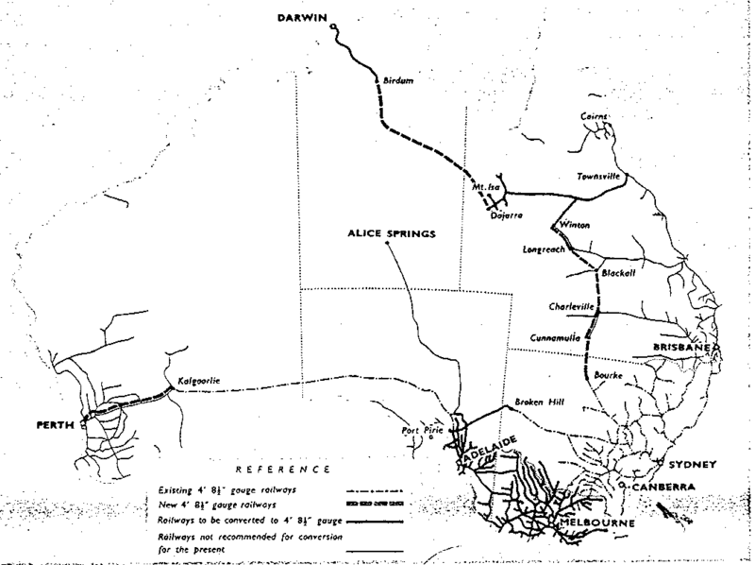
Wikipedia http://en.wikipedia.org/wiki/Rail_gauge_in_Australia
Details of the Clapp report for the Commonwealth Land Transport Board thin lines – 3' 6“ dotted lines – 4' 8.5“ dashed thick lines – new 4' 8.5“ thick lines – 5' 3"
Notes:
Pin everything back to railways in Australia and the choice of gauge. Illustration is from Clapp Report, Wikipedia entry. Railways were the great network of the day, yet through a series of fascinating stories, a situation resulted where your carriage would be lifted up at various points and put on a different track. [NB NZ not that different – narrow 3’6” gauge is the standard]. Result of breaks in gauge - during WW2 ‘upwards of 1,600 service personnel and many more civilians employed to transfer 1.8 million tons of freight ‘;
Once standardisation improved e.g. 1969 ‘Kalgoolie – Perth freight train times were reduced from 31 hours to 13 hours, and passenger trains from 14 hours to 8 hours.‘
Each of these states, or companies, thought they were doing their best, at the time. For us now it’s a question of viewpoint, and the viewpoint we take is that of the users, and that of history, looking back over 150 years. From this viewpoint, it would have been best to find one standard, and stick to it. So, returning to archival description, the particular standard I am interested in is EAD, Encoded Archival Description.

Slide 3
EAD Encoded Archival Description
http://www.loc.gov/ead/
V1 1998
V2 2002
V3 2015
EAC Encoded Archival Context
http://eac.staatsbibliothek-berlin.de/
2011
Notes:
‘Encoded Archival Description (EAD) is an XML standard for encoding archival finding aids, maintained by the Technical Subcommittee for Encoded Archival Description of the Society of American Archivists, in partnership with the Library of Congress.^{[1]}
EAD stands for Encoded Archival Description, and is a non-proprietary de facto standard for the encoding of finding aids for use in a networked (online) environment. Finding aids are inventories, indexes, or guides that are created by archival and manuscript repositories to provide information about specific collections. While the finding aids may vary somewhat in style, their common purpose is to provide detailed description of the content and intellectual organization of collections of archival materials. EAD allows the standardization of collection information in finding aids within and across repositories.’
Team contributed to comments as part of global community of practice, for EAD Version 3, on way this year.
Close relationship with ‘Encoded Archival Context - Corporate bodies, Persons and Families (EAC-CPF) is an XML standard for encoding information about the creators of archival materials -- i.e., a corporate body, person or family -- including their relationships to (a) resources (books, collections, papers, etc.) and (b) other corporate bodies, persons and families. The goal is to provide contextual information regarding the circumstances of record creation and use.’ In 2011 EAC has become an adopted standard of the Society of American Archivists (SAA). A Technical Subcommittee (TS-EAC-CPF) was established under the SAA's Standards Committee. Its main objective is having completed a full review of the standard by 2015.’
Mention also Unicode

Slide 4
“But …”
DC ISAD(G) RAD MARC etc, etc
Notes:
Reaction may be … BUT – other standards. DC, ISAD(G), RAD, MARC, CIDOC CRM, etc
Re rail example – ‘containers’ a standard also – but every state could say ‘sure, we can take freight in containers’ without affecting the basic problem.
Needs to be correct standard for archives, which as we know are each unique, require communication of their provenance, original order, contexts … - (as in the Archival Collections working group statement approved earlier this year).
DC is Internet, but not archives.
ISAD(G) is information for archivists on what to put in a finding aid – it’s by archivists and for archivists, but not for the Internet
MARC is for computers, but pre-internet, and not for archivists – some of you may remember Non-Book or even AUS-MARC

Slide 5
Notes:
NZ National Librarian put me forward as co-chair for the Archival Collections Group because I kept stressing international standards.
Am currently deeply involved with replacing the piece of legacy software at Turnbull (TAPUHI) which has been there since 1991. TAPUHI is software that was built for the parent generation of the junior staff at Turnbull; it was turned on before the internet was available at NLNZ. The drivers sometimes seem to be all about ‘get us onto a modern platform’, and ‘it’s an interim solution’, and I keep saying ‘marry in haste, repent at leisure’. After all, how many times might the rails in various states have been replaced with ‘modern’ rails?
NZGOAL and Cabinet directive– planning for EAD and EAC datasets. Data.govt.nz.
[https://www.ict.govt.nz/guidance-and-resources/open-government/new-zealand-government-open-access-and-licensing-nzgoal-framework/quick-guide-agencies/]
Standards are longer lived than the systems that implement them. So our next system might only be running for the next ten years, but the choices we make about the standards that we adopt now might last 25 years plus. It’s not enough to get a modern platform – what we want is a modern standard.
So, railways – were the great network of their time, were going to change everything, are individually awesome.
It’s all about connecting them up.
Let’s be long-sighted, and cooperative.

