Slide 1

Significance Assessment
NSLA Heritage Collections Forum 2015
Jo Ritale

Slide 2
Significance Assessment Process
NSLA Pictures Project - Guidelines for assigning significance and processing plans
Selection Committee
Establishment of the Collections Working Group
Development of an assessment form
Testing of the form
Implementation

Slide 3
How it works at SLV
Assessment Form
Content Assessment Guidelines
FAQs
Roles and Responsibilities

Slide 4
Collection Assessment Form

Slide 5
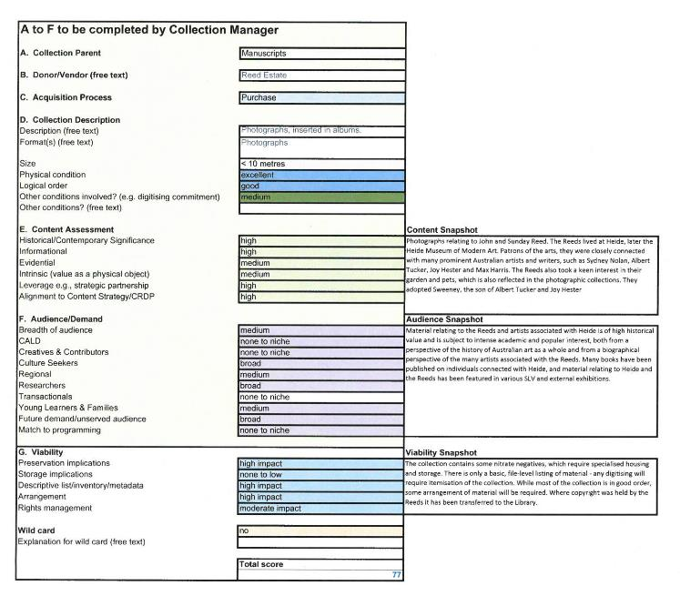
Collection Assessment Form

