Slide 1
Workshop: Discovery of archival collections online.
Marie-Louise Ayres, NLA
Joanne Evans, Monash University

Slide 2
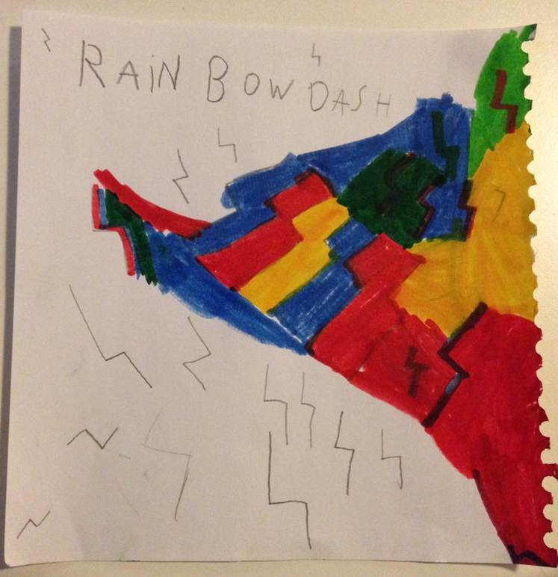
Let’s start with the user …
Kate Bagnall 白碧 @baibi · May 5
A Lightening Bolt Rainbow Dash poster Miss 5 wanted me to put online so people could 'search it up'. #mylittlepony

Slide 3
Key Questions
How do content aggregators like Trove, WorldCat, ArchiveGrid, and DigitalNZ actually work?
What might be the consequences of the way we use MARC fields or adopt international standards for metadata?
How can we maximise the visibility of our archival collections online and strengthen links with other GLAM sector organisations?

Slide 4
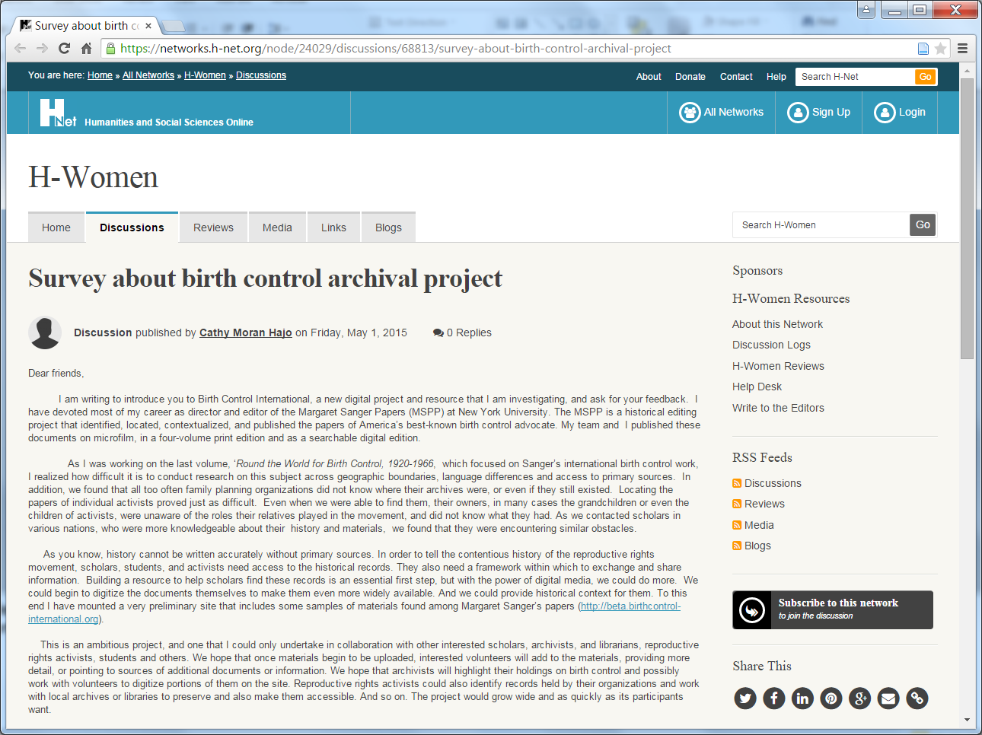

Slide 5
Metadata Interoperability
What are the ways in which metadata about archival resources are currently shared?
  What metadata about
  What entities to provide to
  What services by
  What technical means

Slide 6
Entities | Metadata Formats | Aggregator Examples
Collection Descriptions | MARC | TROVE WorldCat ArchiveGrid
Records Creators People Organisations Families | EAC | TROVE SNAC
Records Series Files/Items | EAD | ArchiveGrid

Slide 7
Technical Means
Metadata Harvesting
  Open Archives Initiative – Protocol for Metadata Harvesting (OAI-PMH)
API
  Trove
  Digital NZ
  State Records NSW

Slide 8
Australian Women’s Register
Supplying EAC records to Trove

Slide 9
Big aggregators - Trove
What does Trove do now?
What is the flow between LA and Trove?
What can Trove aggregate now?
  Collection level records
  Searchable resources (finding aids)
  User generated tags (but only at the 'top' level)
  User generated comments (but only at the 'top' level)
  NOT transcriptions (however generated), NOT entity tags etc.
What will Trove need to do in the near future?
How might this need to change in the longer term?

Slide 10
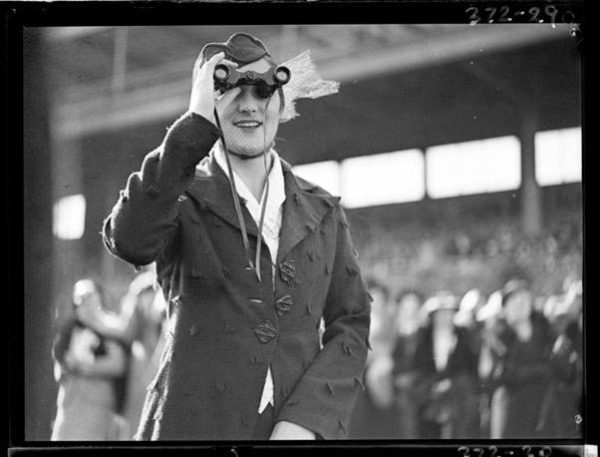



The Australian Women’s Archives Project
Established in 2000
Concerns about women’s visibility
Concerns about protecting records
Concerns about funding
Concerns about connecting with the community

Slide 11
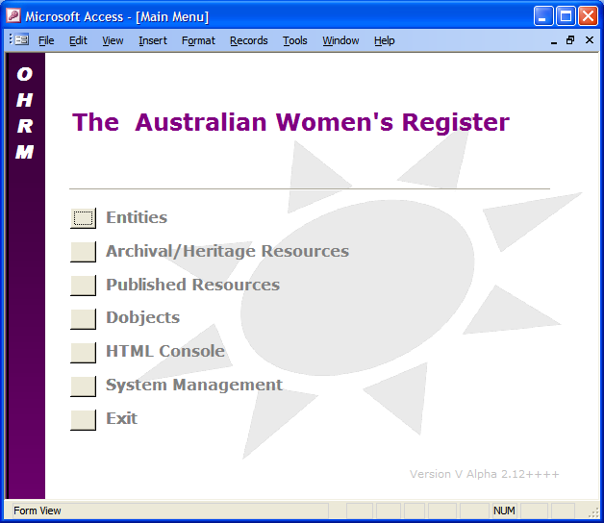
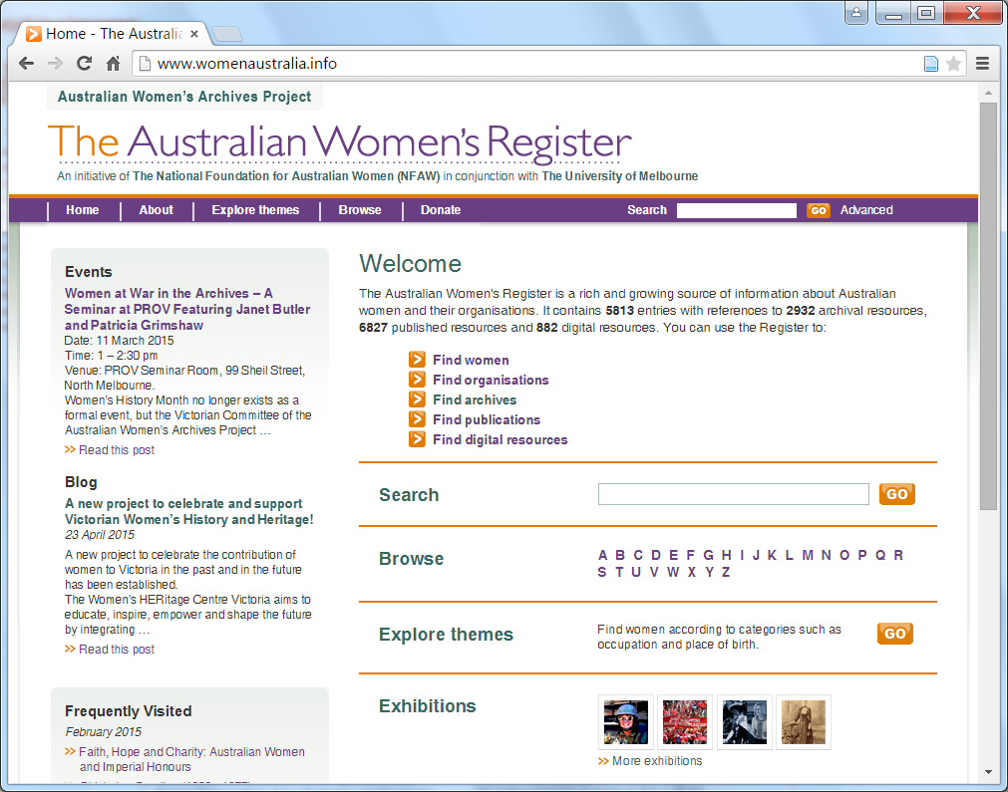

Pub
Page
Exhibition
Page
Dobject
Page
Entity
Page
Arc
Page
A Microsoft Access database …
… from which a set of static html pages can be generated …
… which may then be uploaded to a web server ...
… which are indexed by Google …
… which may then be augmented with site search functionality based on page indexing …
… which may also be transferred to a PostgreSQL database version for structured searching using php search scripts.
Discovery Services
- Site search
- Structured search

Slide 12
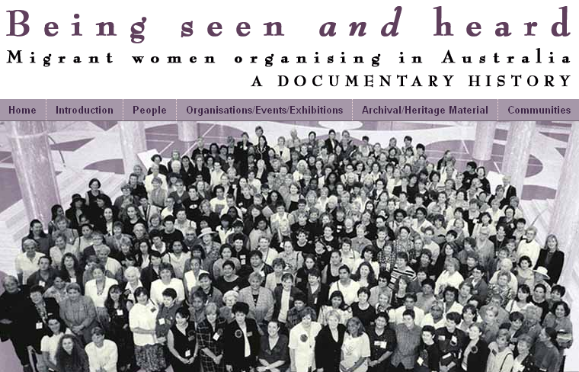
AWR’s Web 2.0 needs
A better architecture of participation

Slide 13














ARC LIEF 2008 – History, Archives and New Technologies: Developing the Australian Women’s Archives Project

Slide 14
Research Funding Opportunity
Primary
Sources
Publications
& other
products
Secondary
Sources
Research
Notes
Search
Australian
Women’s
Register
Citations
Copy and paste

Slide 15




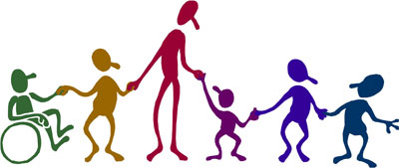
Descriptive Frameworks
National Online
Archival Network
Australian Women’s Register
Register
Harvest
Harvest
Annotate
Researchers
Community

Slide 16
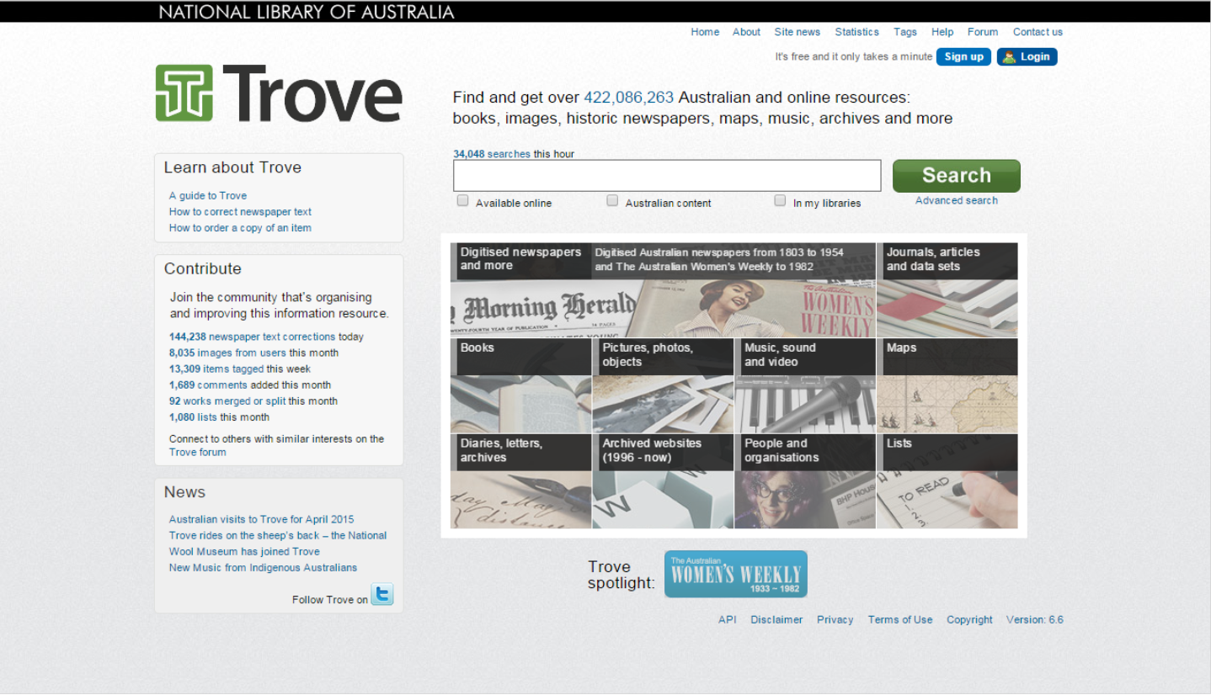

Slide 17
EAC-CPF
<eac>
  <control></control>
  <description>
    <identity><identity>
    <description></description>
    <relations>
      <cpfRelation> or <resourceRelation>
    </relations>
  </description>
</eac>
See http://eac.staatsbibliothek-berlin.de/

Slide 18
Technological development priorities
Priority 3
Harvesting to/from researcher environments
Australian
Women’s
Register
People
Australia
Priority 1
OAI-PMH
EAC
…
Priority 2
Register
refurbishment

Slide 19

Entity
EAC
File
Entity
EAC
File
Entity
EAC
File
Entity
EAC
File
Entity
EAC
File
Entity
EAC
XML
Generate EAC
jOAI Repository
Harvest identity maps and party identifiers as Trove citations
Harvest EAC
SRU

Slide 20
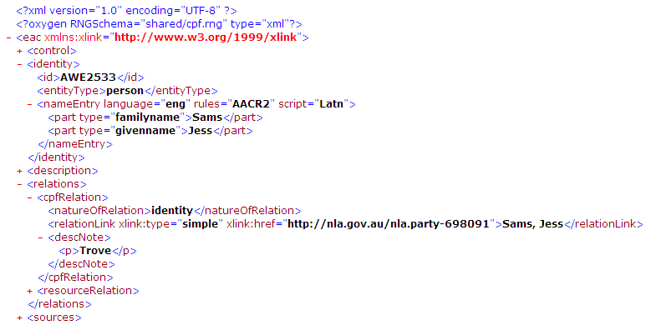

Slide 21
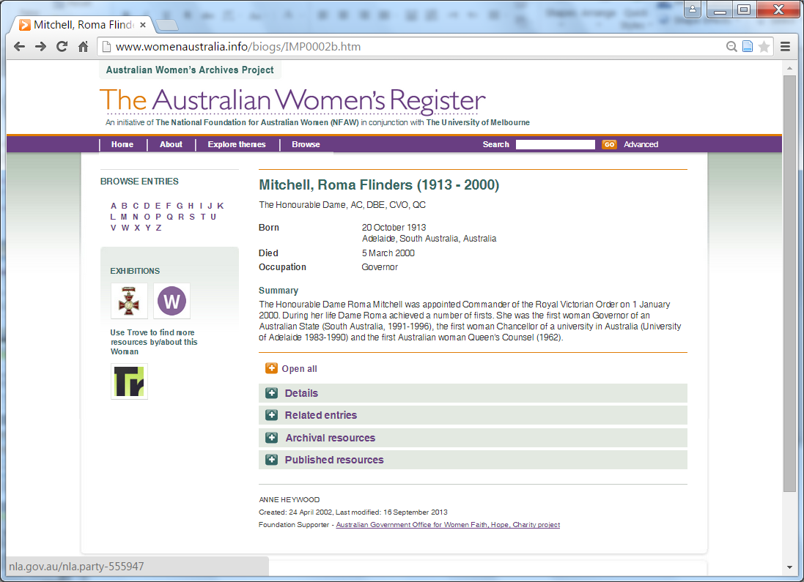

Slide 22
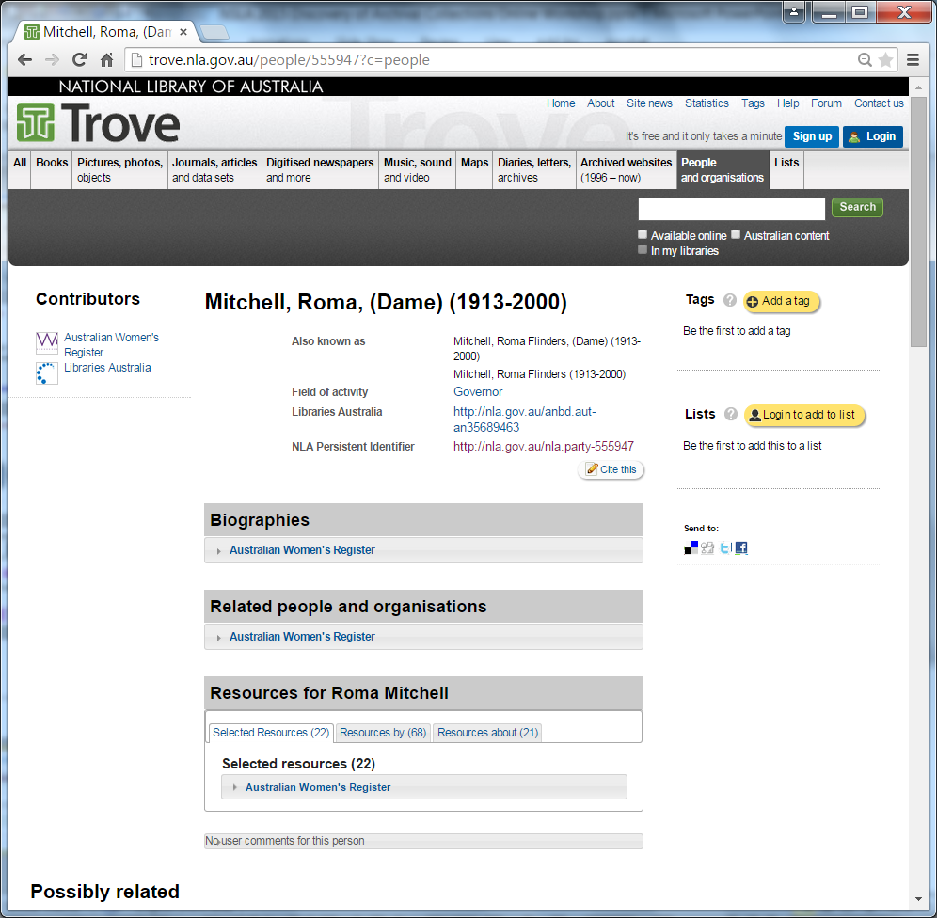

Slide 23
How can we maximise the visibility of our archival collections online and strengthen links with other GLAM sector organisations?
Interoperability by Design

Slide 24
RCRG Research: Interoperability by Design
Greg Rolan, Monash University PhD Candidate
  Transforming Archival Systems for Interoperability, CIRN Prato 2014 PhD Colloquium presentation
ARC Future Fellowship Research Program (2015-2018)
  Connecting the Disconnected: Co-Designing Integrated and Inclusive Recordkeeping and Archival Networks

Slide 25
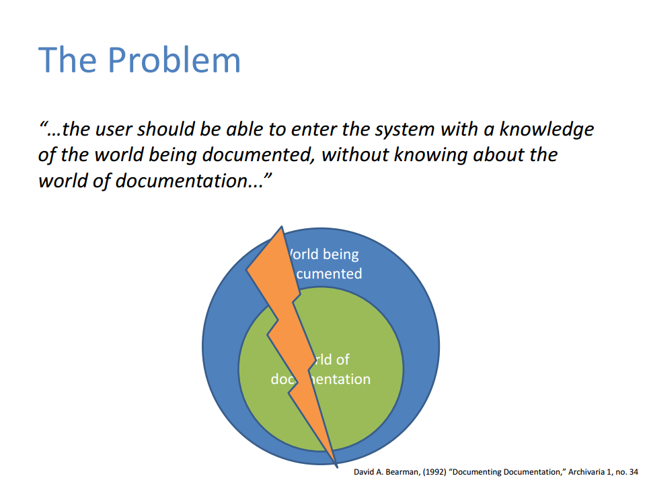
  Slide courtesy of Greg Rolan, Transforming Archival Systems for Interoperability, CIRN Prato 2014 PhD Colloquium presentation

Slide 26
Discoverability Questions
What do we mean when we talk about discoverability of archival collections?
Who do we think the discoverers will/are/should be?
Where do we think they will or should begin their discovery journey?
Where do we think they should end their discovery journey? Will it inevitably be interfaces designed by us?
What is it that we want them to discover?
How much control do we think we need to exert over discovery? Why?

Slide 27
Baby steps
Libraries Australia study from June
  How many NSLA archival collections in ANBD? (should be easy … )
  Are finding aids coded as ‘searchable resource’ (a bit harder)
  What access points are included in catalogue records (much harder, may need help from OCLC)
  Tracing path from LA through other aggregators
  Is coverage as good as it should be?
  What issues will we find?

Slide 28
Known issues
LA Focuses at the bibliographic level route
Only some NSLA libraries work in this way
Trove can search textual finding aids … but searching hierarchical descriptions/delivery systems linked to MARC records …
Trove is not optimised for harvesting or displaying hierarchical finding aids
Should data flow back from Trove to LA?

Slide 29
More known issues
How do we aggregate or at least index a dispersed set of manuscript transcriptions (whether made by machines, humans or a combination)?
How do we aggregate user-generated content that increases discoverability in a distributed environment?
How do we increase the quality of user-generated content?

Slide 30
