Slide 1
My background
Voice
Representation
Relationships
Responsibilities

Slide 2
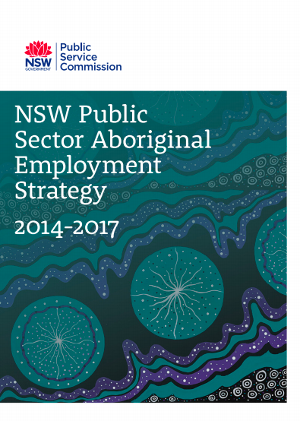
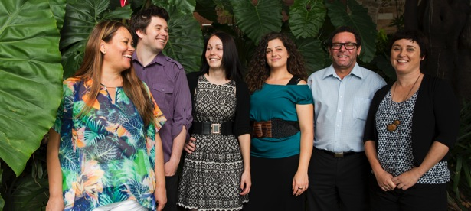
Indigenous Services Branch
The Indigenous Services Branch
promotes the collections and services of the State Library relating to Indigenous people
liaises with Indigenous communities across NSW in regard to the retention and management of Indigenous documentary resources
provides advice to staff and management of the State Library and NSW public libraries on Indigenous matters.
Indigenous Services
A key initiative for the State Library of NSW in 2013.
Unit became a branch reporting to the Mitchell Librarian in Feb 2014.

Slide 3
Content and perspectives
Intellectual Property
Accessibility and Use
Description and Classification of Materials
Secret or Sacred Materials
Offensive Material
Governance and Management
Staffing
Education and Training for Professional Practice
Awareness of Aboriginal and Torres Islander Peoples and Issues
Copying and Repatriation of Records
The digital environment (ATSILIRN, 2012)
http://aiatsis.gov.au/atsilirn/protocols.php
Building contemporary Indigenous collections
Digital infrastructure for Indigenous collections
Public Library Network
Protocols for Libraries, Archives and Information Services

Slide 4
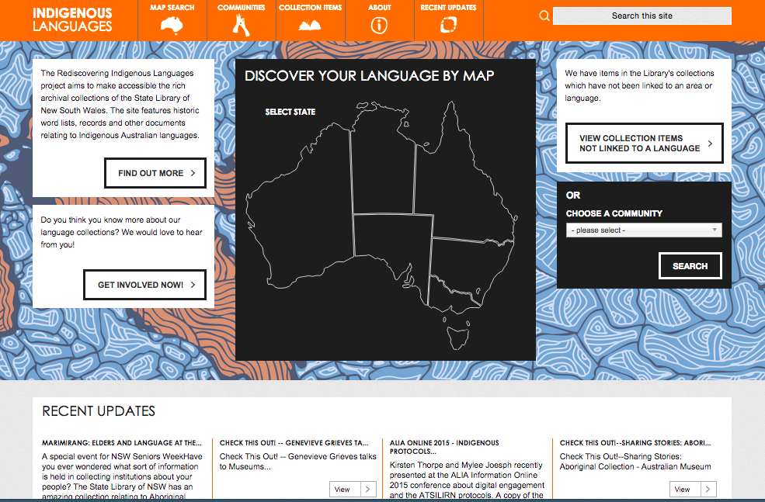
Governance – Leadership
Indigenous Advisory Board
The Indigenous Advisory Board will assist the Library Council and the State Library to respond to the needs of the Indigenous population of New South Wales and to build relationships with communities.

