Slide 1
Managing Indigenous Collections
Kerry Blinco, NTL
Maxine Briggs, SLV
Susanna Iuliano, SLWA
Kirsten Thorpe, SLNSW

Slide 2
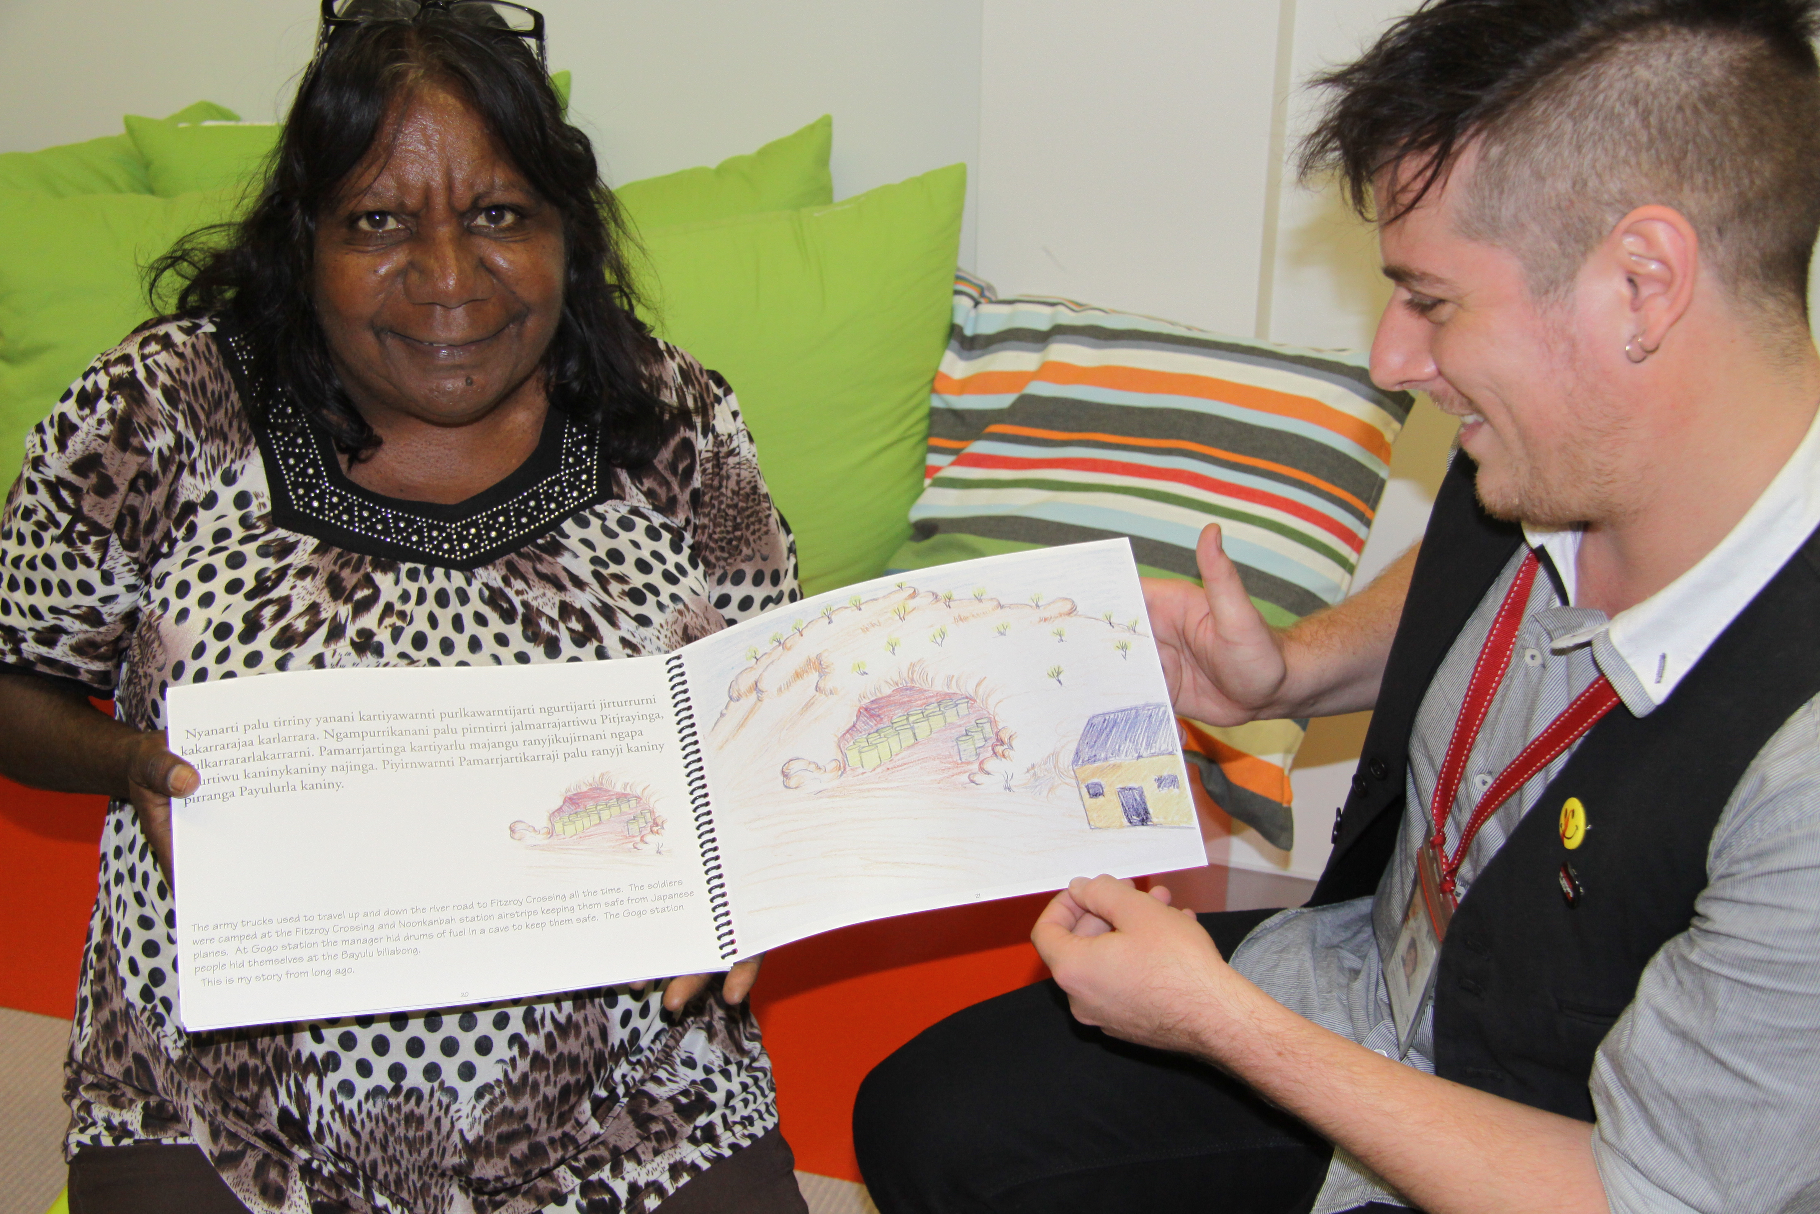
Indigenous Heritage Collections
A significant amount of Indigenous knowledge, some of which is secret and sacred knowledge, is stored in library and archival collections across the country. Collections may contain explicit or implied Indigenous knowledge.
Explicit = e.g. images of ceremony or initiation, descriptions or maps of secret or sacred sites, descriptions of Law.
Implied = photographs of Indigenous art which may contain secret/sacred elements or transcriptions of song or ceremony.
Annette Kogolo at SLWA in 2013, reading her Aunty’s story in a recently digitized Walmajarri Language Book.
Notes:
2

Slide 3
Protocols and Guidelines
The NSLA Indigenous groups recognizes and promotes existing protocols and best practice guidelines for managing and providing access to Indigenous collections.
The National Position Statement for Aboriginal and Torres Strait Islander library services and collection (2014) affirms NSLA commitment to :
ATSILIRN (Aboriginal and Torres Strait Islander Library and Information Network) Protocols for Libraries, Archives and Information Services.
The United Nations Declaration on the Rights of Indigenous Peoples
NSLA Guidelines for Working with Community
Notes:
3

Slide 4
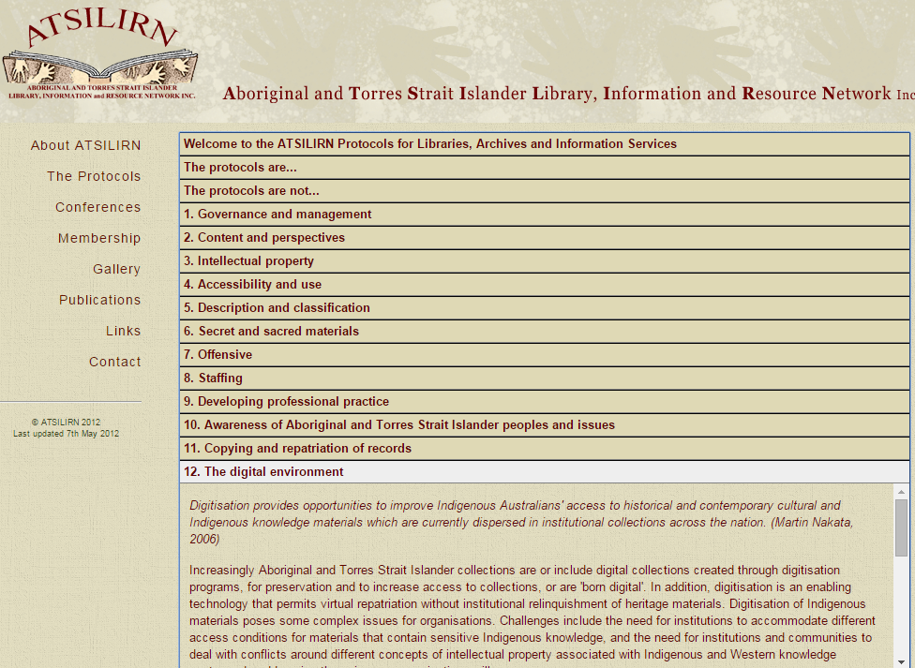
ATSILIRN Protocols and web site, 2015 http://atsilirn.aiatsis.gov.au/
Notes:
4

Slide 5
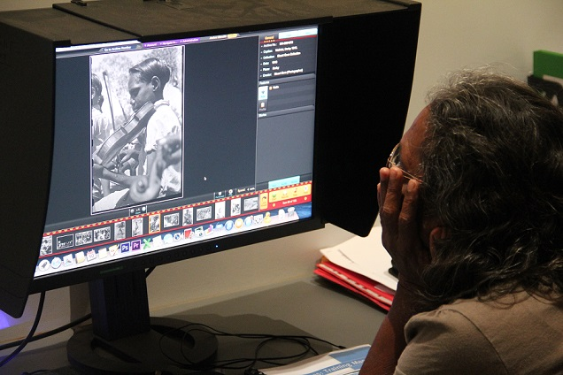
The Storylines Project is an online central access point for digitized Indigenous heritage material. This includes:
Photographs
Oral Histories
Documents
Audio and video material
The interactive archive allows any user to leave annotations on any item in the system, or to request a restriction for specific material.
The annotations and restrictions are managed by SLWA staff with advice from an Aboriginal Reference Group.
Mary Bear identifying people in Storylines at Mowanjum in 2014.
Notes:
5

Slide 6
Welcome Screen from Wurnan Storylines – a community instance run by Mowanjum Community.
Notes:
6

Slide 7
Welcome Screen from Mangara Storylines – a community instance run by the Yawuru people.
Notes:
7

Slide 8
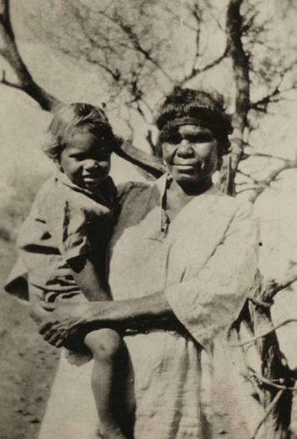
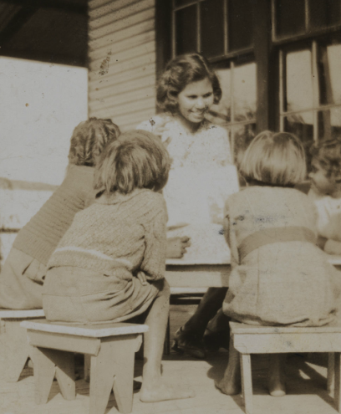
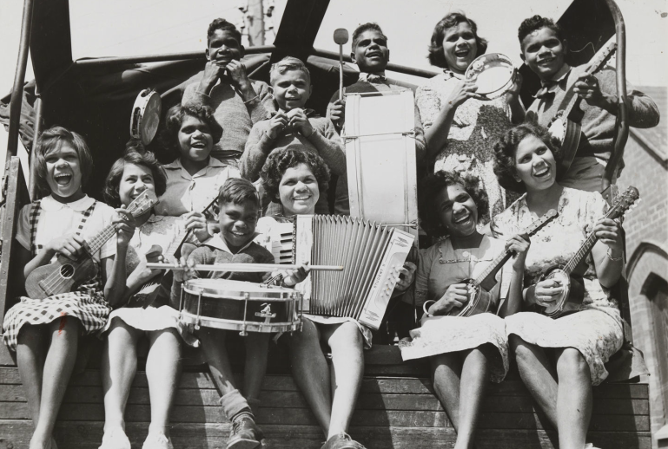
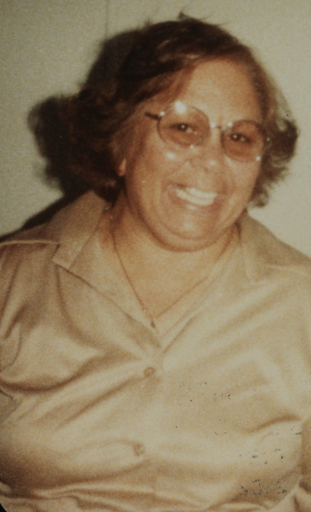
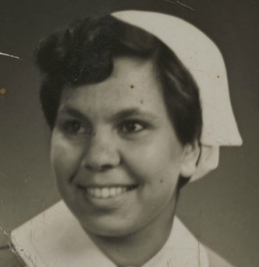
Sadie Canning
Photographs from the Schenk Collection, held at the State Library of Western Australia
Notes:
8

Slide 9
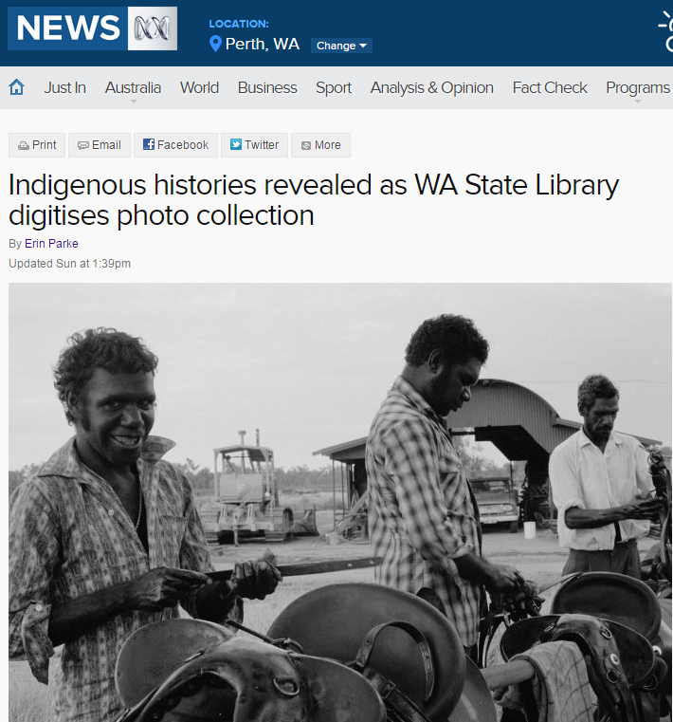
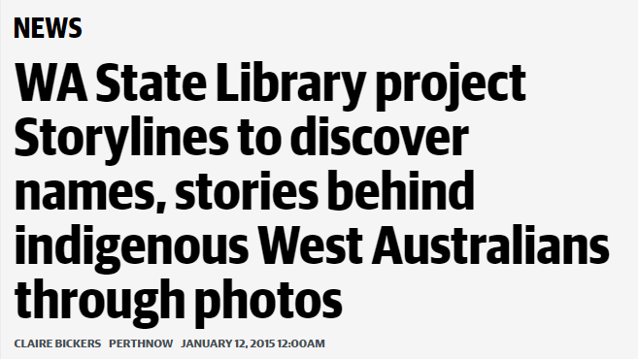
Feedback and community response
PerthNow, January 12, 2015
ABC News, May 10, 2015
Notes:
9

