Slide 1
Digitisation – now what?

Slide 2
Digital Excellence Program- launched 2012
“to digitise, preserve and make accessible the
iconic and priceless collections of the Library
for the people of NSW and beyond.”
In 2012 $48.6 million received for the initial 5 years
10 year program for digitisation and
renewal of systems and infrastructure which enable discovery, access and management of the collection
Notes:
In 2012, the NSW Government announced funding support for the Digital Excellence Program. This commitment provided AUD$52m for the initial five years of a ten year digitisation program. This funding has enabled infrastructure and systems renewal as well as the commencement of a large scale digitisation program focussing on significant, at risk or high demand collections. Implementing such an extensive program, which had key deliverables in the first twelve months, required new skills and knowledge as well as new systems and work practices. Project governance was instrumental to successful achievement of milestones. We have also identified and implemented new business practices to more effective management of key functions and the use of a project management framework to manage projects.
December 2014
The State Library of NSW has announced it will adopt a suite of Ex Libris solutions—comprised of the Alma® library management solution, the Primo® discovery and delivery solution, and the Rosetta digital asset management and preservation system—and Axiell Group’s Adlib Archive to manage its archival collections. These solutions replace multiple legacy systems used by the Library. Together, these integrated systems will enable the State Library to offer a world-class discovery experience to its large user community.

Slide 3
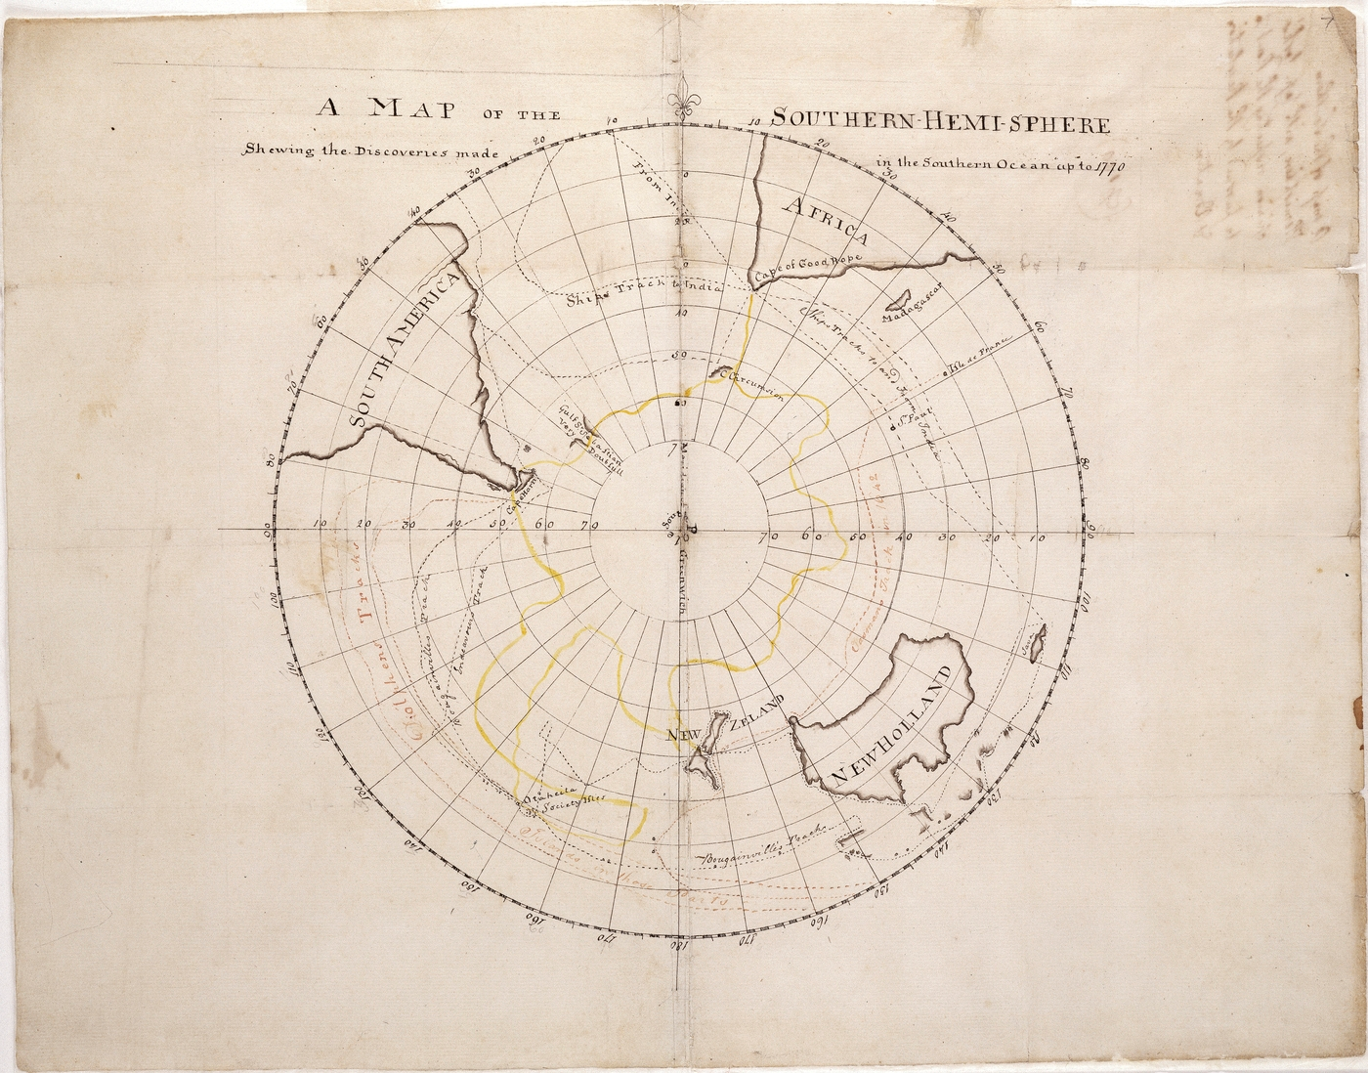
What we have digitised so far….
1.3 million images from 4,500 books
15,000 WWI published items including books, serials, posters
5,500 maps
4,500 photos including over 1,000 glass plate negatives
175,000 manuscript pages
450 objects
15,500 pictorial items including sketches, watercolours and oils
1100 + hours of Oral History
5.2 million pages NSW newspapers
Notes:
1.3 million images from 4,5000 DSM books
15,000 WWI published items including books, maps, posters
4,500 photos including over 1,000 glass plate negatives
175,000 manuscript pages
450 objects
15,500 pictorial items including sketches, watercolours and oils

Slide 4
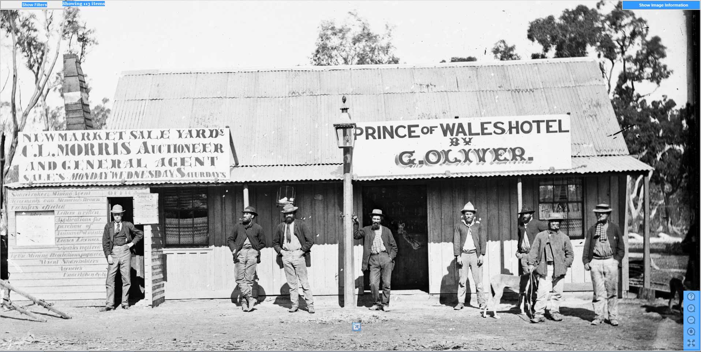
Notes:
Join our discussions about this exciting project to digitise 3,500 glass plate negatives documenting the 1870s gold rush era in New South Wales and Victoria.
The Holtermann Collection is an internationally significant collection of prints, albums and glass plate negatives, including the largest hand coated wet plate negatives ever made. The Holtermann collection depicts New South Wales and Victorian gold towns from 1872 to 1875, and the streets and buildings of Sydney and Melbourne between 1871 and 1876.

Slide 5


Slide 6
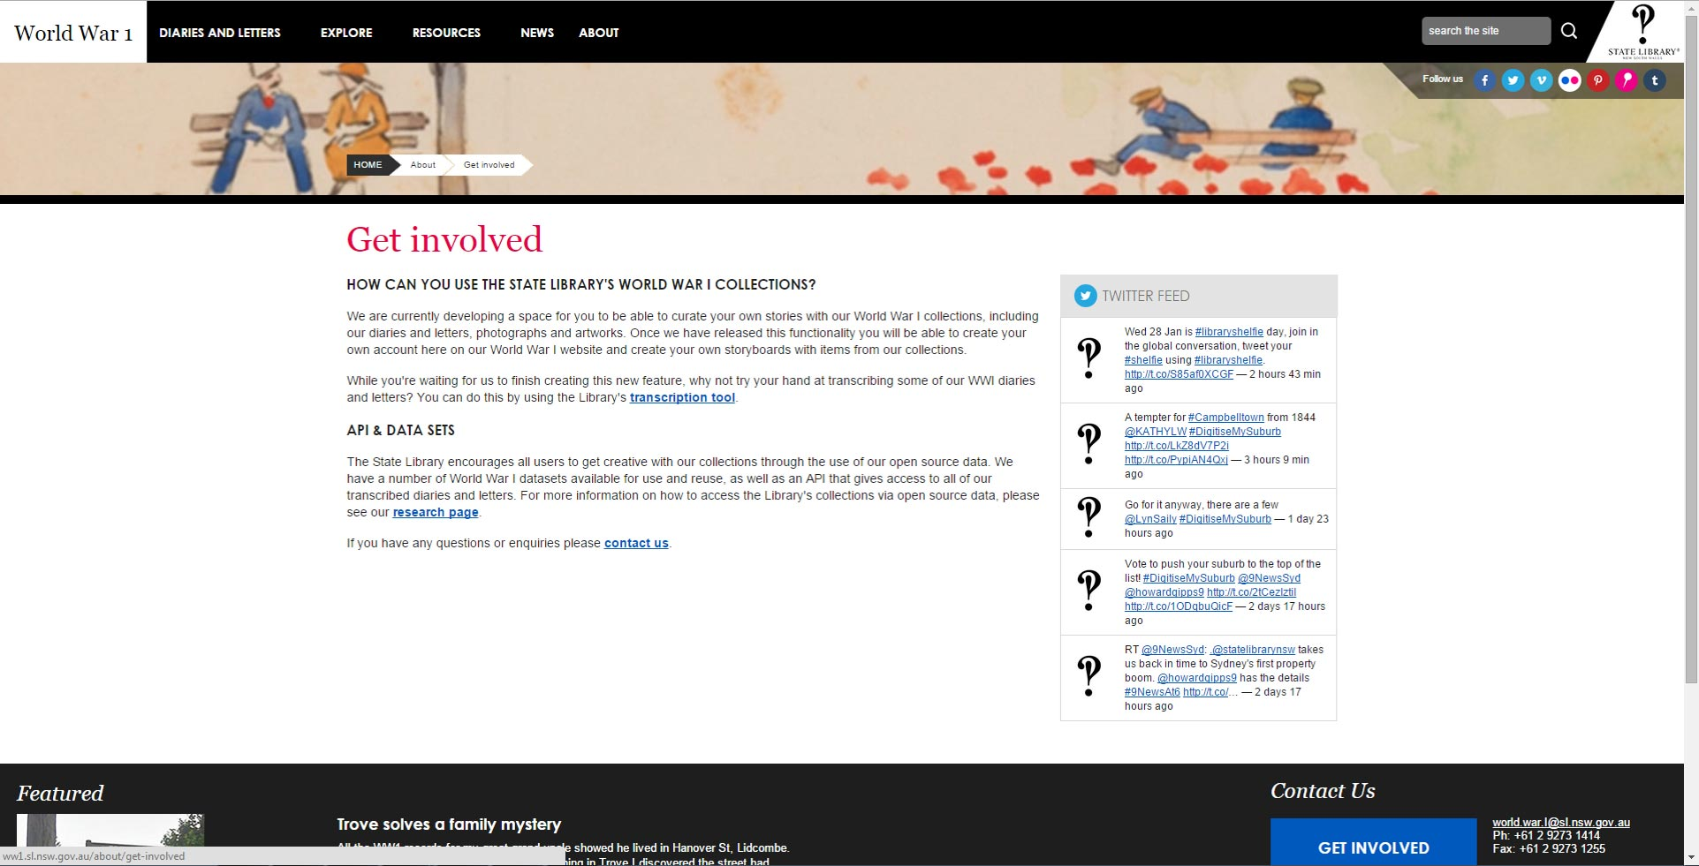
Notes:
Completed: 12,295
Ready for review: 7,430
Partially transcribed: 10, 896
Not Yet Started: 15,845
Users
Total registered users: 1178
Total active users in last month: 160
Total active users in last 3 months: 436

Slide 7
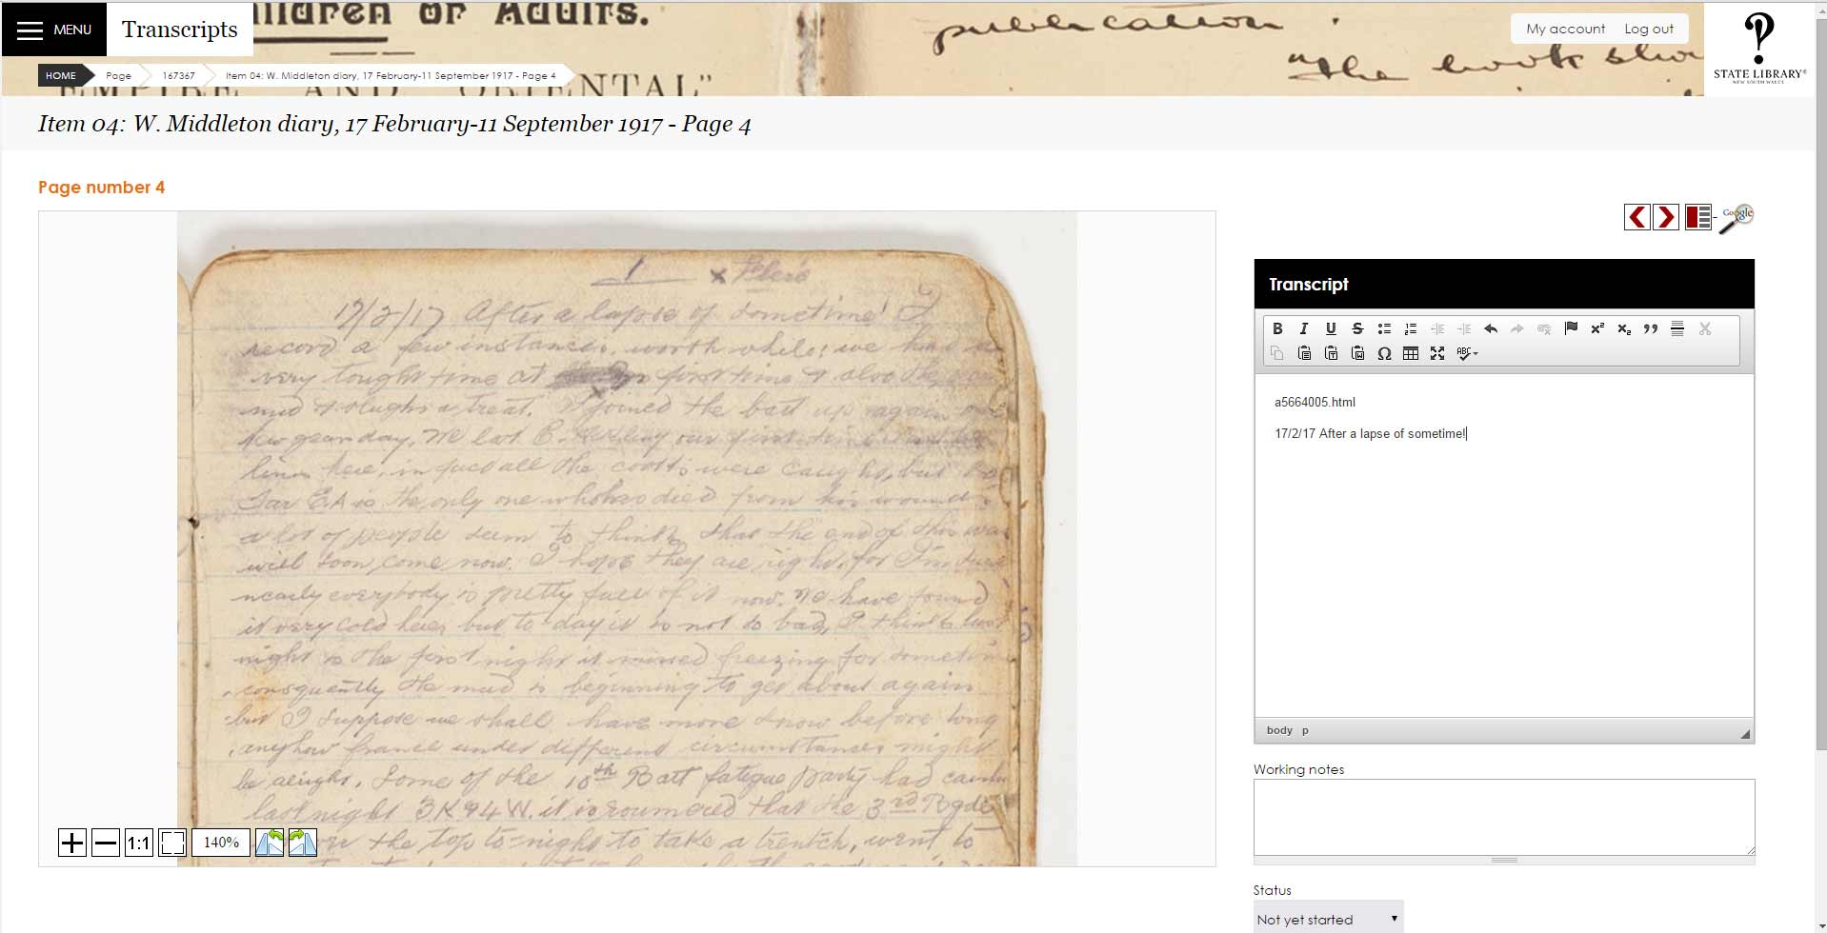

Slide 8
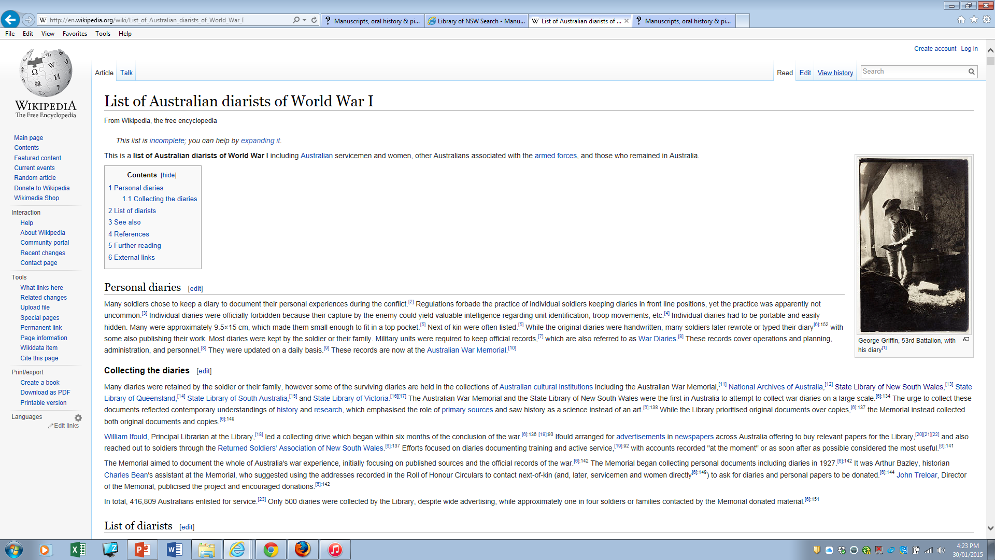
Notes:
Pages:
Completed: 12,295
Ready for review: 7,430
Partially transcribed: 10, 896
Not Yet Started: 15,845
Users
Total registered users: 1178
Total active users in last month: 160
Total active users in last 3 months: 436

Slide 9
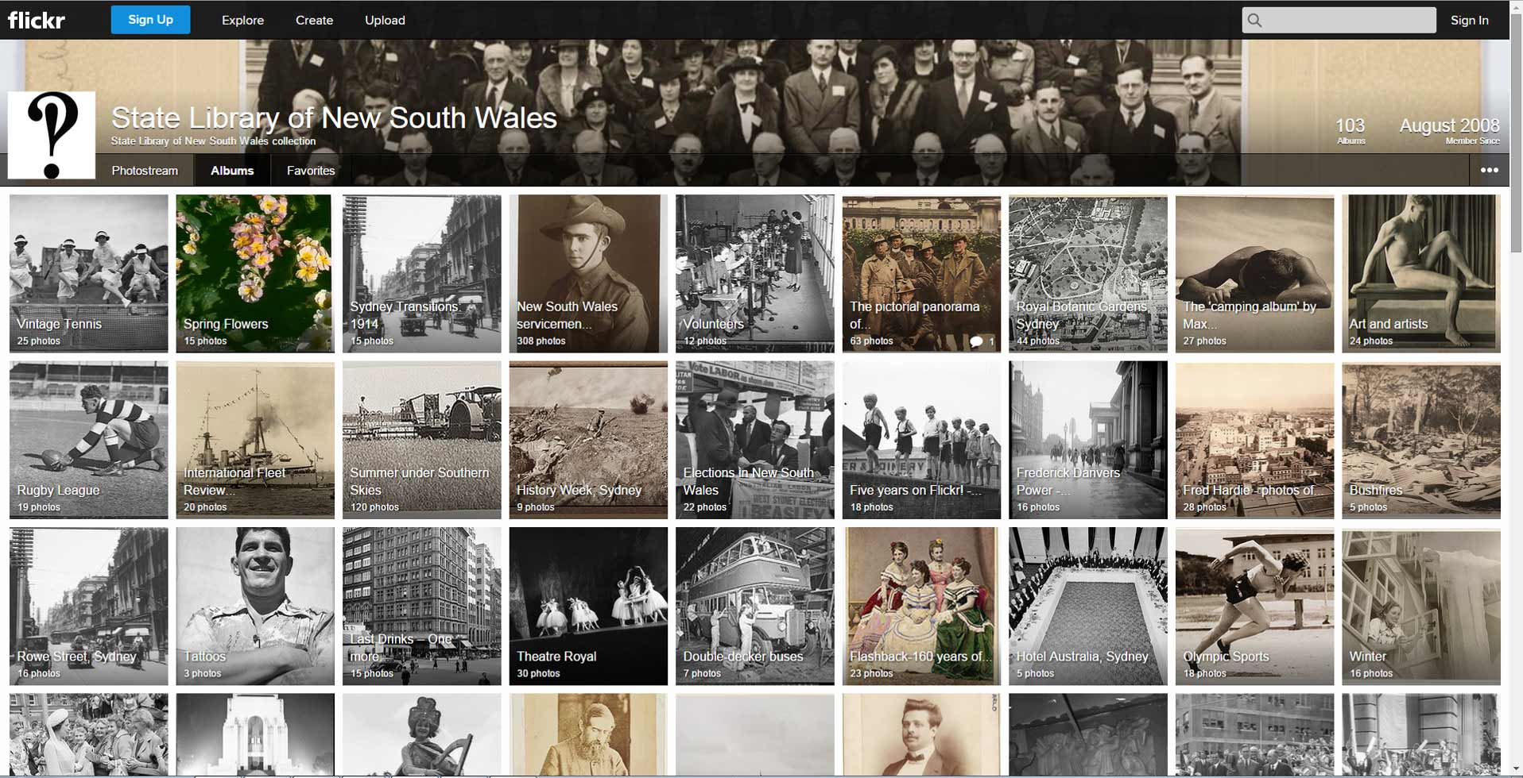
Notes:
25 million views

Slide 10
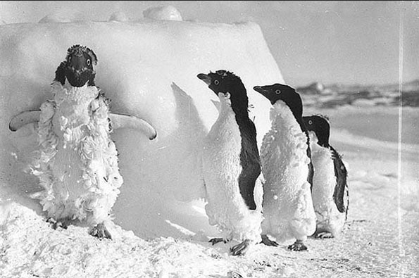
Notes:
Over half a million views

Slide 11
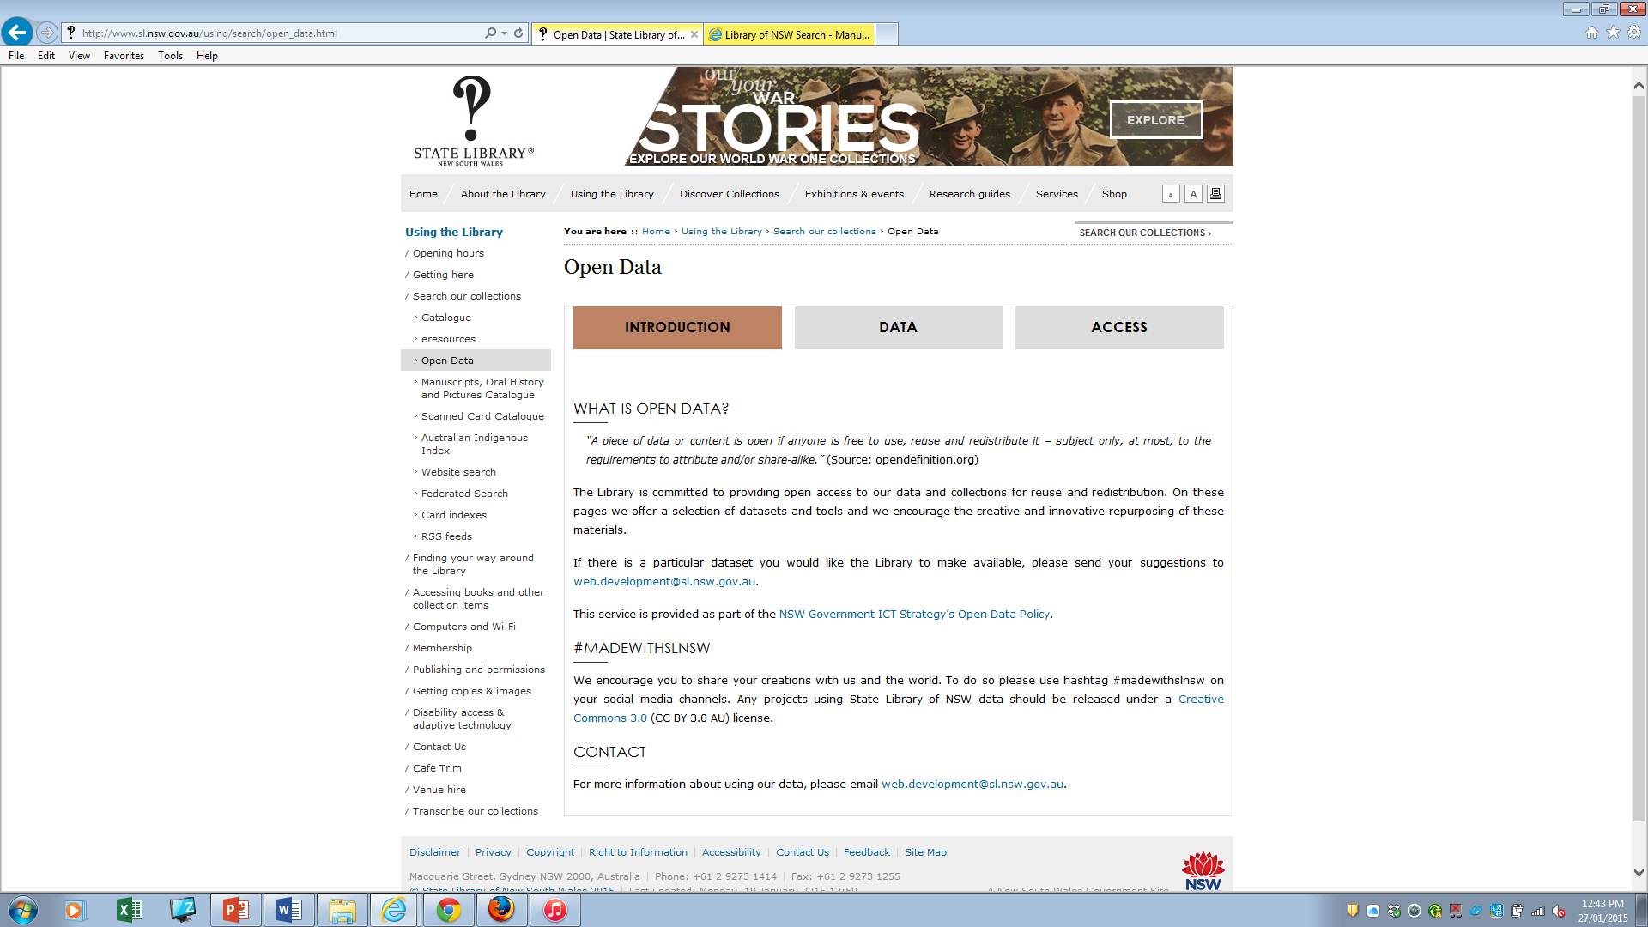

Slide 12
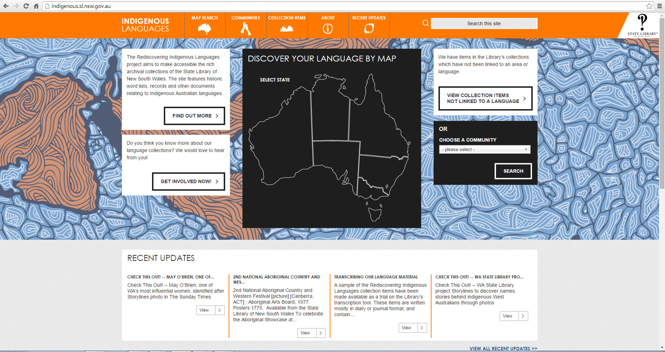
Notes:
The State Library of NSW will provide unprecedented access to vital records of 100 Indigenous Australian languages – many considered to be critically endangered – with the launch TODAY [Monday 24 November] of the Rediscovering Indigenous Languages website, supported by Rio Tinto Australia.
According to NSW State Librarian & Chief Executive Alex Byrne: “Three years ago, with strong support from Rio Tinto Australia, we embarked on a landmark project to revitalise, rescue and preserve Indigenous languages from the State Library’s archival records.
“Our prime purpose was to find and return this deeply critical information to the communities to whom it belongs, and in the most culturally appropriate ways,” said Dr Byrne.
Internationally renowned linguist Dr Michael Walsh took on the mammoth task of sifting through the Library’s 14kms of letters and journals authored by colonial surveyors, officers and missionaries. He discovered valuable details on 100 Indigenous Australian languages – including word lists and vocabularies – that were thought to be lost.
Over 250 Aboriginal and Torres Strait Islander languages were spoken prior to Australian settlement in 1788, but now only 20 are spoken comprehensively.
The website <indigenous.sl.nsw.gov.au> will provide communities with access to digitised copies of these rediscovered word lists and vocabularies.
“Many people will experience their languages for the very first time through our new website so we’re working closely with communities to consult on the most appropriate ways to provide access to the records,” says Kirsten Thorpe, manager of the State Library’s Indigenous Services Branch.

Slide 13
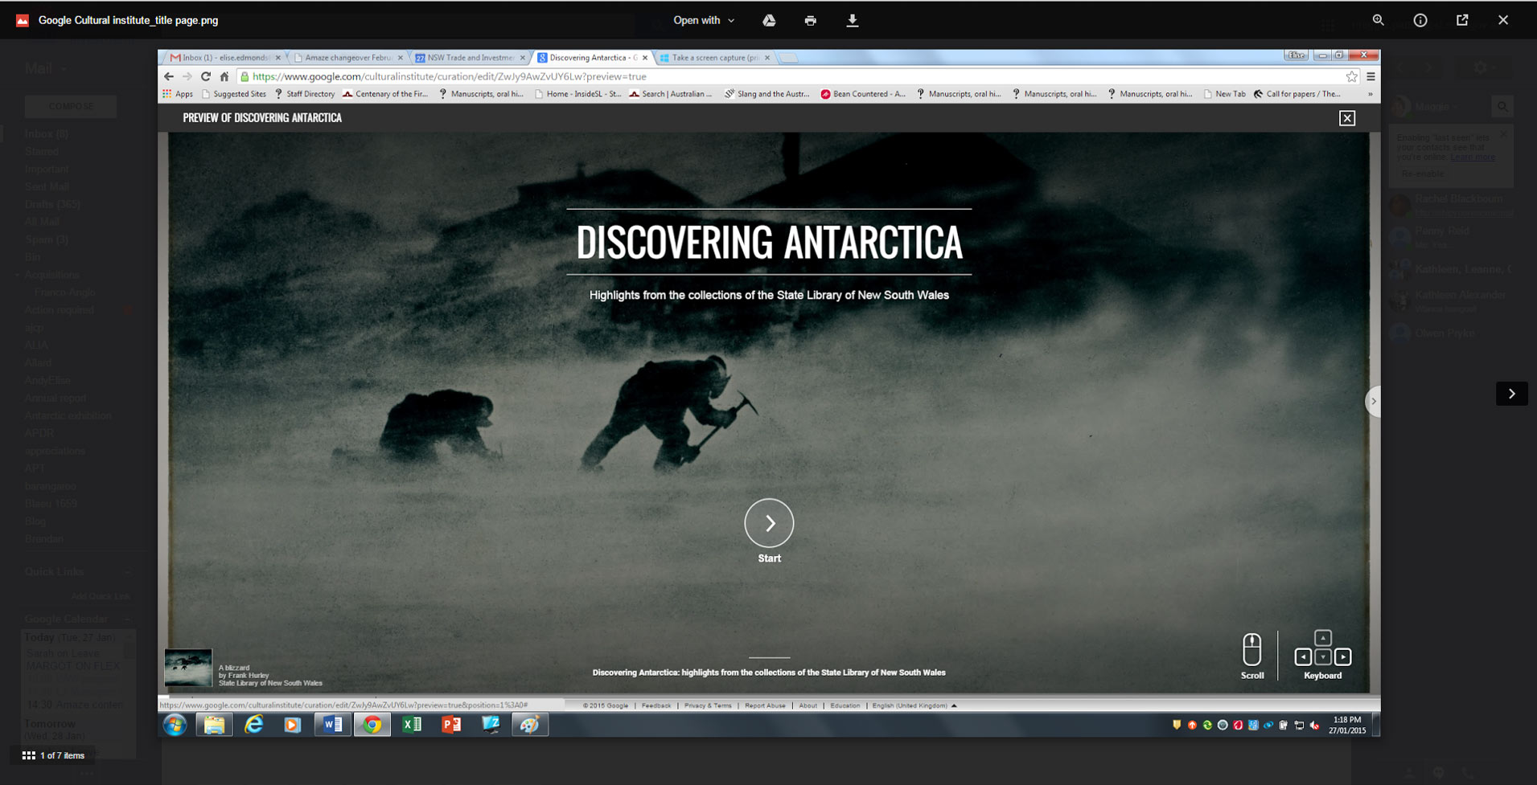

Slide 14
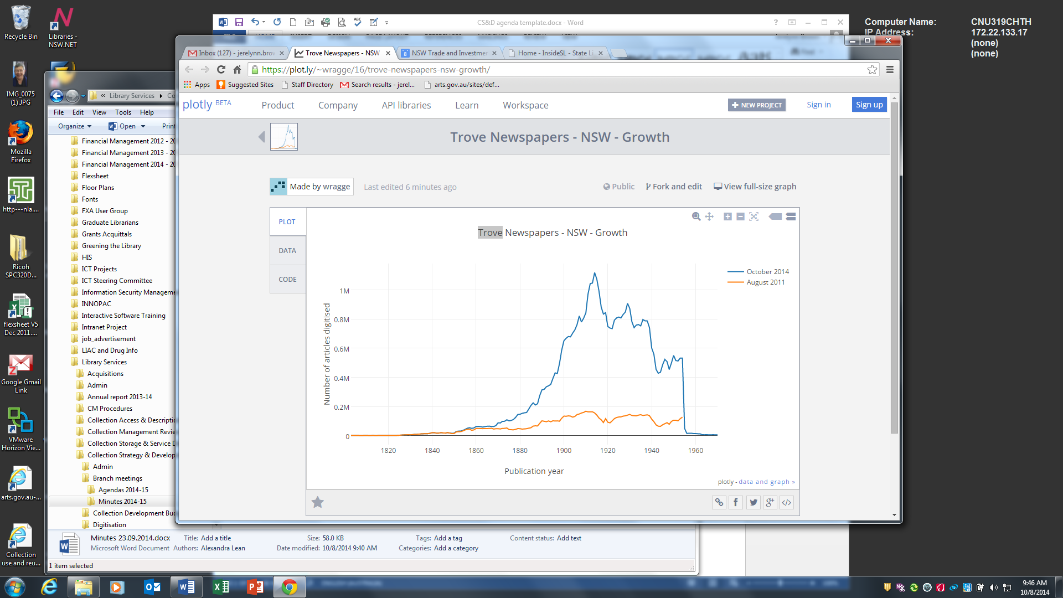
Digitisation of NSW newspapers

Slide 15
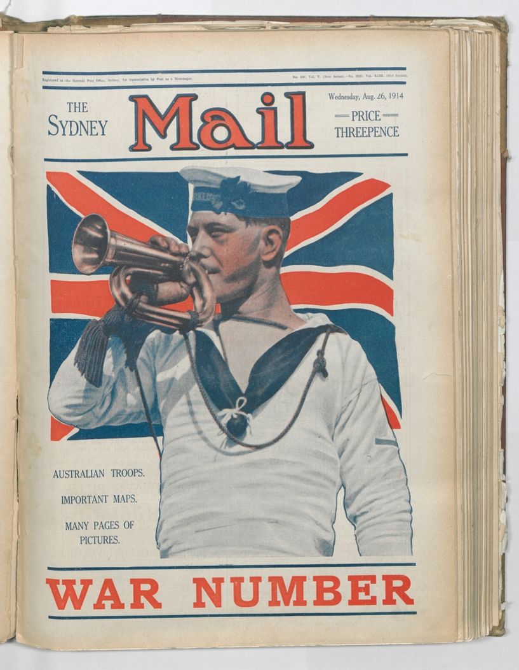
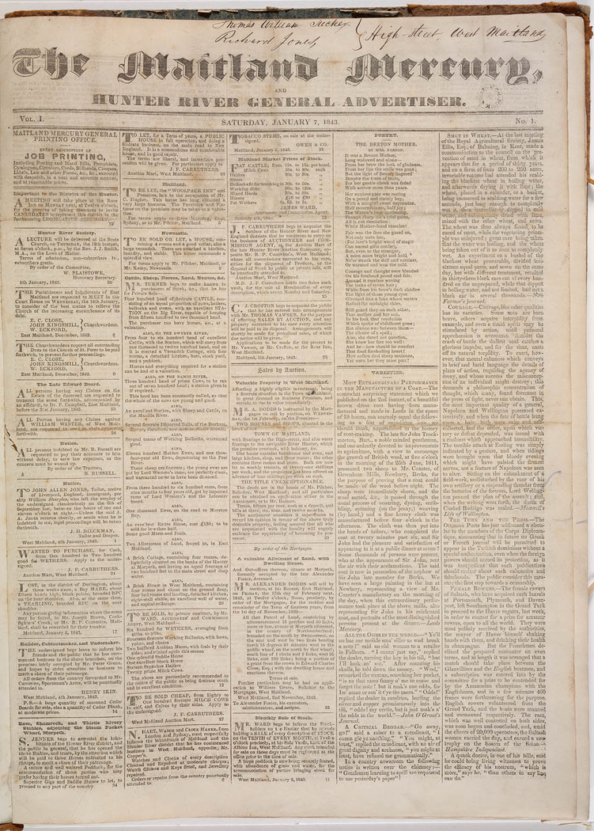

Slide 16
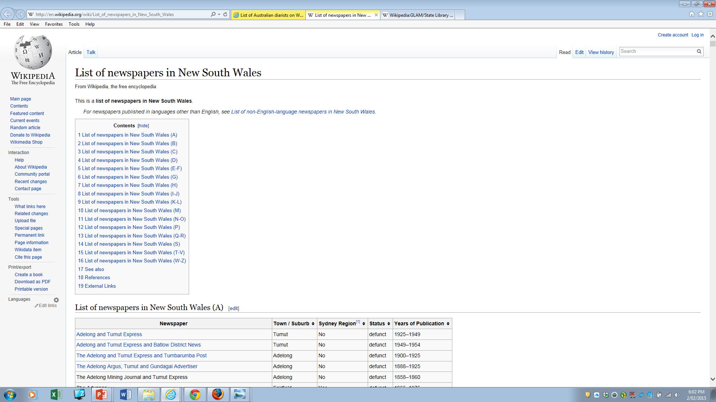

Slide 17
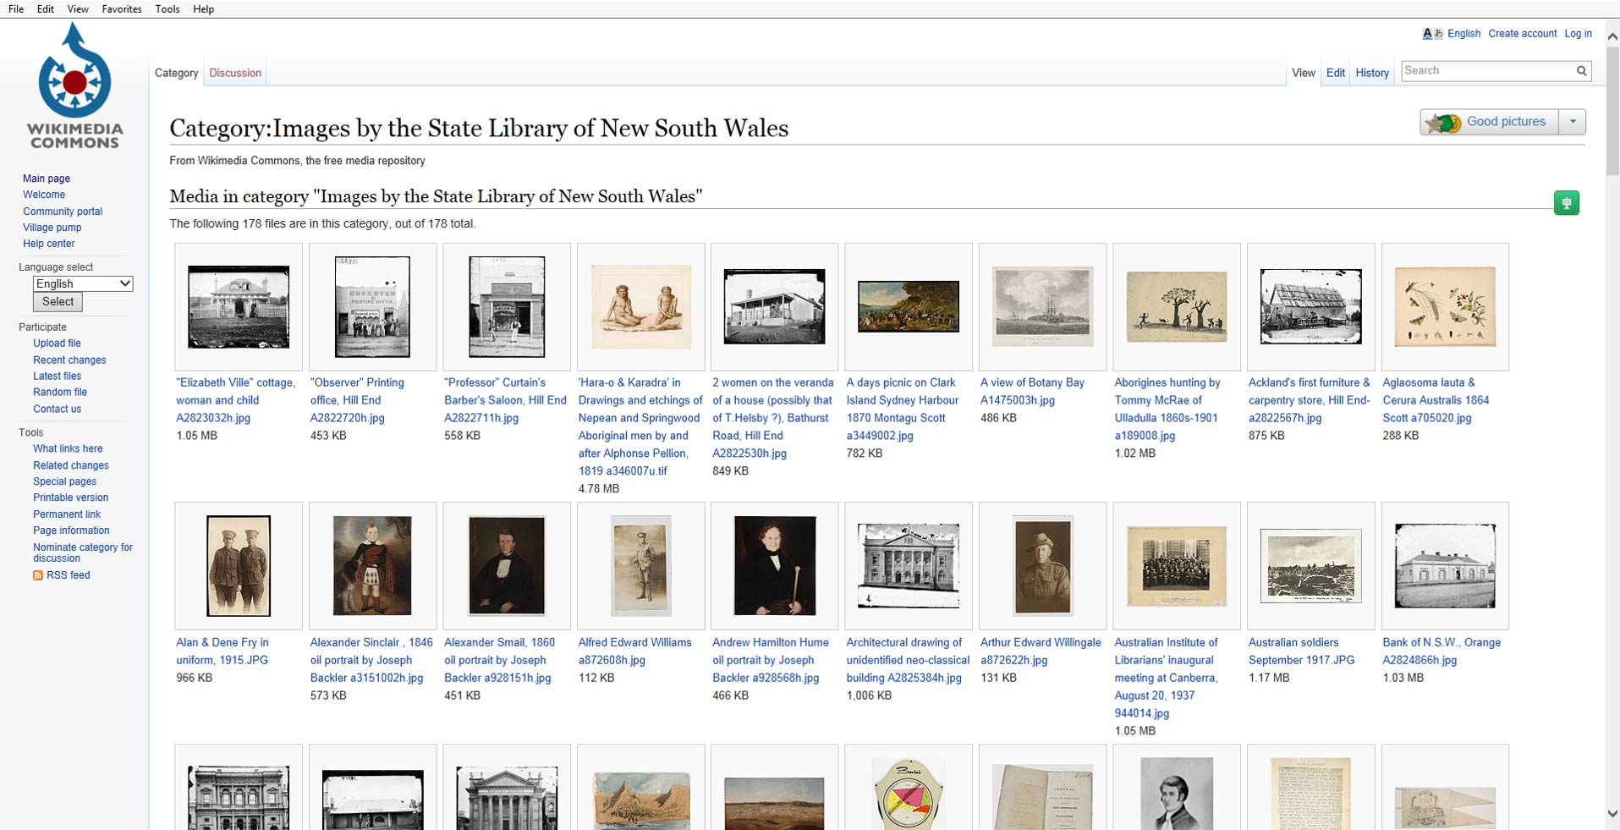

Slide 18
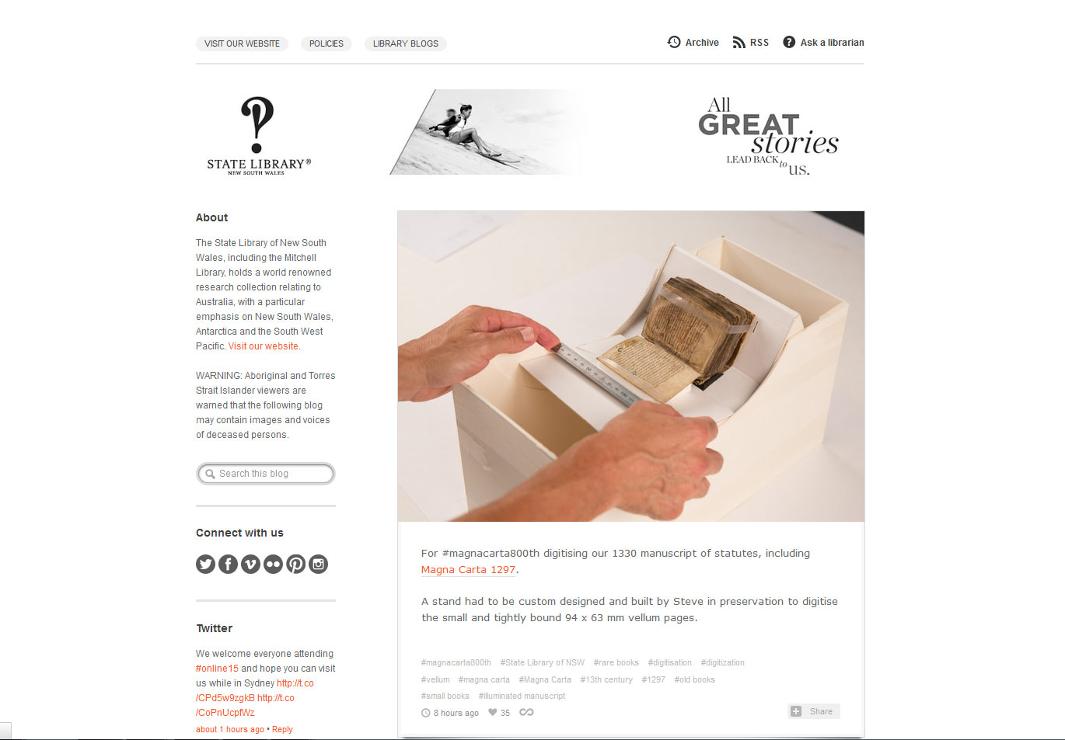
Notes:
Tumblr, Instagram, Pinterest , Facebook, Historypin

Slide 19
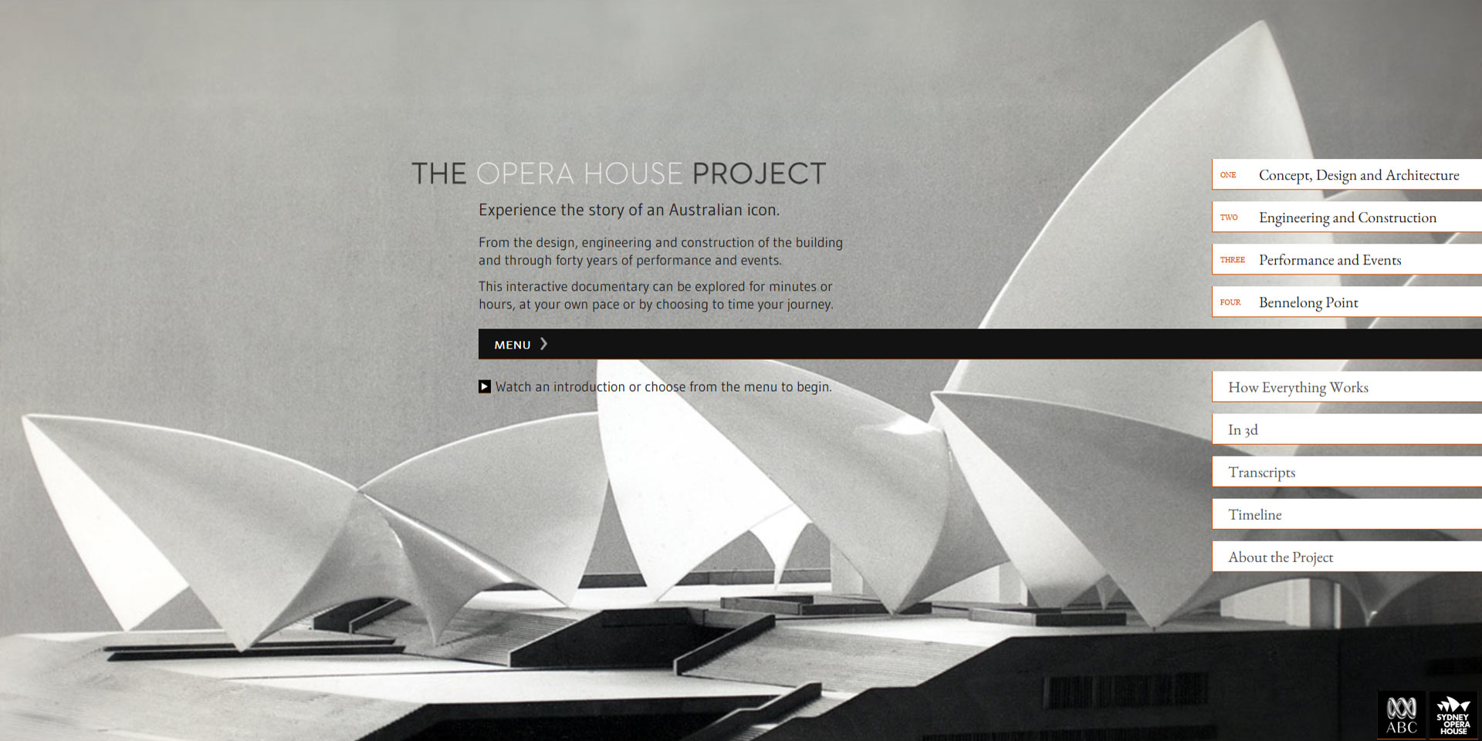

Slide 20
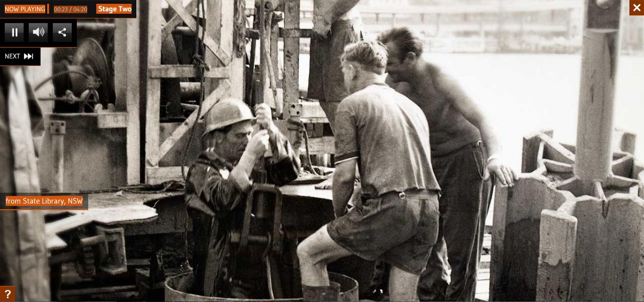

Slide 21
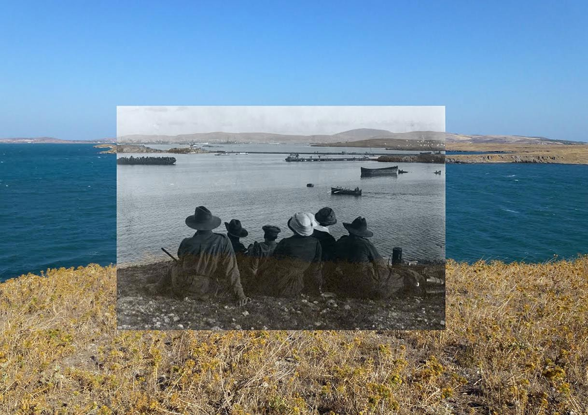
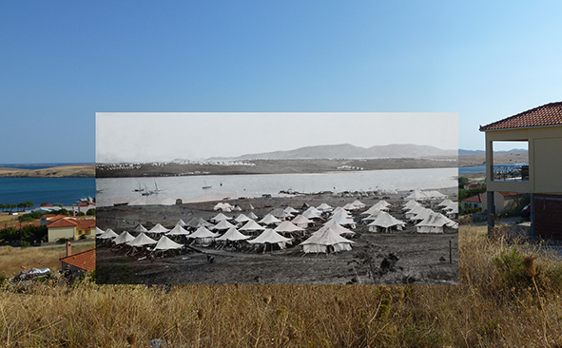
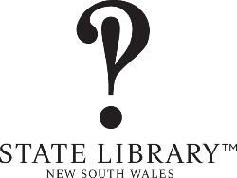
Notes:
Photographs of the Third Australian General Hospital at Lemnos, Egypt & Brighton (Eng.) / taken by A. W. Savage
400 silver gelatin photoprints
Albert William Savage, a photographer of Moore Park, Sydney, was born in Kent, England. He enlisted in Sydney aged 25 and was marked unfit for active service due to eyesight, then marked fit as a special case. He embarked for Lemnos on board RMS Mooltan, 15 May 1915 and was posted as a private to No.3 Australian General Hospital, then transferred to the Australian Flying Corps in Abbeville, Apr. 1917 where he worked as a stores clerk. He was granted leave for photography, attending Hawksworth Wheeler & Co., Folkestone, June- Oct. 1919. He returned to Australia on the Pakeha, 24 Nov. 1919

Slide 22
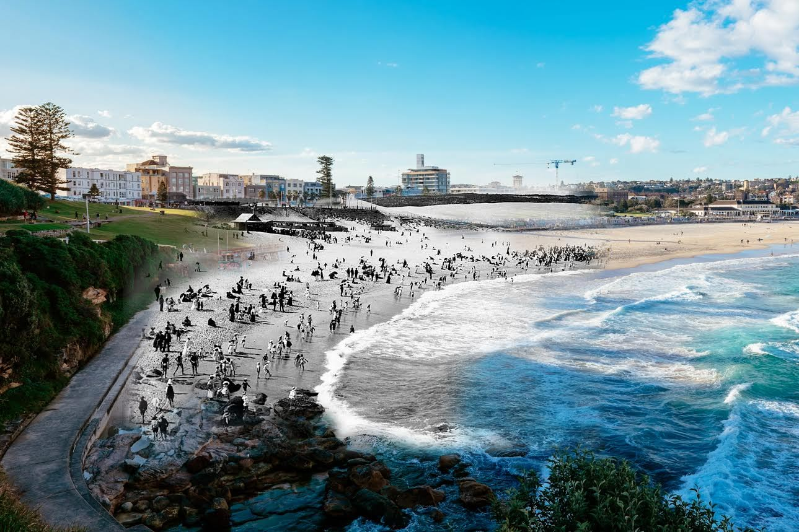
Notes:
On display until 22 February 2015
Sydney Transitions: 1914 / 2014 explores changes in our society by focussing on physical landmarks that have remained the same over the century as all around them the community continues to evolve.
Sixteen digital montages combine century-old images sourced from the collections of the State Library of NSW with photographs of the same location today taken by 702 ABC Sydney’s John Donegan.
Image: View of Pitt Street looking south from Rowe Street (with tram crossing King Street), photo montage by John Donegan

Slide 23
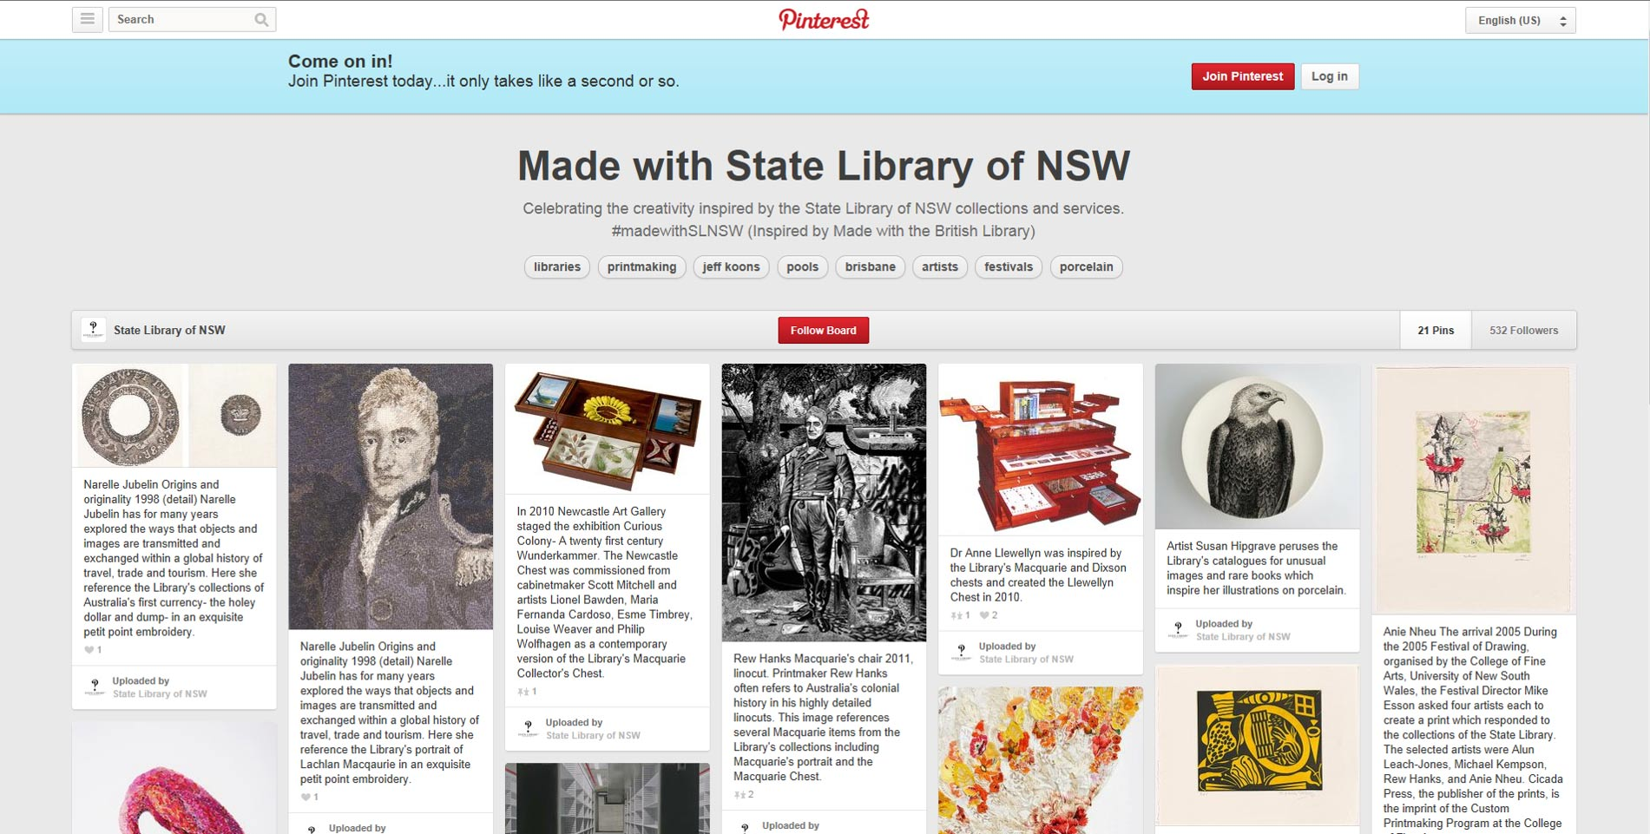

Slide 24
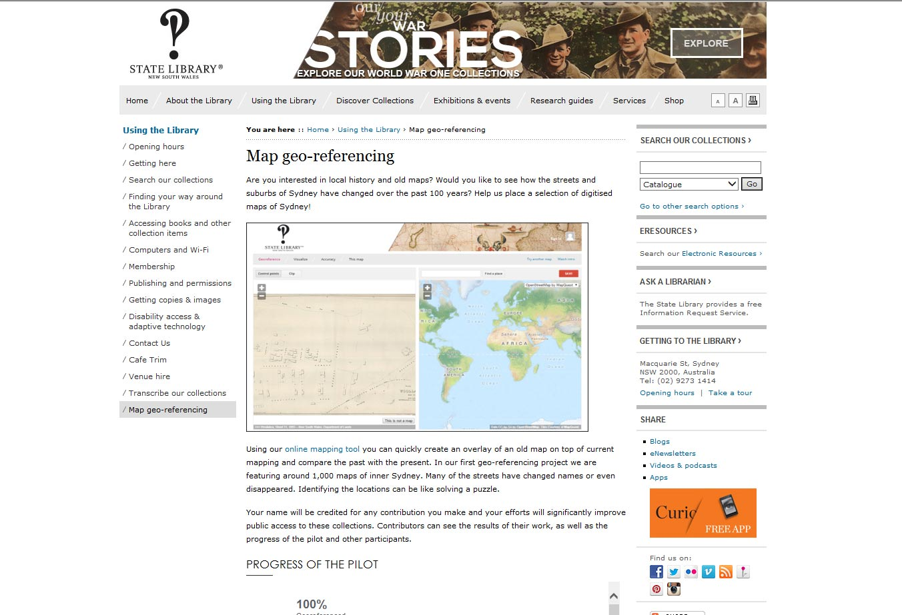

Slide 25
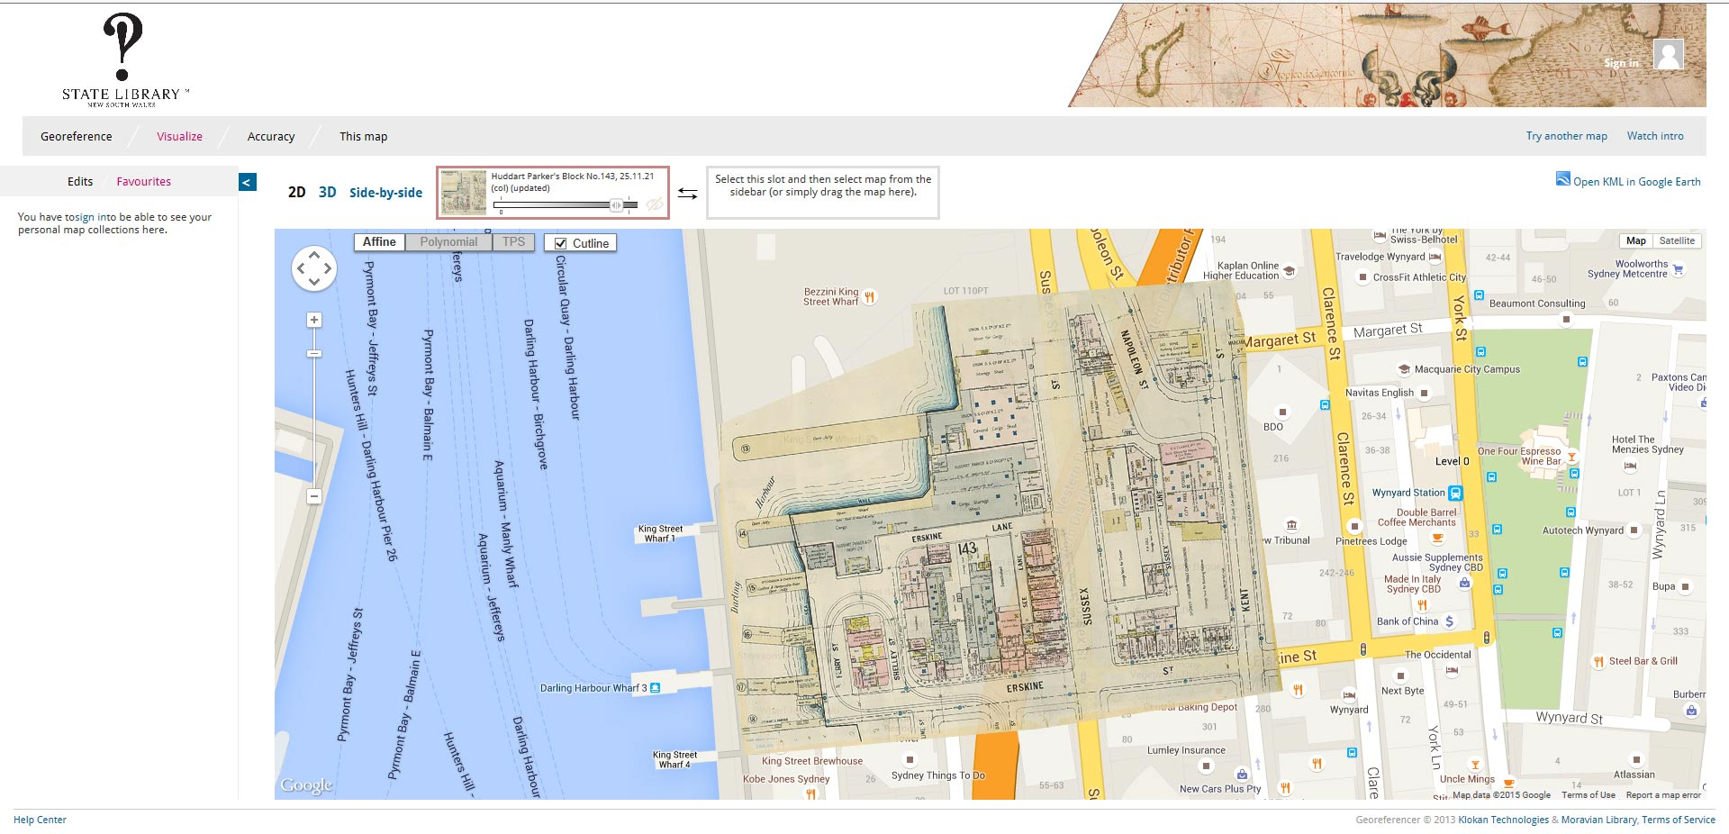
Notes:
908 maps

Slide 26
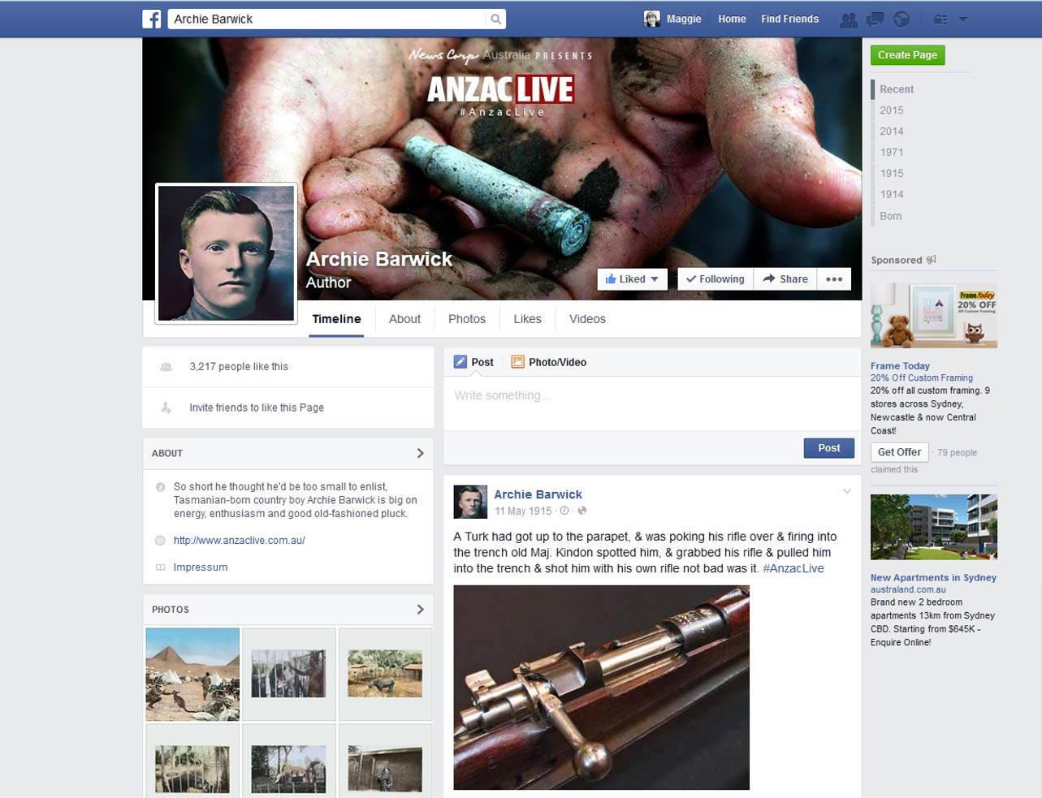

Slide 27
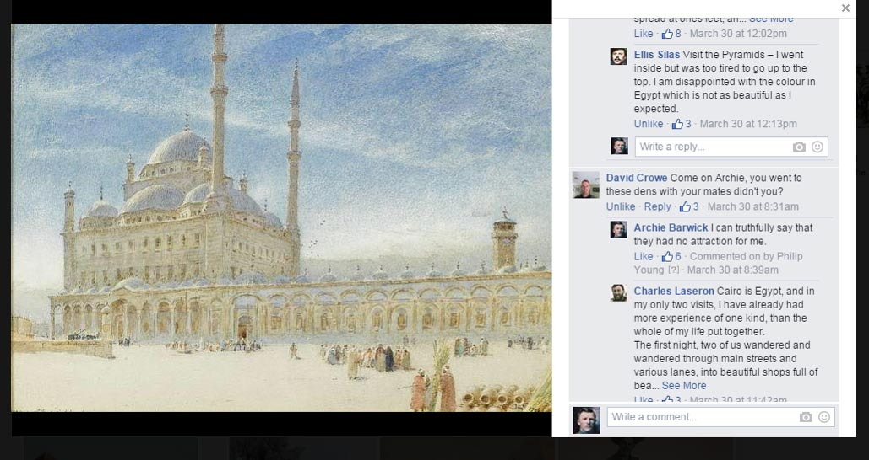

Slide 28
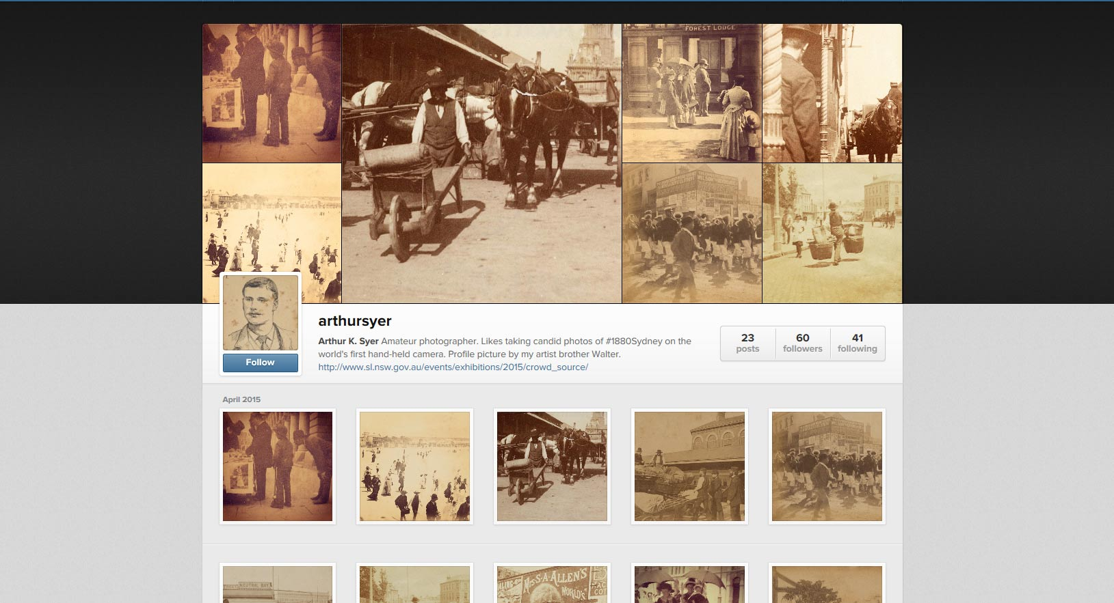

Slide 29
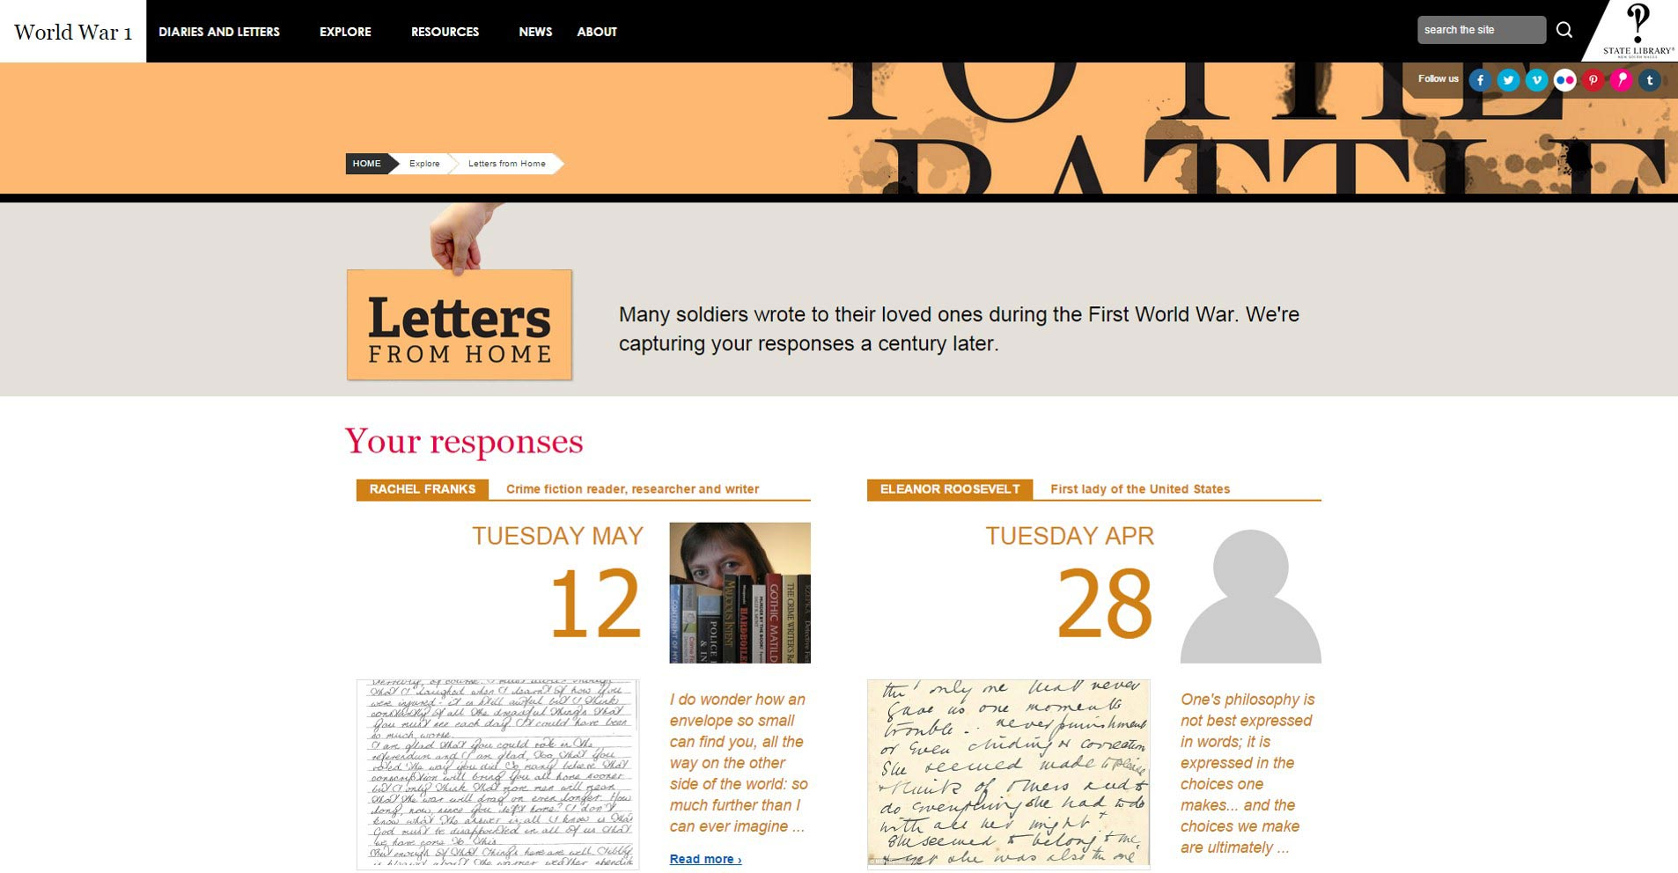

Slide 30
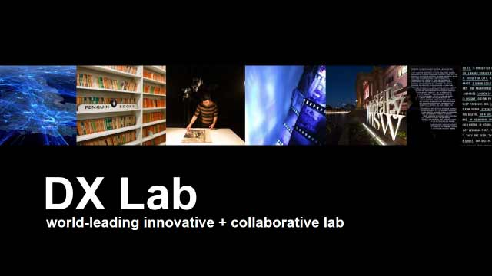
Notes:
First Lab in a GLAM institution
Launch at Remix
Partner broadly: digital organisations, GLAM sector
Students & researchers, creators, sponsors + audiences
Audience first -do it because it matters not because it’s shiny
Design creatively with data and partners
Don’t over bake -audiences need to connect through simple + meaningful experiences
Innovate-be sure to push the boundaries
Iterate-if something is already built, just improve on it.
Digital experiences-not isolated projects
Be open -share, co-curate and promote re-use where possible
Meet the Data Owners event - event with Code For Australia http://www.codeforaustralia.org
Google Streetview camera operators next week, tentatively booked in for early morning 7am on Thursday and Friday
Remix launch – visualisations with Grumpy Sailors

Slide 31
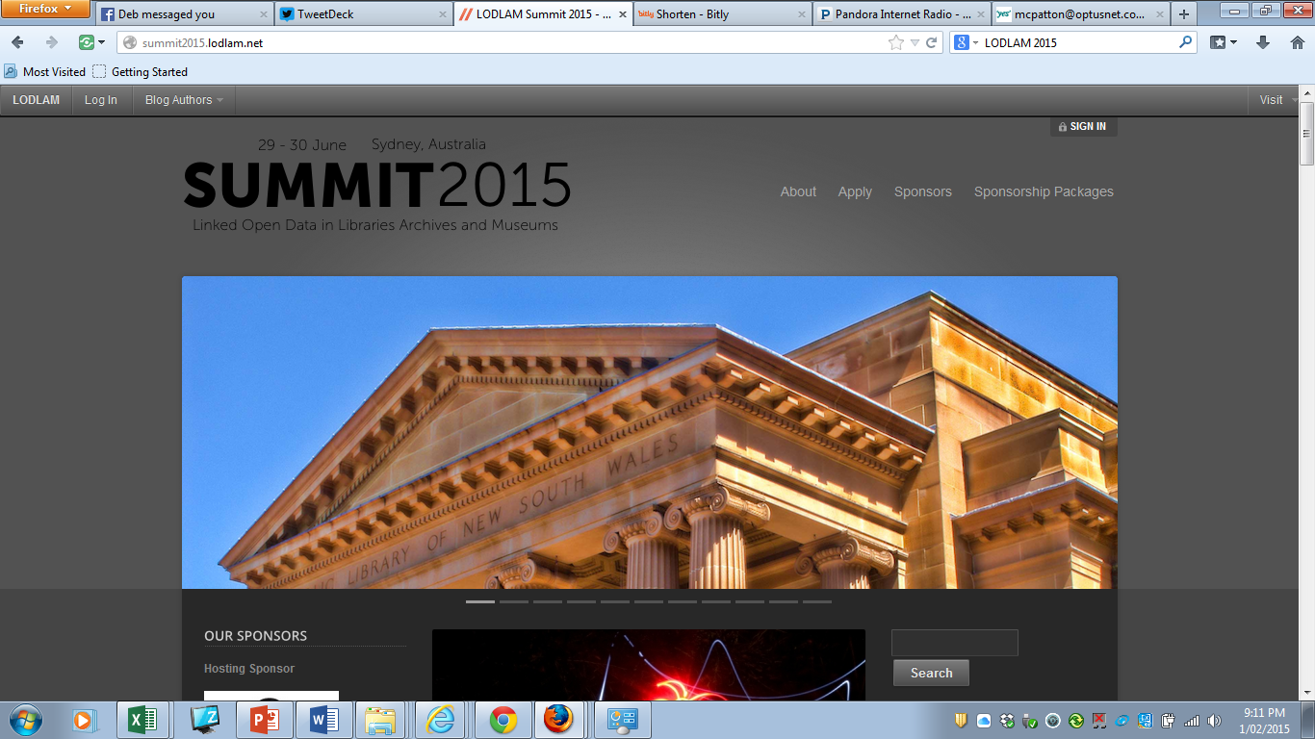
Notes:
LODLAM 2015 in Sydney, Australia
The third international Linked Open Data in Libraries, Archives and Museums (LODLAM) summit will be held in Sydney, Australia, at the State Library of New South Wales on 29-30 June, 2015. Thought leaders from around the world working in digital cultural heritage, eScience or eResearch, and the digital humanities come together at the Summit to debate, share their case studies, experience, thinking, hack skills, and data management methods.
The LODLAM Summit is being timed to run in collaboration with the annual international Digital Humanities 2015 conference, also being held in Sydney: 29 June – 3 July, 2015. Collaboration and coordination between the organizing groups boosts options for attendance, exposure and promotion.
The Summit will be limited to about 100 participants, and limited travel grants will be available this year. Our sponsors help to cover the costs of the Summit including attendee meals and support of the LODLAM Challenge awards. We have severalsponsorship opportunities available and are actively seeking partners to help support the international collaboration that has grown over the past four years and gained momentum.

Slide 32
Any questions? maggie.patton@sl.nsw.gov.au
Notes:
Acknowledgement that this is a team effort from staff across the Library from the reading rooms to the imaging studios, involving librarians, curators, photographers, conservators and media staff

