Slide 1
Digital Scholarship
Joanne Evans
Monash University

Slide 2
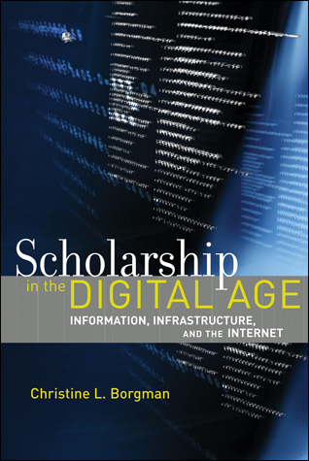
Digital Scholarship
“Scholars in all fields are taking advantage of the wealth of online information, tools and services to ask new questions, create new kinds of scholarly products, and reach new audiences. The Internet lies at the core of an advanced scholarly information infrastructure to facilitate distributed, data- and information-intensive collaborative research.”

Slide 3
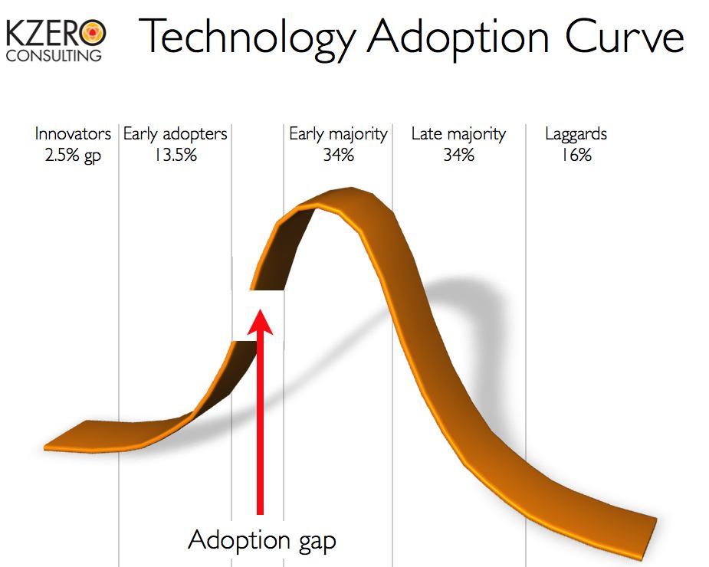
Digital and Networked Scholarship
“Scholarship in the sciences, social sciences and humanities is evolving, but at different rates and different ways. ”
Notes:
Social sciences and humanities researchers also researchers and builders of the new information infrastructures

Slide 4
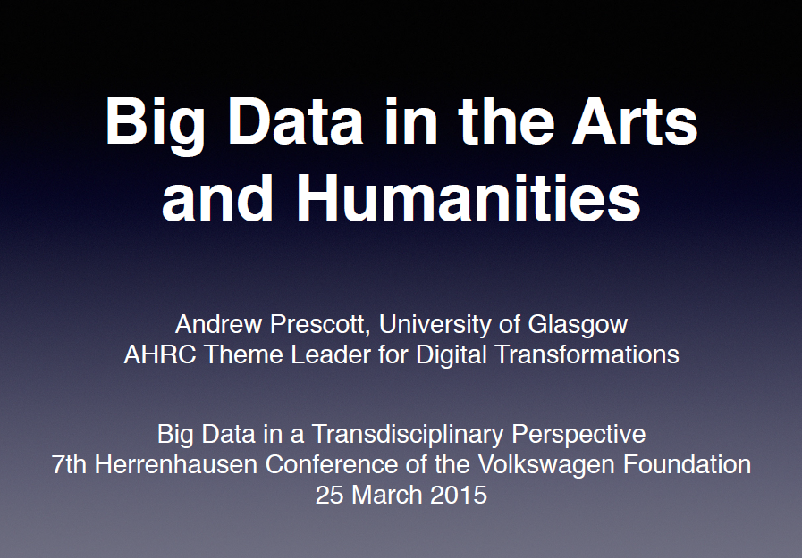
http://www.slideshare.net/burgess1822/prescottherrenhausen

Slide 5
Networks of Data, Information and People
“Scholarly data and documents are of most value when they are interconnected rather than independent.”
“The networking of distributed data and documents requires the interoperability of systems and services, which in turn requires standards. … facilitating open access to information, ease of use, and adaptation to local practices is among the grander challenges of constructing an information infrastructure.”
Notes:
The outcomes of a research project could be understood most fully if it were possible to trace an important finding from a grant proposal, to data collection, to a data set, to its publication, to its subsequent review and comment …
[these capabilities] depend more on the consistency of data descriptions, access arrangements, and intellectual property agreements than on technological advance”

Slide 6
Digital and Networked Scholarship
“These developments exist within a rapidly evolving social and policy environment, as relationships shift among scholars, publishers, librarians, universities, funding agencies, businesses and other stakeholders.”

Slide 7
Digital and networked scholarly information infrastructure
“While the new technologies receive the most attention, it is the underlying social and policy changes that are the most profound and that will have the most lasting effects on the future scholarly environment.”

Slide 8
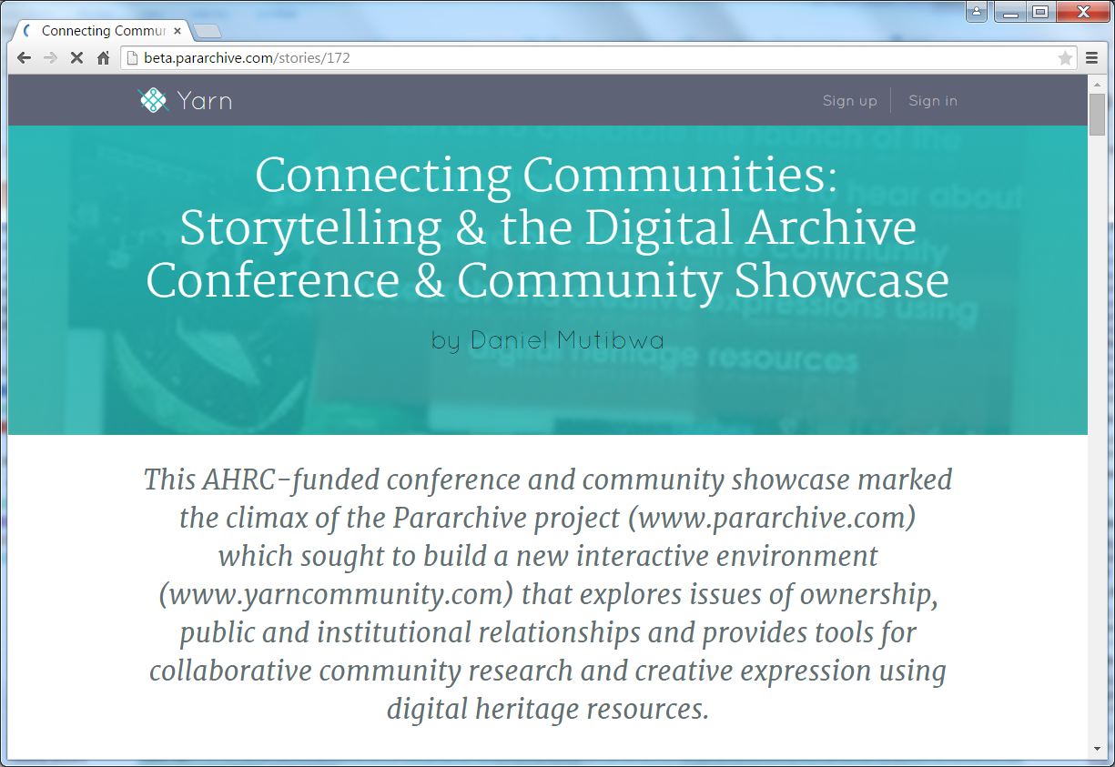

Slide 9
