Slide 1
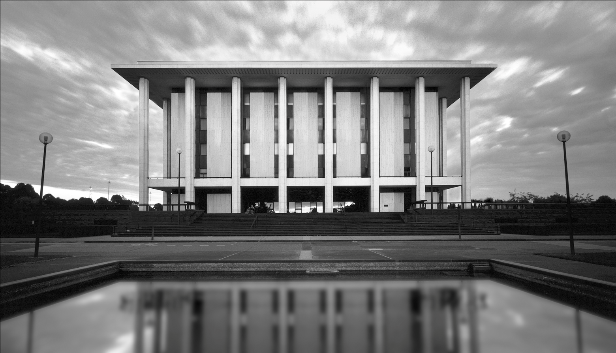
DIGITAL FORENSICS
Forensic Toolkit: a tool to process born digital records
Emma Jolley
Curator of Digital Archives
Notes:
Background – not an technical person – but archivist for a long time – used to managing all formats in an archival collection.
Team requires people from multiple disciplines – archivist, IT, Digital Collecting Support etc.
Functionality of FTK, functions that it represents in the Collection Management Workflow and then briefly some of the challenges and lessons that we’ve learnt from working with born digital material.
Note FTK is not a preservation tool but a tool for Collection management (A&D, Appraisal etc).

Slide 2
Why Digital Forensics?
The process of identifying, preserving, analysing and presenting digital evidence in a manner that is legally acceptable.
Provenance
Original Order
Chain of Custody
Identifying
Authenticity
Notes:
In reading and analysis I was doing – Digital Forensics kept coming up. The same names kept appearing – Bodleian Library at Oxford, Harvard, British Library, Standard University, Yale University, New York University and the Library of Congress. So applied for Friends Fellowship and went to the UK where I visited Oxford, British Library, Wellcome Trust. While at Oxford introduced to the Forensic Toolkit and while at Wellcome Trust and the National Archives was introduced to the Safety Deposit box digital preservation system which later become “Preservica” which NLA is currently implementing.
What is digital forensics – The definition looked really familiar to archival theory and these terms kept coming up. Read further, approach was exactly that taken by archivists to manage collections.
And they have really cool tools and lots of them.
Originally created for law enforcement, corporate security and IT professionals who needed to access, manage and evaluate evidential value of files, folder & computers and maintain their authenticity. These functions are also required for the management of archival collections.
I also needed something to help in the discussion – needed something to show and tell and to help with the ‘communication’ across different professions (the “see” argument) – FTK allowed me to “show’ people what we wanted” and also to have a system to work out workflows.

Slide 3
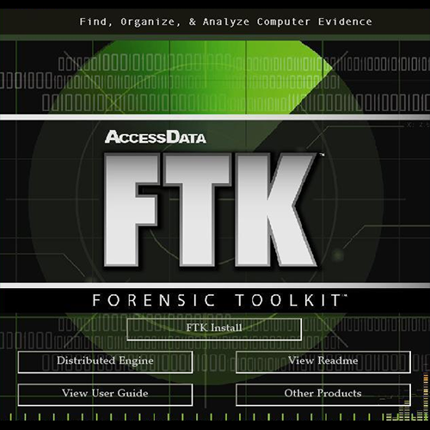
Forensic Toolkit
Notes:
Forensic Workflows and FTK relies on using a disk image to serve as a baseline copy of the Data from the Disk. Upon which further extraction & creation of metadata & analysis can be performed without making any changes to the records themselves.
Also using additional tools to harvest such as Write Blockers, Creating disk images is essential to ensuring Provenance, original order & chain of custody.

Slide 4
Case Summary
Notes:
FTK refers to disk images as “Evidence” and to Collections as Cases. Setting up the case allows you to identify the collection, Accession or control numbers and provide any wider context relevant to the case.
This ‘Case’ functionality allows aggregating multiple digital objects, which may reside in different disk images or folders but which belong to the same collection or case.
Evidence Processing – allows you to set up the processing schedule which allows you among other things to say which Checksums (MD5, SHA-1, SHA-256) and how many you want to use, create thumbnails for graphics, identify duplicate items, whether you want to identify Explicit Images or include Deleted files.

Slide 5
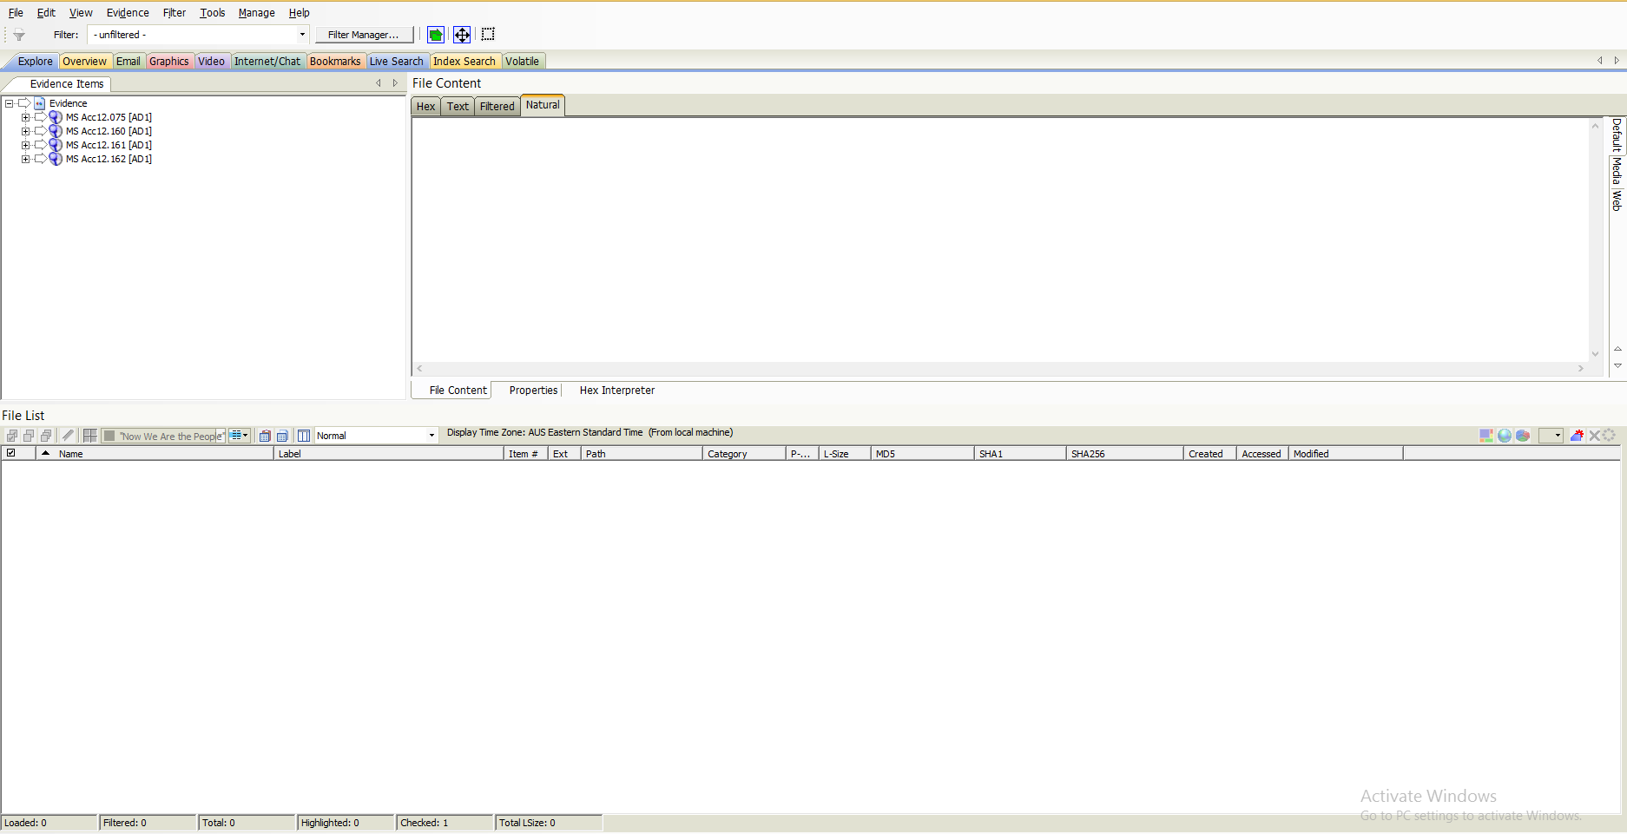
Overview of FTK Screen
Notes:
The main feature of the FTK interface is the location, organisation and exportation of data. The interface contains tabs, each with a specific focus which we’ll go through. Each of the coloured tabs ( 3 rows down) will display the data in different structures and ways:
Explorer – Lists the Evidence/ Records in a directory structure, similar to the windows explorer. Evidence can be viewed in physical or logical drives.
Overview – the 2nd tab – narrows your search to look through specific documents types or to look for items by the status or file extension.
Email – This tab is used to view emails, mailboxes and attachments
Graphics – to view graphics in the collection using Thumbnails
Video – Used to watch video contents and the detailed information about them.
Internet / Chat – to view detailed information about the internet / chat data in the collection (browser history etc)
Bookmarks – Generates a group of files to be referenced in a group (ie a Series). Additional information such as Series descriptions, quantity, etc can also be added here. Can be exported as a Report with Series Title, description etc
Live Search – used to search information across the collection using keywords.
Index Search – As all data is previously indexed in the ‘processing’ or ingest phase, this search is quick and effective

Slide 6
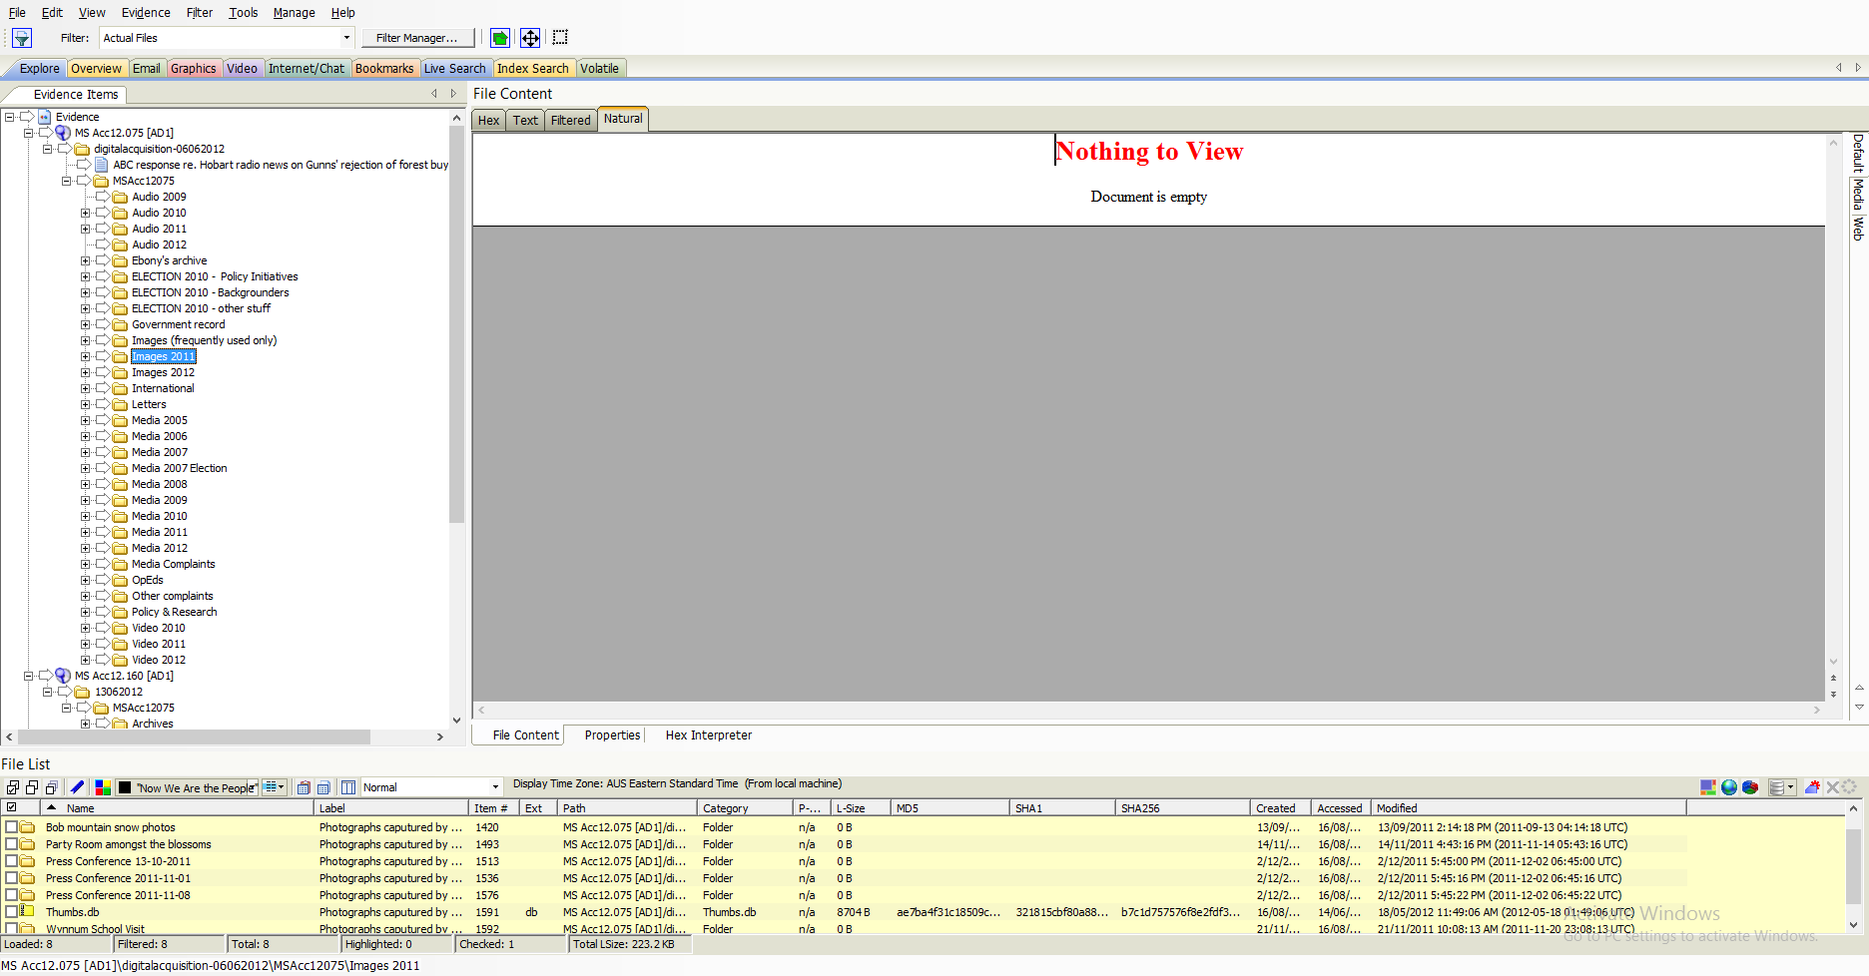
Explore View
Notes:
Explore tab displays all of the contents of the collection files and drives as the original user would have seen them.
Lists directory structure of each evidence item, similar to the way you would view directory structure in Windows Explorer. This is the structure created by the donor. In the bottom panel – you can see the itemised content of the folder marked “Images 2011”. You can also see the technical metadata extracted from the original digital records – Name (as applied by the donor), unique number applied by FTK, check sums, date created, date modified, date last accessed.

Slide 7
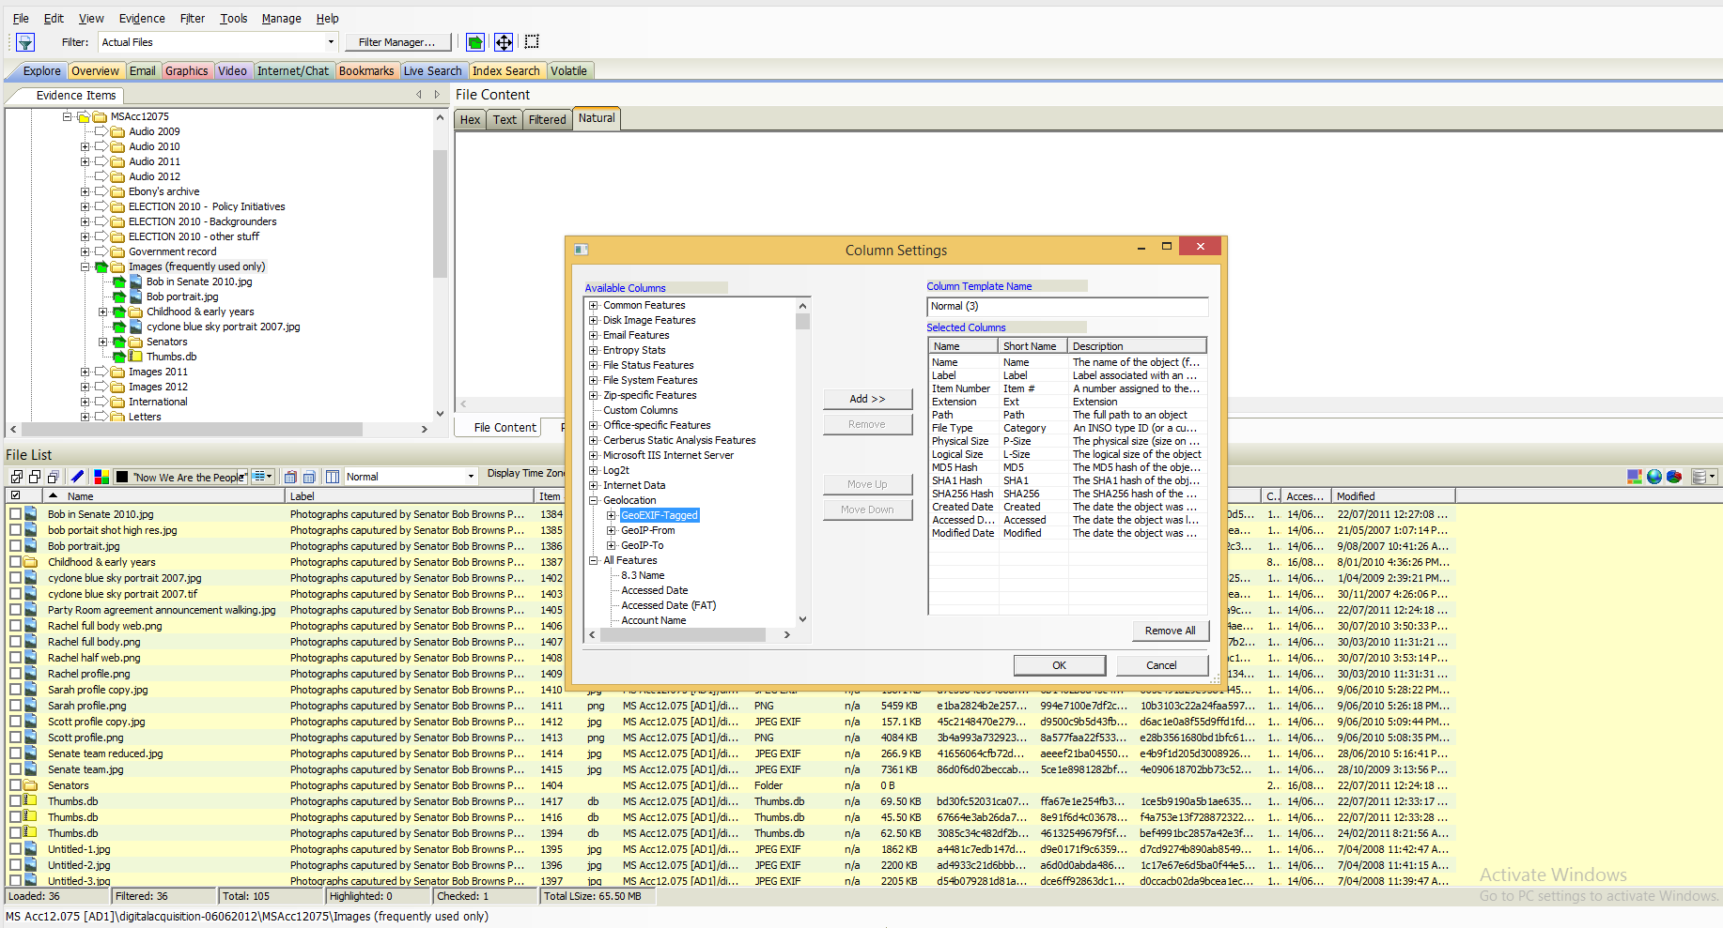
Explore View – Additional Technical Metadata
Notes:
You are able to add additional metadata to the standard view – Name (as supplied by the creator), label, item, extension, path, check sums,
You can choose which columns to display as well as the order of the view. Here I’ve chosen to add the GEO EXIFF Tag elements…
Could also add Email items, technical metadata, security, duplicate files etc.

Slide 8
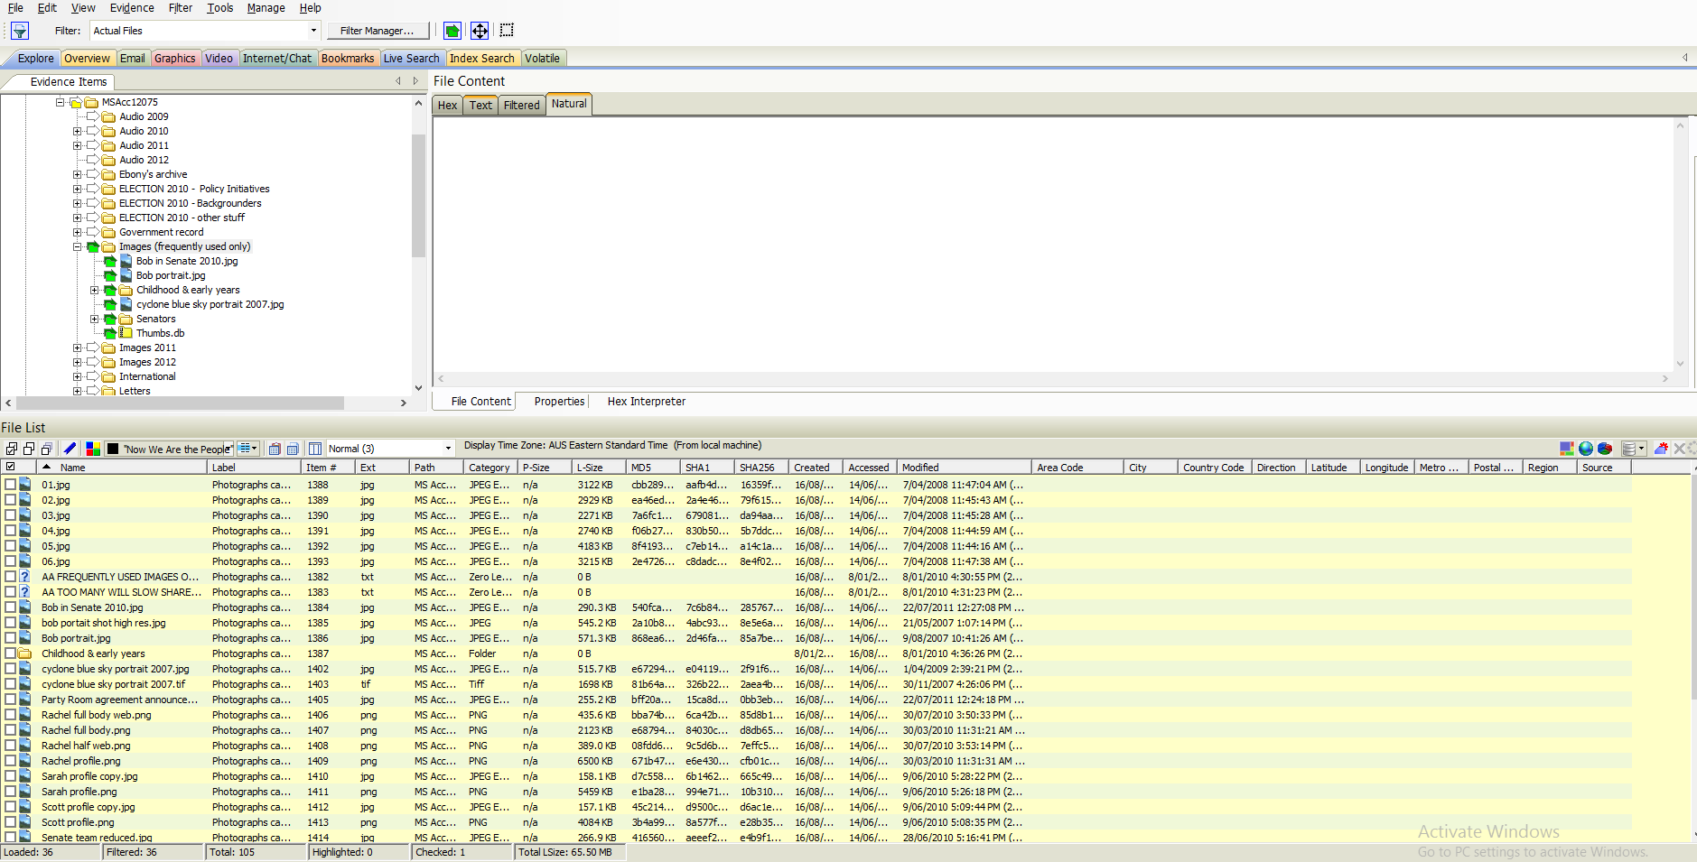
Explore View – Additional Technical Metadata (part – 2)
Notes:
You can see that the GEO tags have been added. If they had been populated by the creator (usually in photographs) the information would appear here.
Note the addition of: Area Code, City, Country, Latitude etc.

Slide 9
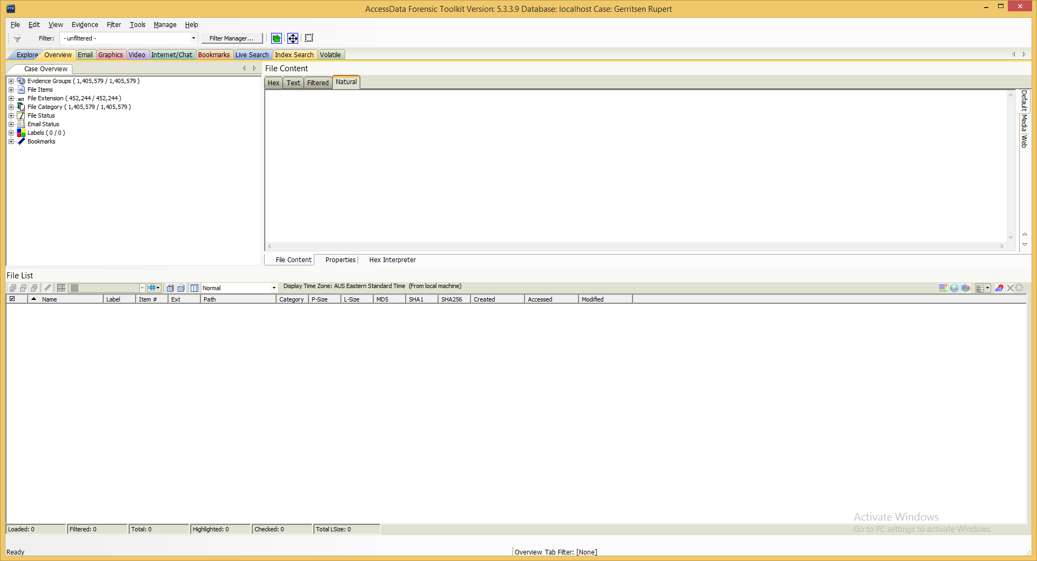
Overview View
Notes:
The Overview tab provides a general view of a case. You can find the number of items in various categories, view lists of items and lists of individual items by category, status, and extension. The categories include: Evidence Groups, File items, File Extensions, File Category (types of records – databases, documents, email, folders, graphics etc), File Status, Email Status, labels and bookmarks.

Slide 10
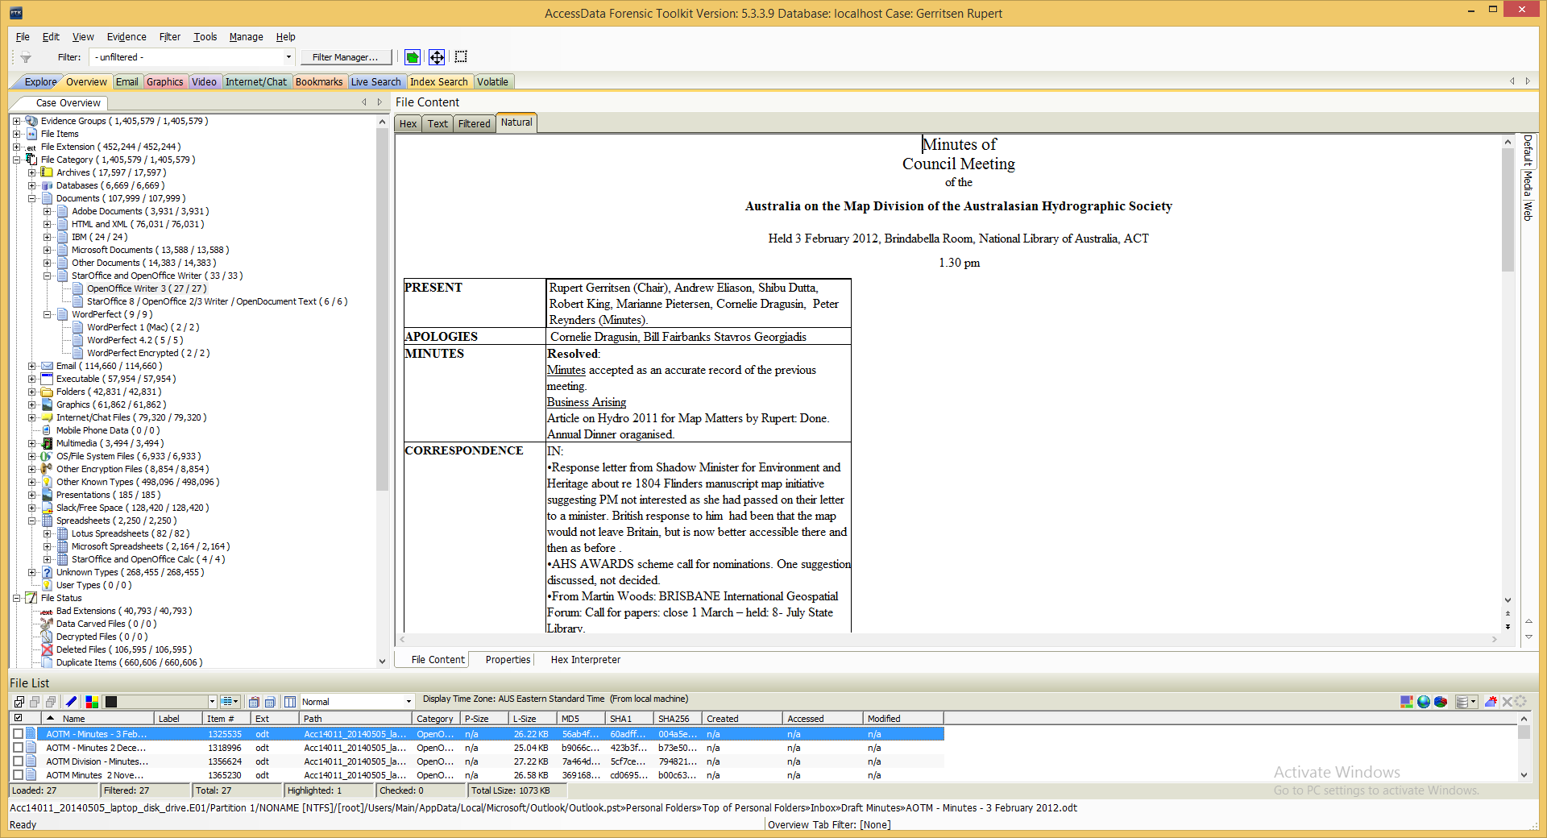
Overview View
Notes:
Overview – Old formats, file status
Number and type breakdown.
In this example I’ve expanded the File Category to look at the type of records & number included in the collection databases, documents, emails, graphics, multimedia, spreadsheets. Notice in the documents that it lists by the format it was created in – eg WordPerfect 1 (Mac), Word Perfect 4.2 etc. The Document rendered was originally created in Star Office 8.

Slide 11
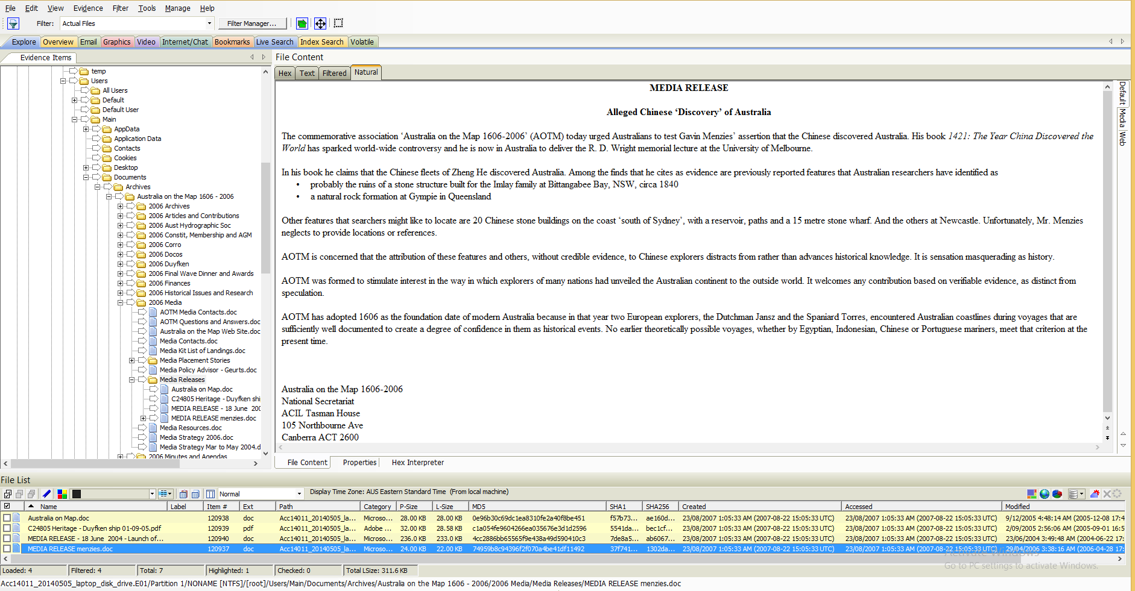
Viewing Content
Notes:
Content viewer – Displays the record or image – with a choice of different view formats – Hex, Text, Filtered, Natural, Properties (Metadata).
The natural tab – which your can see the document in now – displays a files’ content as it would appear normally. The viewer uses INSO filters for viewing hundreds of file formats without the native application having to be installed.

Slide 12
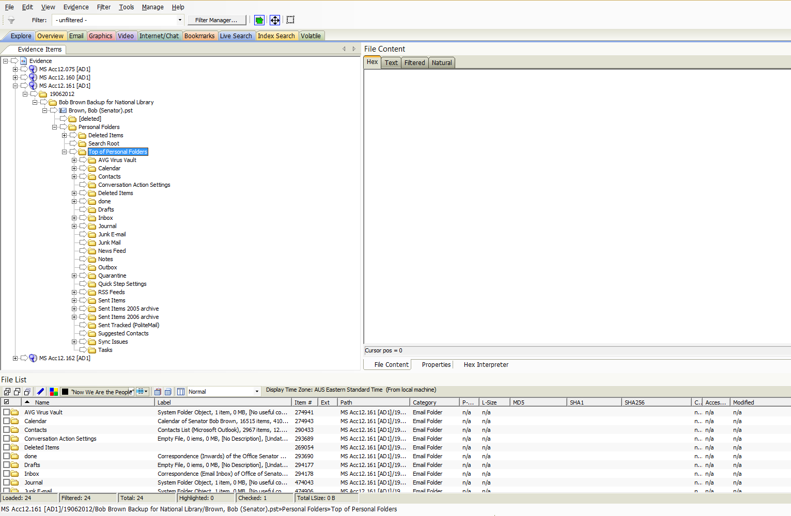
Email View - 1
Notes:
Email View through Explorer– as view of the structure of the donors email system - (note calendar, inbox, send box, RSS Feeds etc)
Again this is the structure (in the inbox, sent etc) created by the Donor.

Slide 13
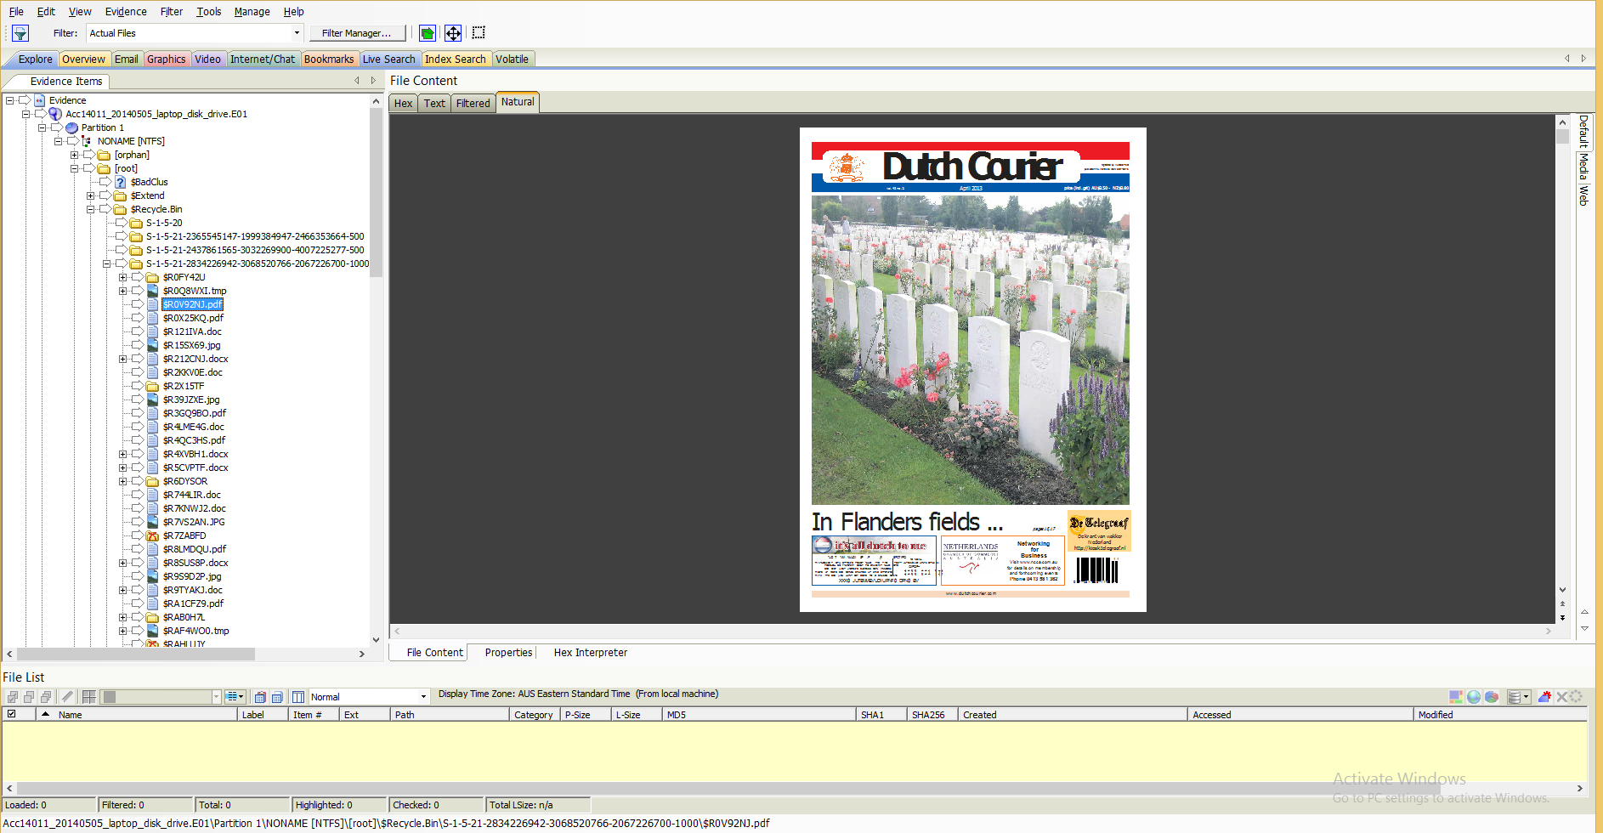
Email View 1 – Deleted Items
Notes:
Email view 1 (explorer) – deleted items story – lesson learnt!
Empty recycle bin before capturing the disk/digital objects. We now need to find a way to go forward without the deleted items or mark them as closed (as instructed by the donor).

Slide 14
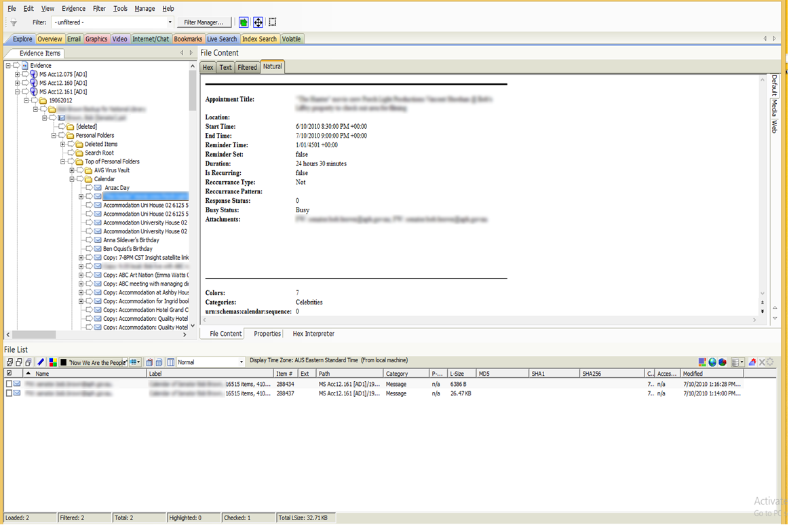
Email View 1 – Calendar view
Notes:
Calendar View

Slide 15
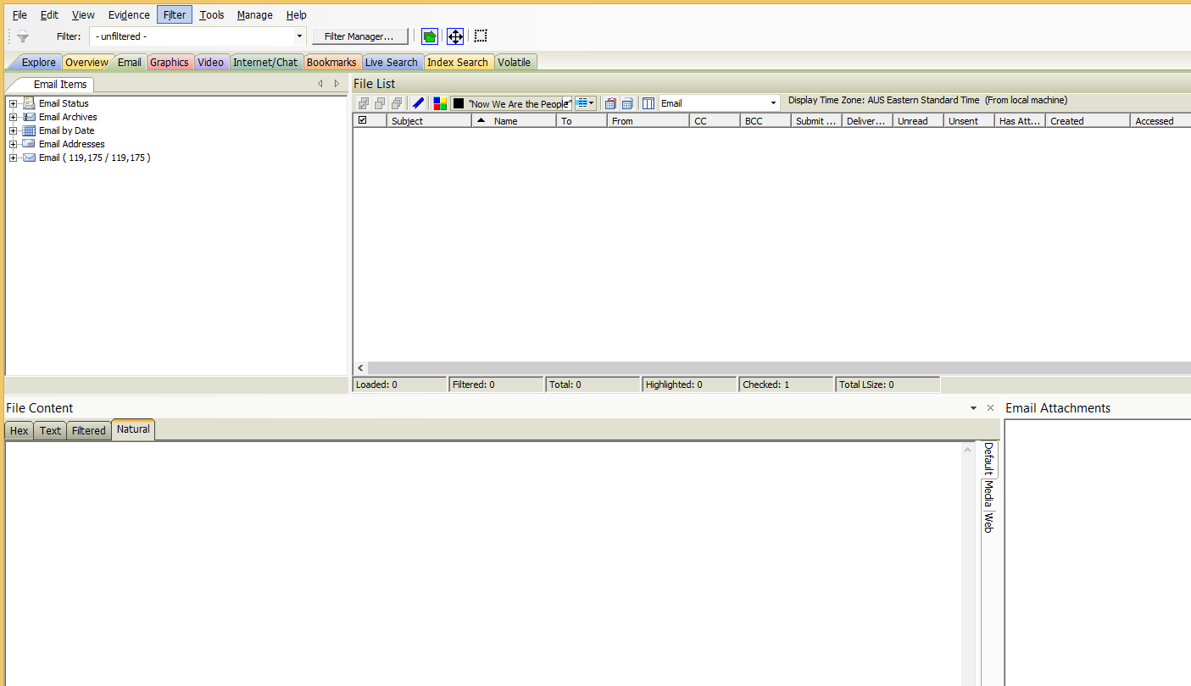
Email View 2
Notes:
Email View – specific – different breakdown (email status, Archives, Date, Addresses, Email (general) – 119,175

Slide 16
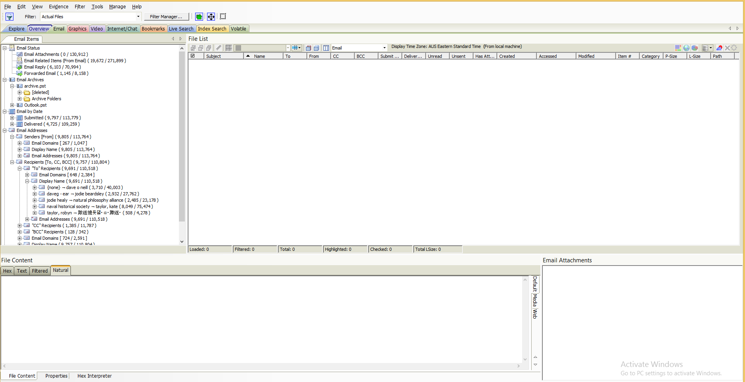
Email View 2
Notes:
Expanded email view – Email by Addresses expanded – recipients.

Slide 17
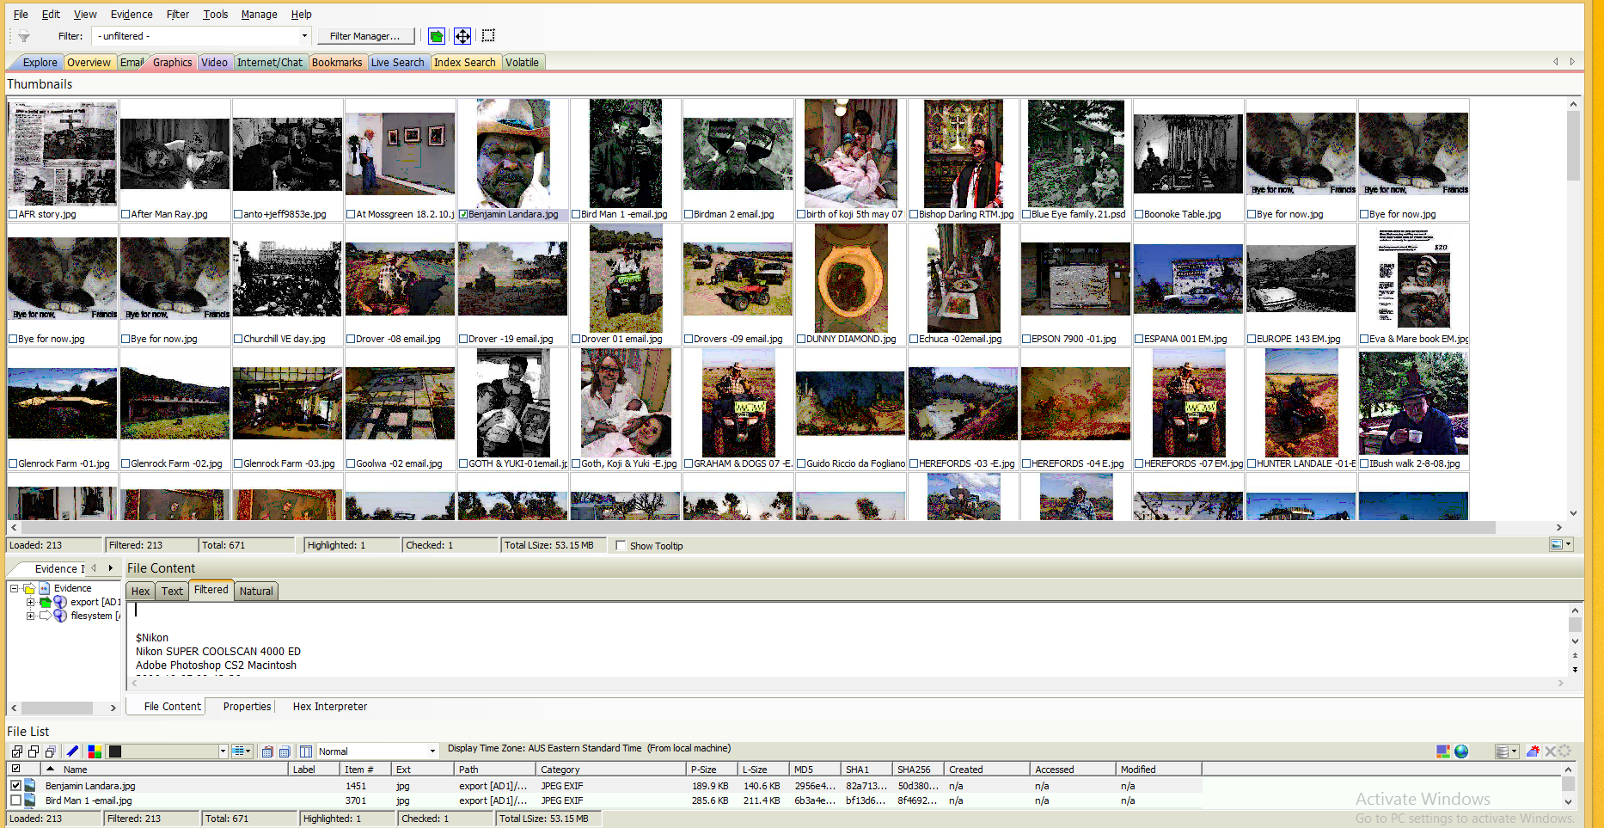
Graphics View
Notes:
Graphics – thumbnail view of of the images from a collection regardless of (can make thumbnails different sizes – this is medium)

Slide 18
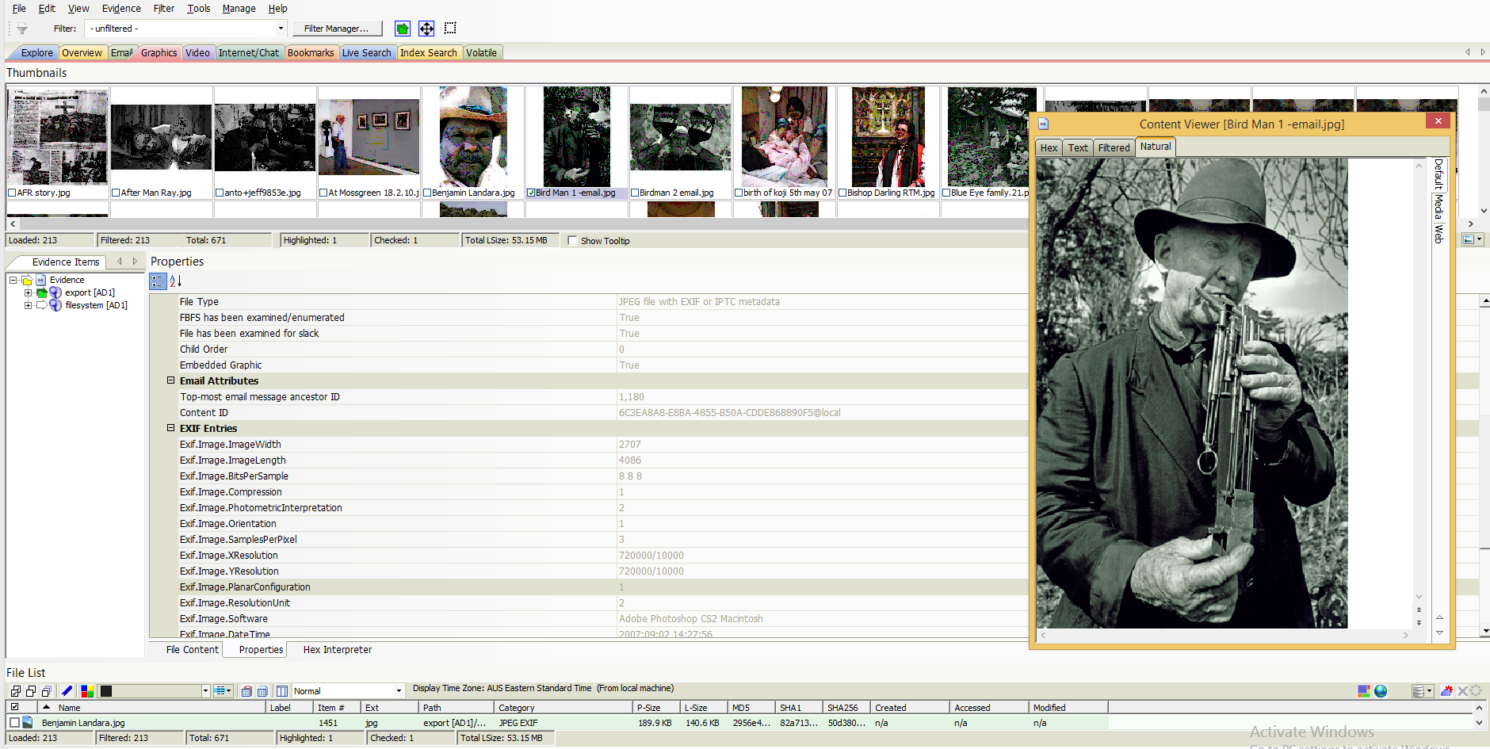
Graphics View – Properties view (metadata)
Notes:
Graphics – Properties view – metadata – file type – JPEG File with EXIF or PPTC metadata. Image software – Adobe Photoshop CS2 Macintosh.
Note – detachable pane – very useful when looking at different units. You can also move the detached pane to a second monitor if you have one set up.

Slide 19
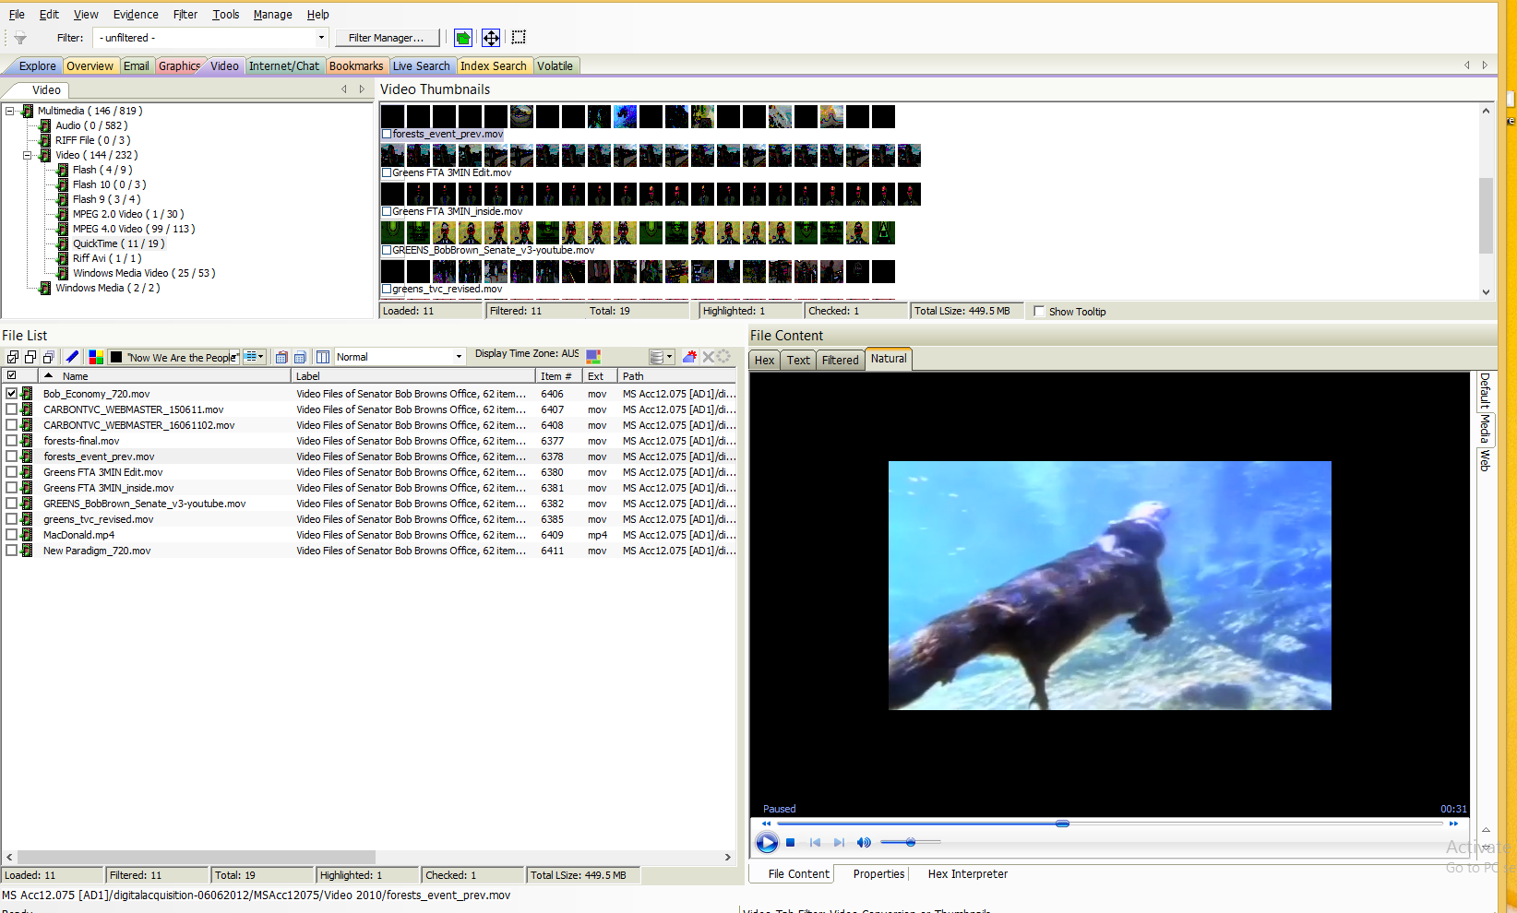
Video View
Notes:
Video View – lets you view detailed information about the video files in the collection.
You can generate thumbnail images from the video file – allows you to quickly examine a portion of the contents without having to watch each media file individually.
The video tab also includes an embedded media player that lets you view the contents of the video file. You can also choose o create a common video type for each of the various video types in the case – these common video types are not the actual video files form the evidence, but a copied conversion of the media that is generated by AccessData. This lets you view the contents of multiple video type, in a common resolution, and something rate.

Slide 20
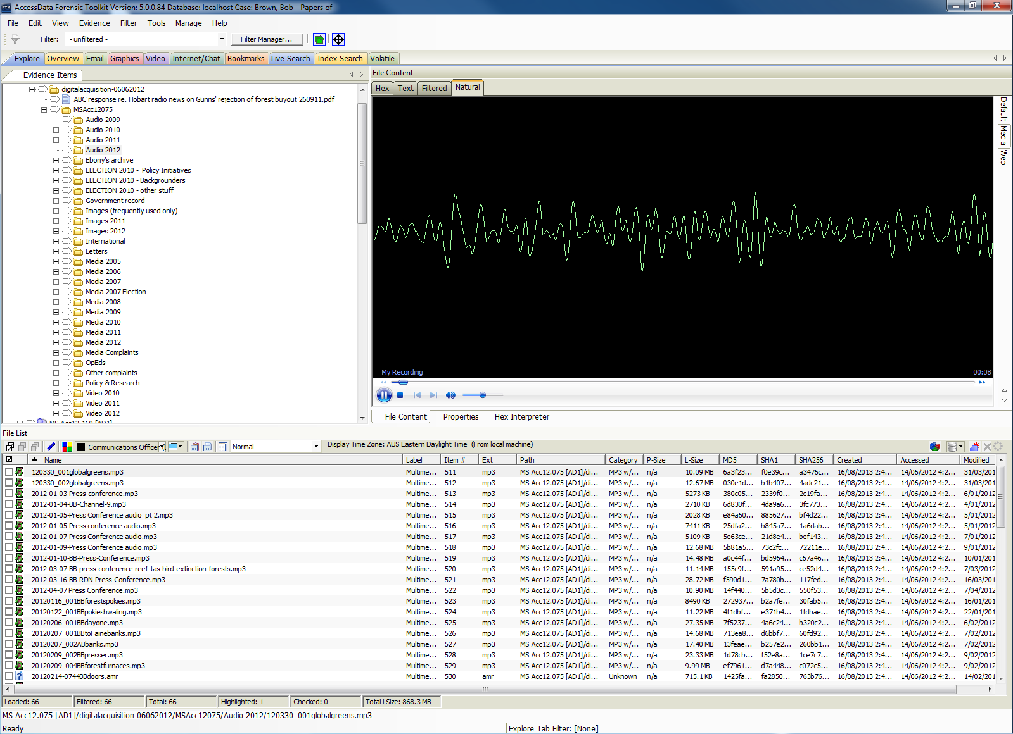
Audio Player
Notes:
Audio Player. Allows you to hear audio recordings in the collection while viewing the creative metadata.

Slide 21
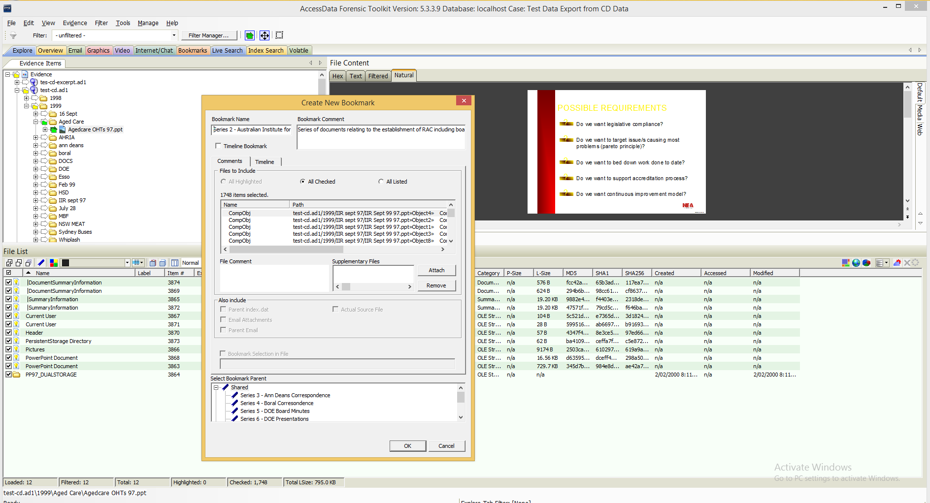
Bookmarks (Serialisation – Arrangement and Description)
Notes:
A bookmark is a group of files that you want to reference as a group. Contents can come from anywhere within the case (remaining within their original order of course). Bookmarks can also be nested within other bookmarks (allowing for sub-series to be created). The records you bookmark to a single group can be of any format or location within the collection hierarchy.
This is where we start to add our own description. Description sits on top of the records and doesn’t make any changes to the original digital objects it is describing.
Serialisation – choosing which items to include in Series 2 – Explorer view – chosen the Folder/s and items that I want to add to Series 2 – and create a new bookmark.

Slide 22
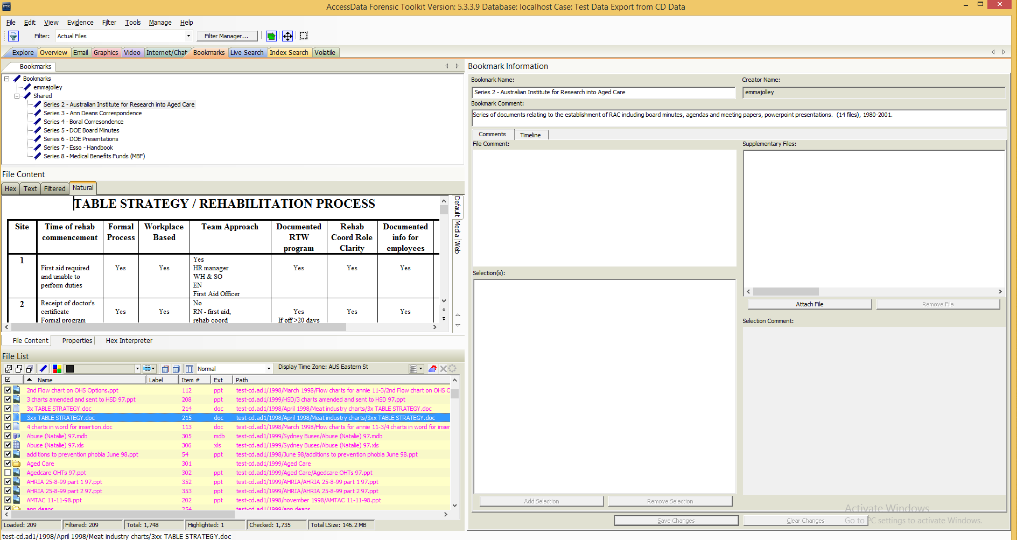
Bookmarks (Serialisation – Arrangement and Description)
Notes:
Serialisation – choosing which items to include in Series 2 – The pink colour indicates that the items have been tagged to a Series. Notice Series listed in Top left hand corner & items in Series listed bottom left.

Slide 23
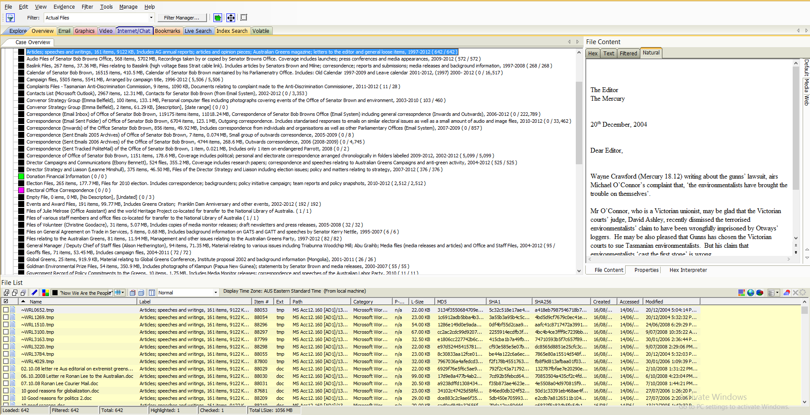
Labels (Analysis)
Notes:
Labels – initially used for serialization but too short a text field and too hard to see. Best use would be to flag particular attribute eg original carrier, subject, specific preservation work required etc.

Slide 24
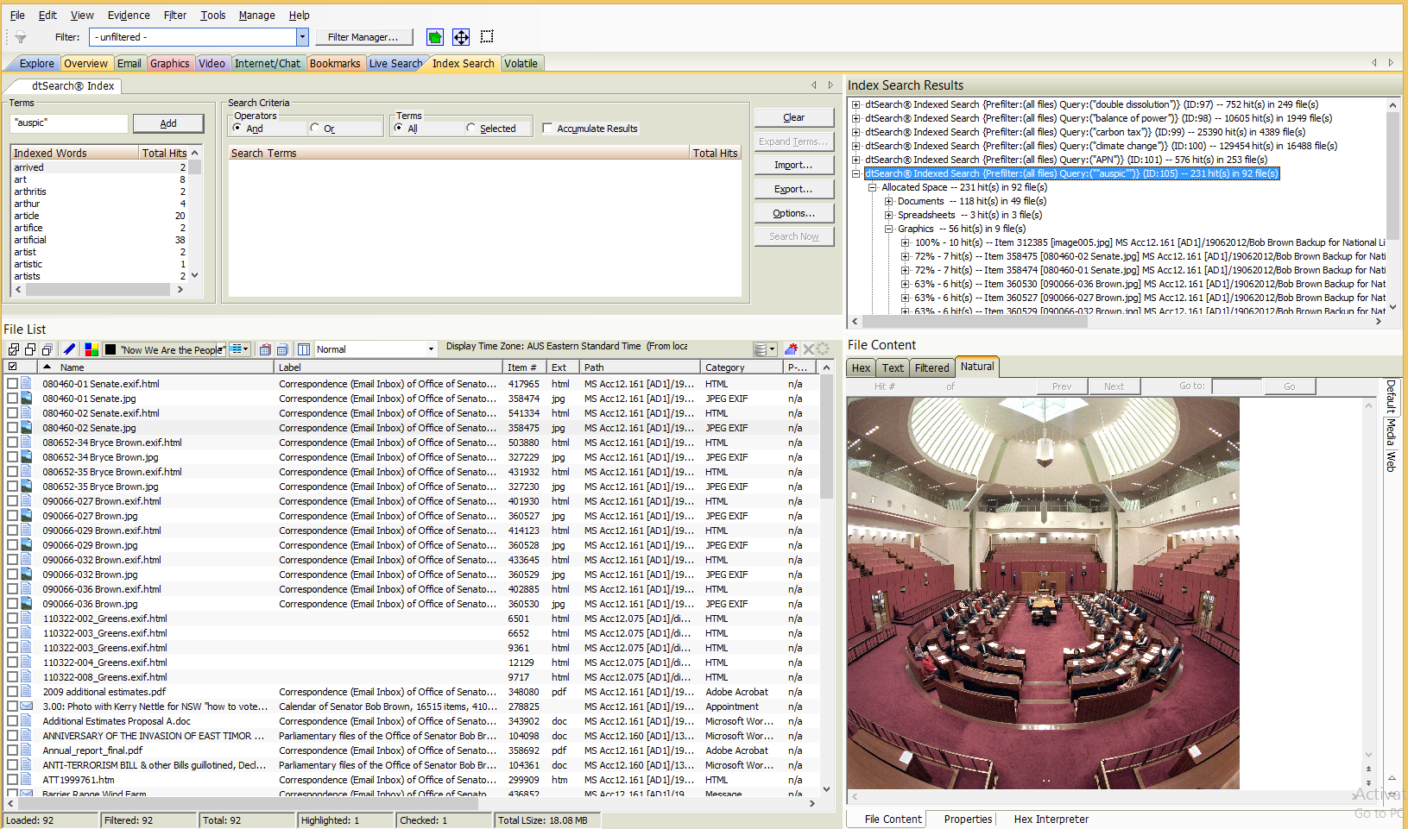
Searching (Index)
Notes:
Searching – entire collection for “AUSPIC” to try to determine any copyright restriction – got 231 hits in 92 files and some hits in unallocated space (meaning deleted files).
Searching is fantastic. All content is indexed. Various different types of searching available including: Index Search, Pattern Search (eg Credit Cards), Fuzzy Hashing etc.
Selected an image from the search and can now view the metadata or properties.

Slide 25
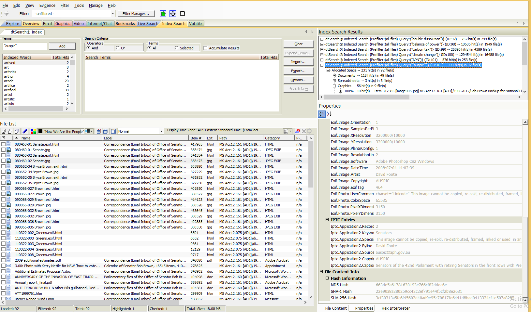
Searching (Index) – Copyright and IP statements
Notes:
Searching – metadata (properties view – indicating image cannot be copied, re-distributed, framed, linked or used…, copyright owner AUSPIC
Metadata of the selected item – indicating image cannot be copied, re sold, redistributed etc. Copyright owners is records as being AUSPIC.

Slide 26
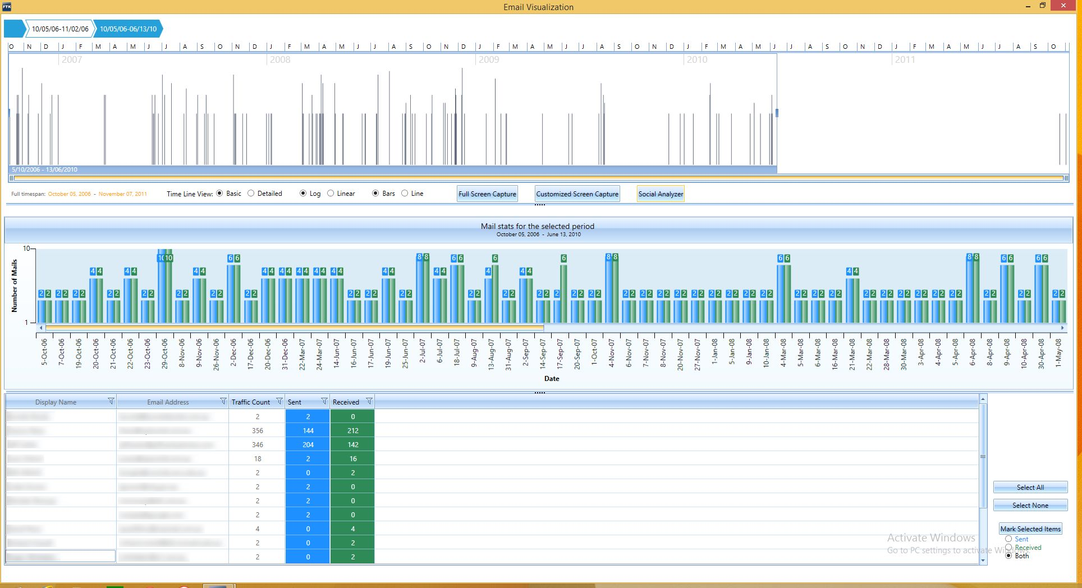
Visualisation – Time Series (Email)
Notes:
Data visualisation is a feature that provides a graphical interface to enhance understanding and analysis of a set of files an emails in the collection. It supports files data, email data and internet browser history.
This is a time line view (over the Email group) – The top portion of the window is the time line which displays a graph with a representation of the data it has analysed. The data is displayed from the oldest date on the left the newest date on the right.
The bottom group – identifies correspondents and the number of emails send and received by them.
Names have been deliberately obscured.

Slide 27
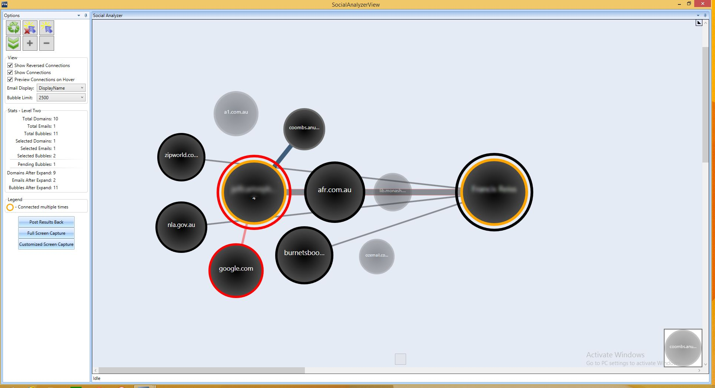
Visualisation – social analyser (email)
Notes:
Another view / visualisation of the number of contacts between email correspondents…..Yellow and Red are the central correspondents and
Valuers used the visualisation functions a lot.

Slide 28
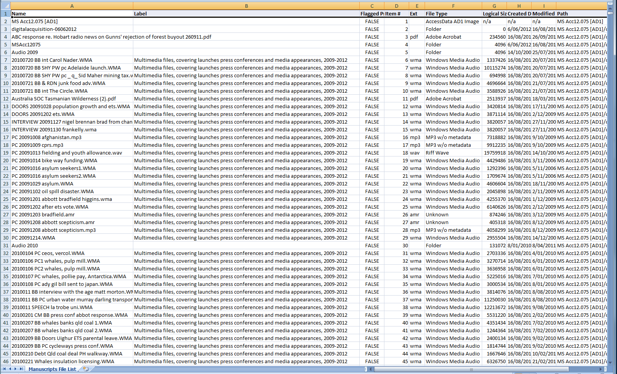
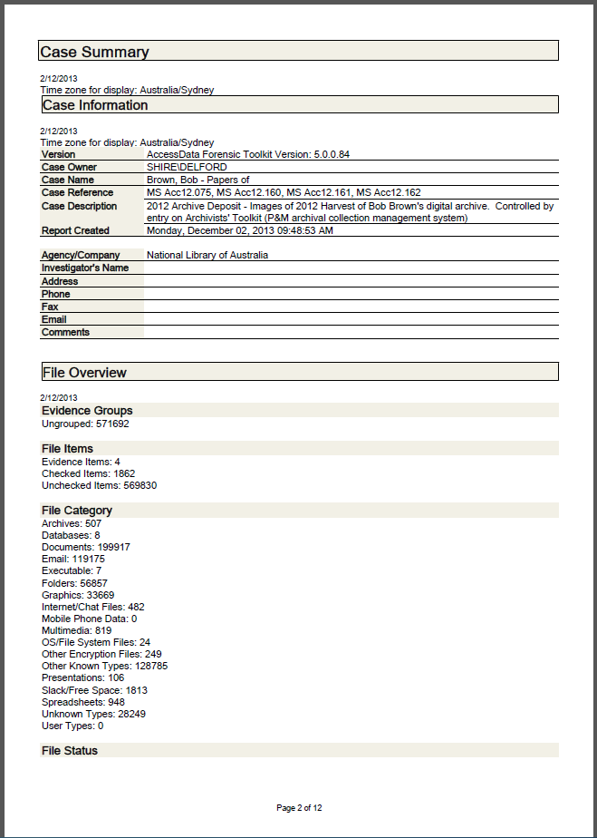
Reporting
Notes:
Reporting - Being a proprietary solution targeted at a different market’s needs means the reporting is also quite targeted.
There are two types of reports: a Manifest-like one (CSV/Excel) which includes the additional serialisation and descriptive work done by Archivists and a case and associated content compendium one.
Output is possible in PDF, HTML, XML, RTF, ODF formats.

Slide 29
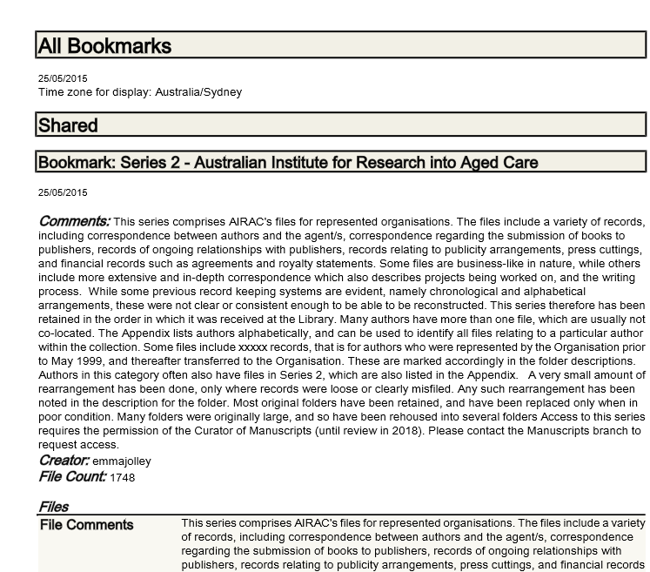
Reporting – Finding-aid
Notes:
Bookmark – finding-aids view (apologies for the data – test data!!)

Slide 30
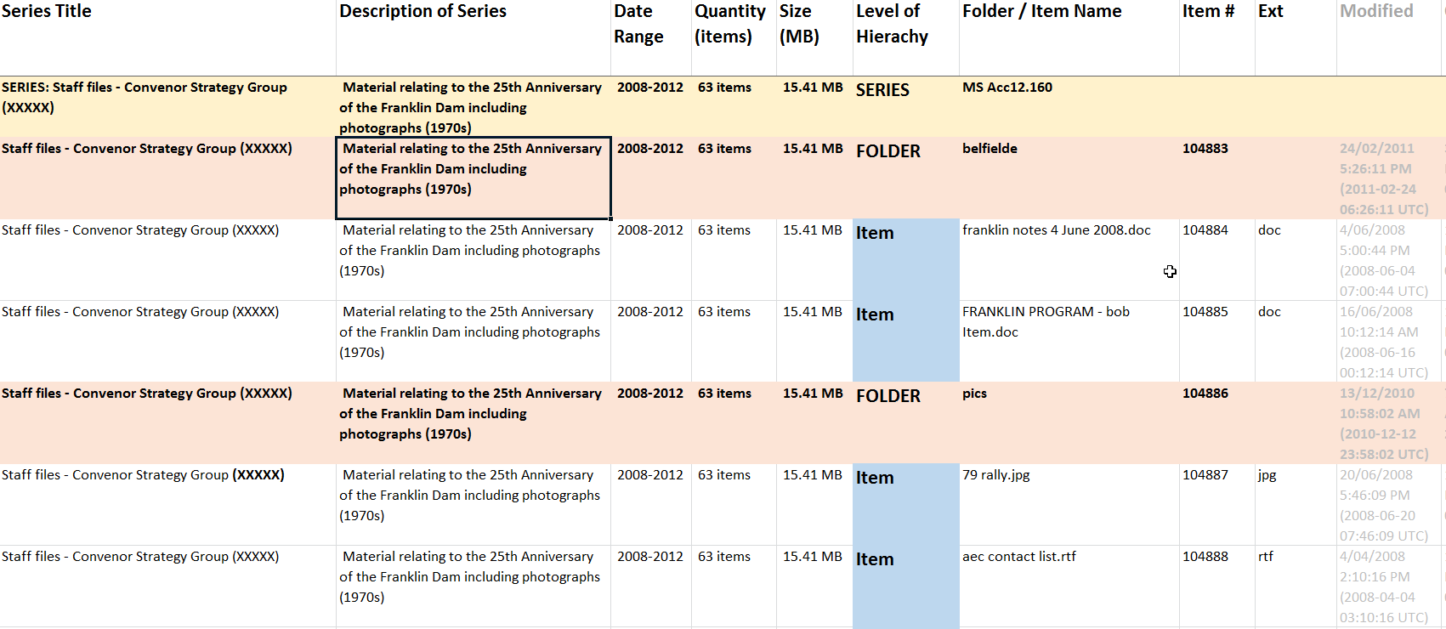
Reporting – Donors List (Finding-aid)
Notes:
Example of CSV/Excel export of the manifest report (while a substantial amount of formatting and editing).

Slide 31
Issues and Challenges
Professional interactions (vocabulary)
Donors metadata
Description
Hybrid collections
Perceptions of the challenge
No two collections are the same
Getting the Description into CMS
Notes:
Professional interactions – different language. FTK allowed me to “show’ everyone what I meant.
Donors metadata – donors often don’t create good metadata – be prepare to encourage and train them [as a start please everyone write meaningful subject lines and put your emails in Folders!)
Description – value of description of digital records called into questions by various search & discovery tools – descriptive practice needs to be reviewed and where it sits in discovery.
Hybrid collections
Perceptions of the challenge – surely it’s easy to work it out if we give you some time.
No two collections are the same – meaning different approaches are sometimes needed to different situation. You don’t exactly start again from scratch but you usually do have research and plan for an unexpected element in the transfer (maybe a different operating system, different file types (databases, proprietary software – such as Sibelius).
Getting the description into CMS

Slide 32
Lessons Learnt
Plan, Plan, Plan, visit and plan some more
Expect the unexpected
Digital Transfer is very resource hungry
Appraisal must be at CDP level (and Functions)
A single person isn’t going to do it (need a village)
Theory is the same regardless of format
Notes:
Plan, plan, plan – and accept that you won’t be able to cover everything
Expect the unexpected
Digital Transfer is very resource hungry – be prepared to fund it and allocate sufficient resources
Appraisal – level of appraisal should not lie in examination of the digital object but in the broader level. Like both the Contiuum (archivist as creator), Macro appraisal (appraise the functions not the records).
Appraisal needs thoughtful assessment of the activities of the record creator against your CDP – not item level appraisal. Lies in definition of appraisal – “Process of evaluating business activities to determine which records need to be created & captured and how long the records need to be kept”
A single person can’t do it all – you need a village
Theory is the same regardless of format
You will make mistakes, there is no 1 answer, success built on time, perseverance and trusted relationships

