Slide 1
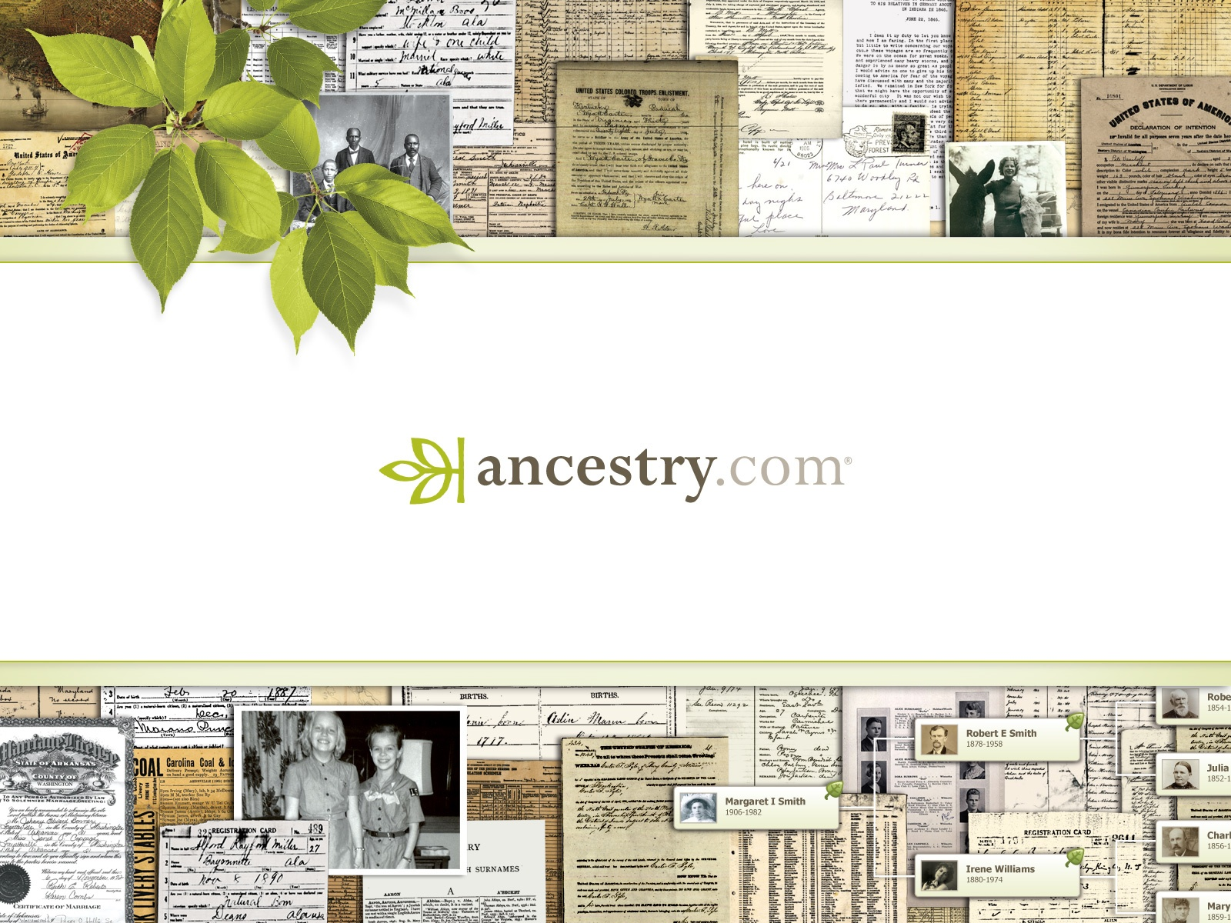
NSLA Heritage Forum – Digitisation
State Library of Queensland, 14th May 2015

Slide 2
Introduction
I’m responsible for making sure that Ancestry keeps getting better and better in Australia
My love of history started as a young boy with my two grandfather’s WW1 medals
After over 10 years of working for supermarkets and phone companies, on big data warehouses, I returned to Australia and my first love. History.
I love helping people to discover their own stories and Ancestry is a platform for people to understand their story, their identity and it’s fit with the Australian story
I truly believe that human’s capacity for reason is driven by access to information. The scaling of the collections available to all is making us better people
2

Slide 3
About Ancestry.com
Ancestry is the world’s largest online family history resource with 2.1 million subscribers across its Ancestry.com branded websites.
And over 2.7 million subscribers across all its websites, including Archives.com, Fold3.com and Newspapers.com
Ancestry.com.au provides access to more than 2 billion searchable Australian, New Zealand and UK family history records
Technology:
Ancestry.com currently manages about 10 petabytes of structured and unstructured data including over 15 billion of records detailing birth, marriages, deaths, immigration and military service.
On average, more than 75 million searches are handled by Ancestry.com servers daily.
The Ancestry Mobile app – iOS and Android – have been downloaded more than 11 million times since January 2011
3

Slide 4

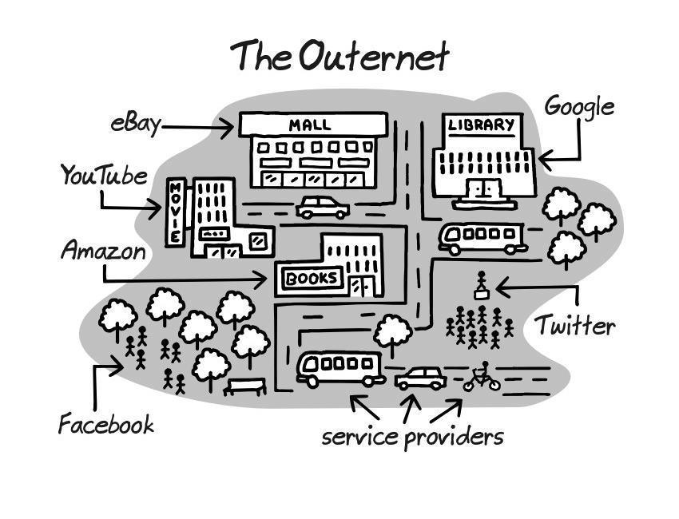
Who is Ancestry?
  Ancestry is the starting point for family history
  Google is the online starting point for everything else
  Libraries are perceived as the offline google

Slide 5
Digitisation – Scale
  Ancestry is connecting up family history collections
  The platform offers a cradle to grave timeline for families, which works to describe the life lived in between e.g. marriages or who we love, jobs or what we do with our lives, our legacy or our children
  By connecting collections that valuable to a nation by themselves e.g. the WW1 service records with our national databases of electoral rolls and BDMs, we allow the community to understand its people better.

Slide 6
Why do we digitise?
  Preservation
  Access
  Traffic or visitation. On and offline
  Monetisation

Slide 7
Digitisation – Format flow
Microfilm
Digital
Assets
Original
Records
1
2
3
  We usually start with microfilm
  Progress to digital assets, then to
  Imaging of original records
  More and more we working on digital collections first.

Slide 8
Digitisation - Benefits
Microfilm
Digital
Assets
Original
Records
1
2
3
  Access, Preservation, cost absorbed by Ancestry
  Access, Cost recovery, monetisation
  Access, Preservation, cost absorbed by Ancestry

Slide 9
Digitisation – Tasmania Archives & Heritage Office
Microfilm
Original
Records
Promotion
1
2
3
  Access, Preservation, cost absorbed by Ancestry
  Creation of digital assets for TAHO collection including records not published on Ancestry
  Sponsorship of ASA Conference in August in Hobart. Launch of convict materials at that event. Telling community about stories in the collection.

Slide 10
Digitisation – Access benefits
  Access to millions of members internationally. Ancestry is the world’s largest online family history resource with 2.1 million subscribers
  Access to the digitised collections via the Library edition free to the community in library and archive reading rooms. Public library network is effective delivery mechanism to state and local communities
  Our recent projects with National Archives of Australia and Public Records Office Victoria included provision of Ancestry subscriptions to all state and local reading rooms.

Slide 11
Digitisation – Traffic
  Ancestry platform offers ease of access. Members can access the collections at home in their pyjamas
  For example, the National Archives of Australia WW1 service records were shared on Ancestry in March in partnership with the NAA
  Timing is critical! Launched for Anzac Day and centenary of Gallipoli landings. All records linked and referenced to NAA
  Page views on NAA collections went from an average of approximately 100,000 views / month to over 1 million page views in April.

Slide 12

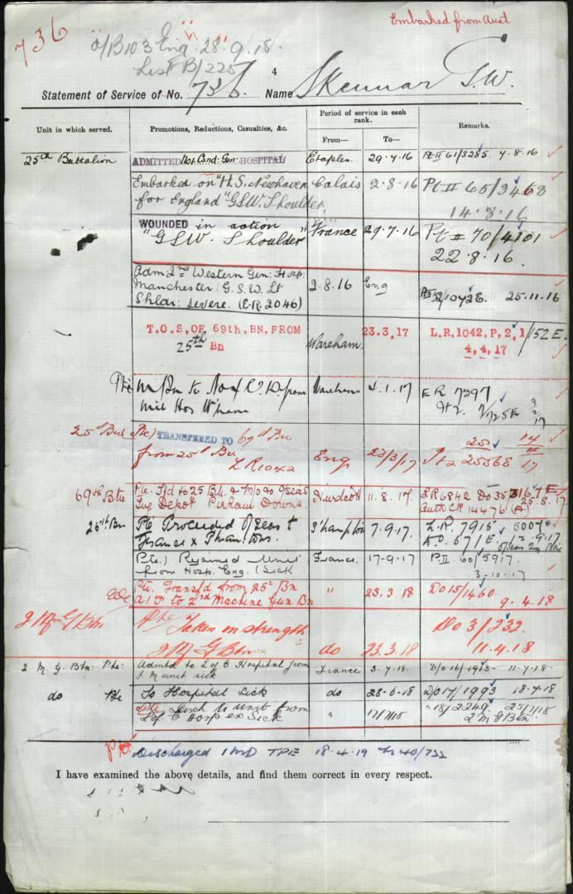
Australia, WWI Service Records, 1914-1920
  This unique collection of over 12 million images and 376,000 records includes service dossiers for Australians who served in WW1 in the following units:
  Australian Imperial Force
  Australian Naval and Military Expeditionary Force
  Royal Australian Naval Bridging Train Australian Flying Corps
  Australian Army Nursing Service
http://search.ancestry.com.au/search/db.aspx?dbid=60864

Slide 13
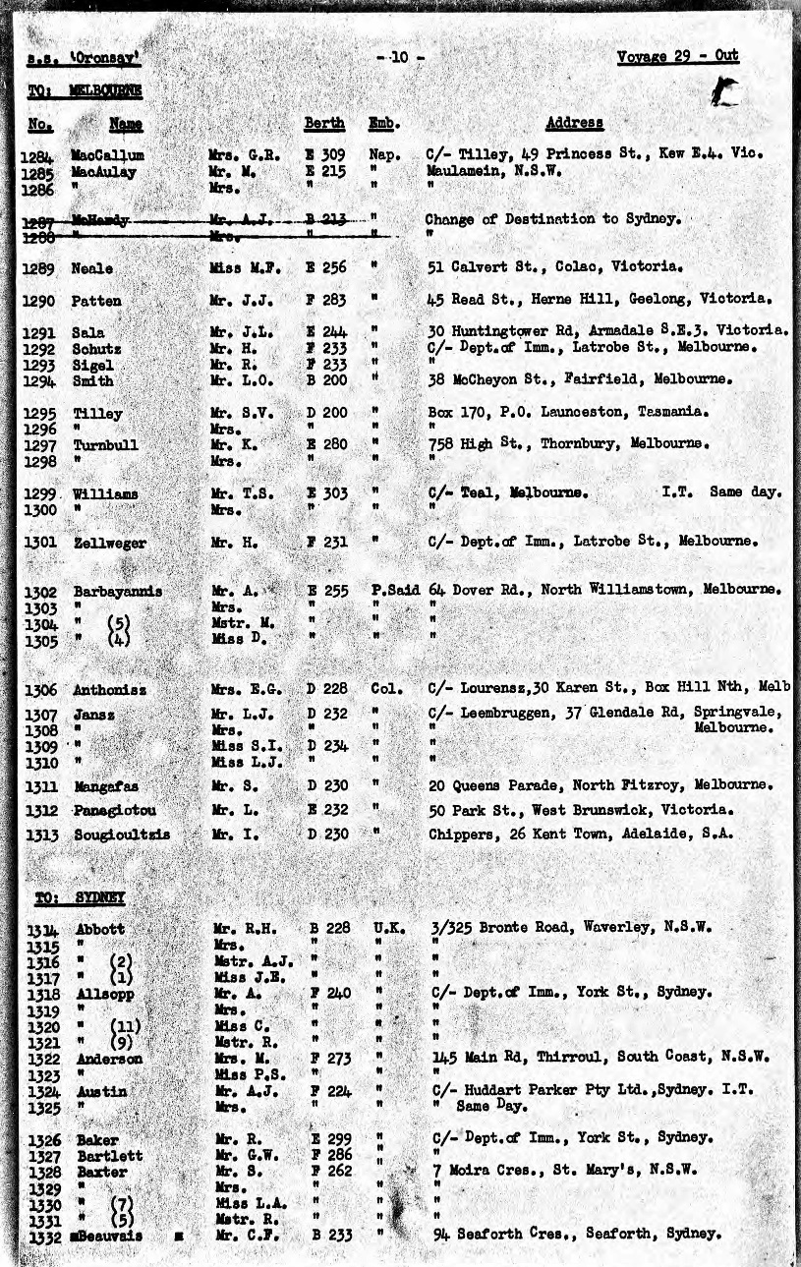
Fremantle Passenger Lists, 1897-1963
  The collection includes ship passenger arrivals, crew lists, air arrivals, and quarantine lists. The records were kept on a variety of forms, with varying degrees of information, but can include:
  passenger names
  date of arrival
  ship name
  port of embarkation
  residence (sometimes including address)
  travel class
  forwarding address for correspondence
  age
  marital status
  occupation
  nationality
http://search.ancestry.com/search/db.aspx?dbid=5378

Slide 14
Digitisation – Ancestry aims to inspire
  Discovery of family and identity
  Inspires visitation. A library’s collection on Ancestry inspires members to know what else a library has in its collection. Ancestry connection encourages community to visit the library.
  Inspires creativity. For example, our sponsorship of GovHack continues in 2015 with hopefully an International Library prize for Australia and NZ.

Slide 15
Valuation = visitation
  If it’s valuable then people will visit. You just have to tell them about it
  Sharing increases the value of the original and drives visitation both on and offline
  Take the Mona Lisa. Shared billions of times as a digital image in photos and all other channels, and this appears to have increased its value
  Now you can’t visit Paris without a trip to the Louvre. In fact, many visit Paris to see the Mona Lisa.
  Collaboration with Ancestry offers like opportunities

Slide 16
Collaboration
  “Do you want to hear a story”. Question from the SLQLD receptionist.
  One vineyard in an area needs to have an exceptional vintage and location to drive visitation. Many vineyards, cafes and a bit of jet boating in a area drives many people to visit a destination!
  Partnership – collaboration with Ancestry can help drive connection with community, access, visitation, preservation and monetisation of your collections

Slide 17
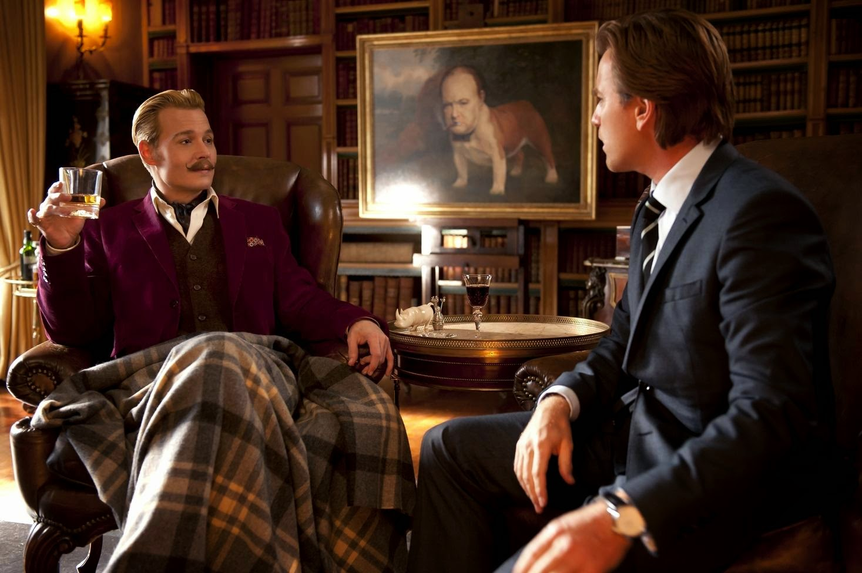
Collaboration - Library visitation
  To the library chaps!
  Librarians have the local and collection knowledge to answer questions online platforms cannot

Slide 18
Any Questions?
Thank you for your time
Email: bmercer@ancestry.com.au
Twitter: @ancestrycomau
Mobile: 0405 272427

Slide 19
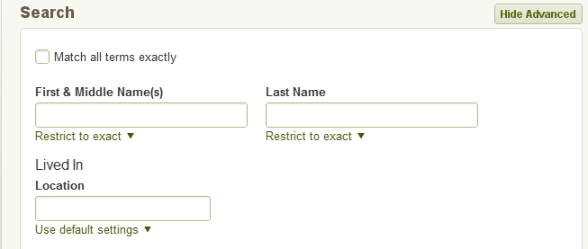
Update to Australian Electoral Rolls, 1903-1980
  About 70% of the electoral rolls in this collection were previously transcribed. In this update, we’ve added the remaining 30% of rolls. We’ve also added images and records for rolls that were previously missing from the collection:
  Tasmania (all districts for 1958-1980)
  New South Wales (select districts for 1968, 1972, and 1977)
  Electoral rolls are great to use as “census substitutes.”
  Rolls usually include Name of voter, Gender, Address, Occupation
  Total:
  Over 100m records
  Over 1.5m images
  New:
  Over 30m records
  Over 61,000 images
Notes:
URL: http://search.ancestry.com.au/search/db.aspx?dbid=1207

Slide 20
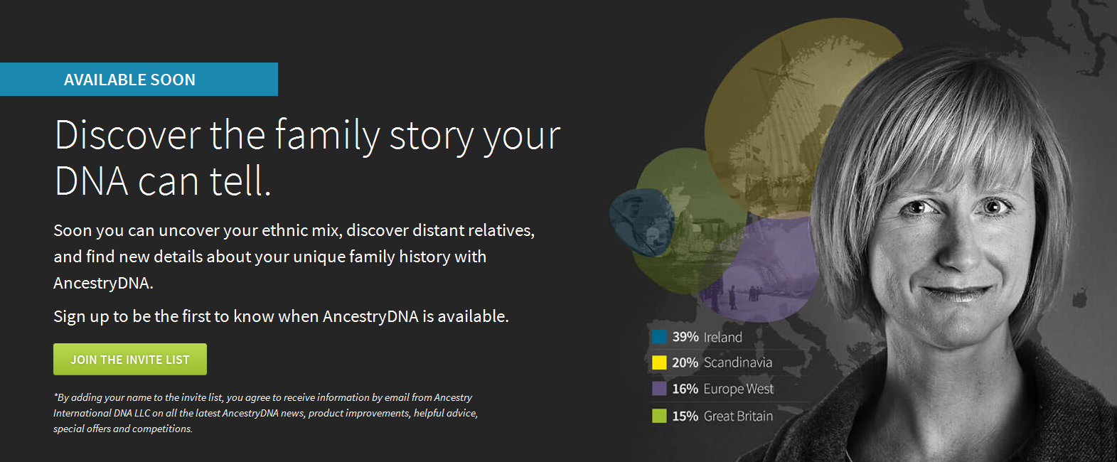
AncestryDNA is coming in 2015
  Family history is in our DNA. Be the first to get your results!
  Signup to be the first to know, add your name to the invite list:
  http://dna.ancestry.com.au

Slide 21
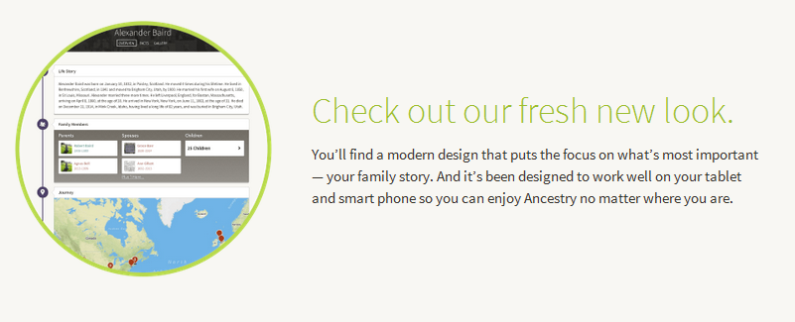
Ancestry is changing: Website improvements
  Ancestry is always working to improve your onsite experience.
  We’d like to invite you to become a part of the Ancestry beta.
  To join the beta, simply add your name to the invite list:
  http://home.ancestry.com/beta
Notes:
Read more: http://blogs.ancestry.com/ancestry/2015/02/19/sneak-peak-new-ancestry-website-coming

Slide 22
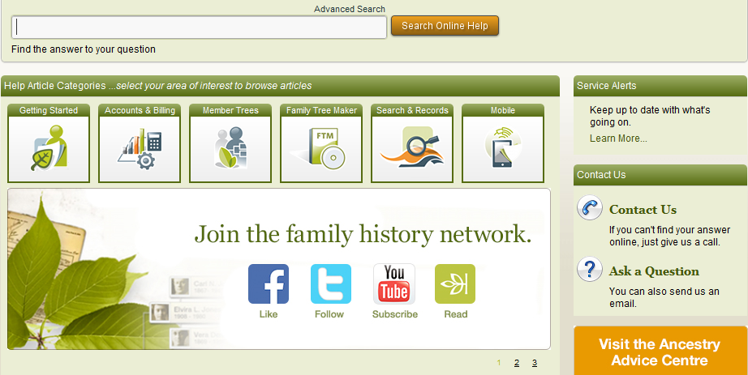
Getting help with your questions
  You’ll find lots of answers for your questions in our online help:
  http://ancestryau.custhelp.com/app/home
Notes:
Ancestry.com.au youtube: https://www.youtube.com/user/AncestryAU

Slide 23
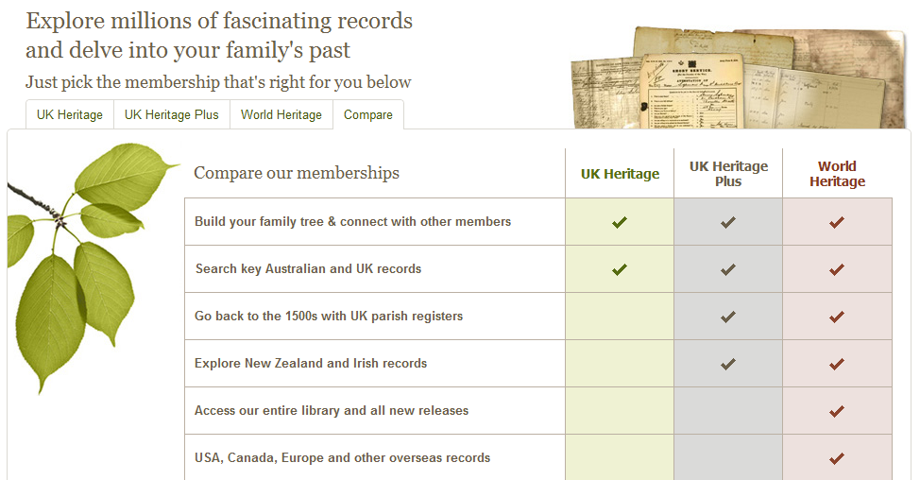
Understanding our subscription packages
  You’ll find more on our 14 day free trial and subscriptions at:
  http://www.ancestry.com.au/cs/offers/subscribe?sub=1

