Slide 1
Technology based innovation in literacy and learning
Megan Perry | Manager, Learning Services
Louise Prichard | Web Coordinator
State Library of New South Wales

Slide 2


Slide 3
Mobile Multimedia Guide joint project
NSW Government Department of Trade & Investment’s ‘Collaborative Solutions Mobile Program’
Art Processors
State Library of New South Wales

Slide 4
Art Processors =
developed ground-breaking mobile guide technology as part of ‘The O’, at the Museum of Old and New Art, in Hobart, Tasmania
first step in the company’s software commercialisation process

Slide 5
State Library =
a new way to explore, interact and learn about one of Sydney’s iconic institutions and its collections

Slide 6
User consultations =
Year 4 to Year 10 students day
coordinated by SLNSW Learning Services

Slide 7
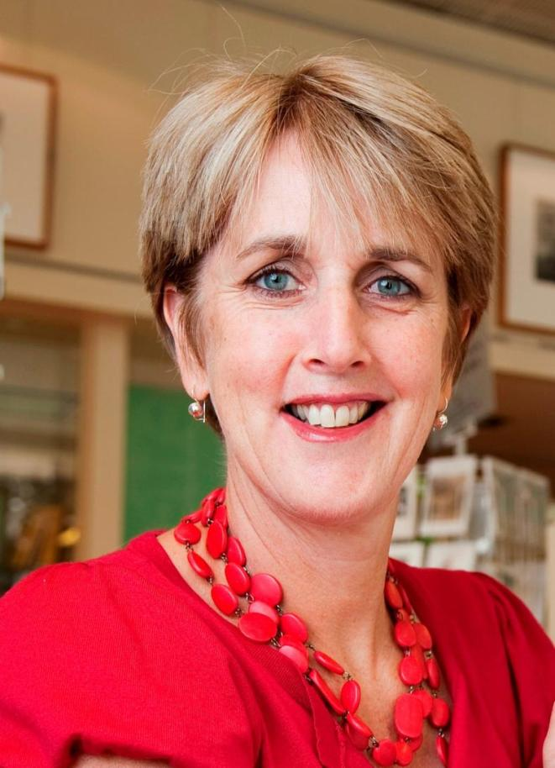
Pauline Fitzgerald
Senior Education Officer

Slide 8
Student voice =
Coalition of Knowledge Building Schools
Ashfield Boys High School
Bowral High School
Wiley Park Public School
St Ives North Public School
Granville Boys High School
Methodist Ladies College
Monte Sant’ Angelo Mercy College
Glenmore Park High School
Condell Park High School
Stewart House
St Peters College
St Mary’s Star of the Sea
Loreto Normanhurst
Friends of the Coalition
State Library of NSW
Australian Museum
Taronga Zoo
Supported by
Faculty of Education and Social Work
at the University of Sydney under
the guidance of
Professor Susan Groundwater Smith

Slide 9
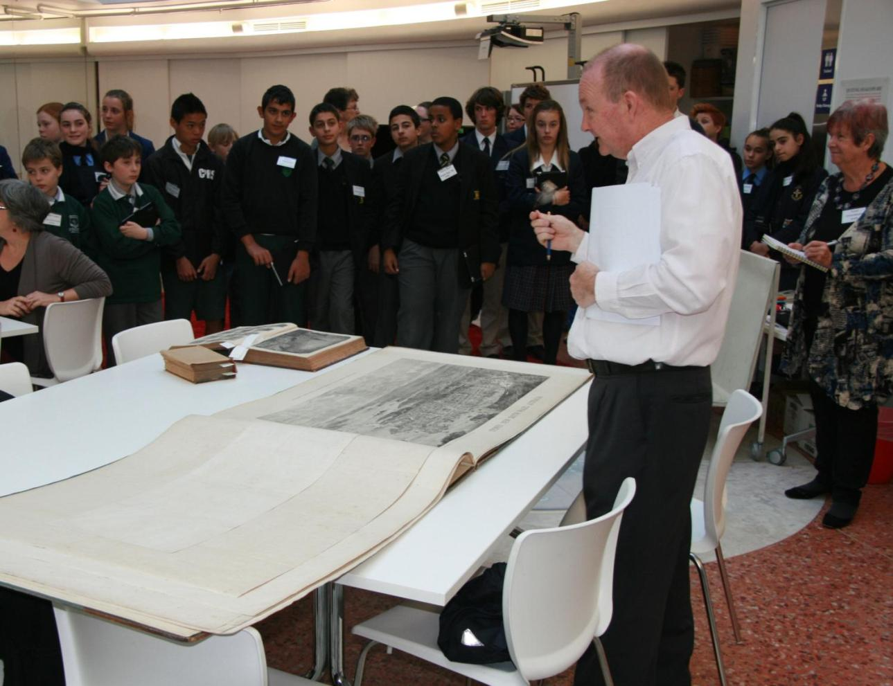
15 August 2012 = consultation begins

Slide 10
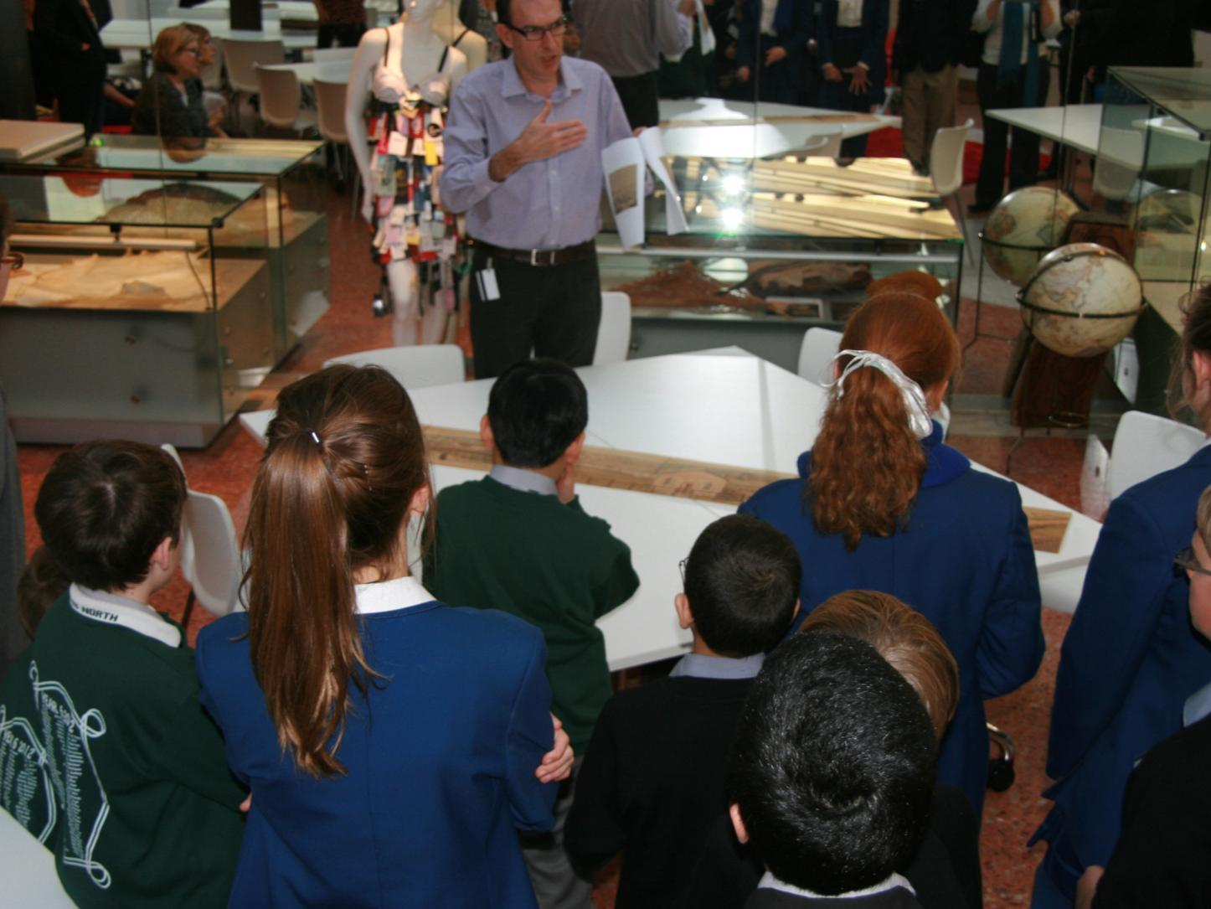

Slide 11
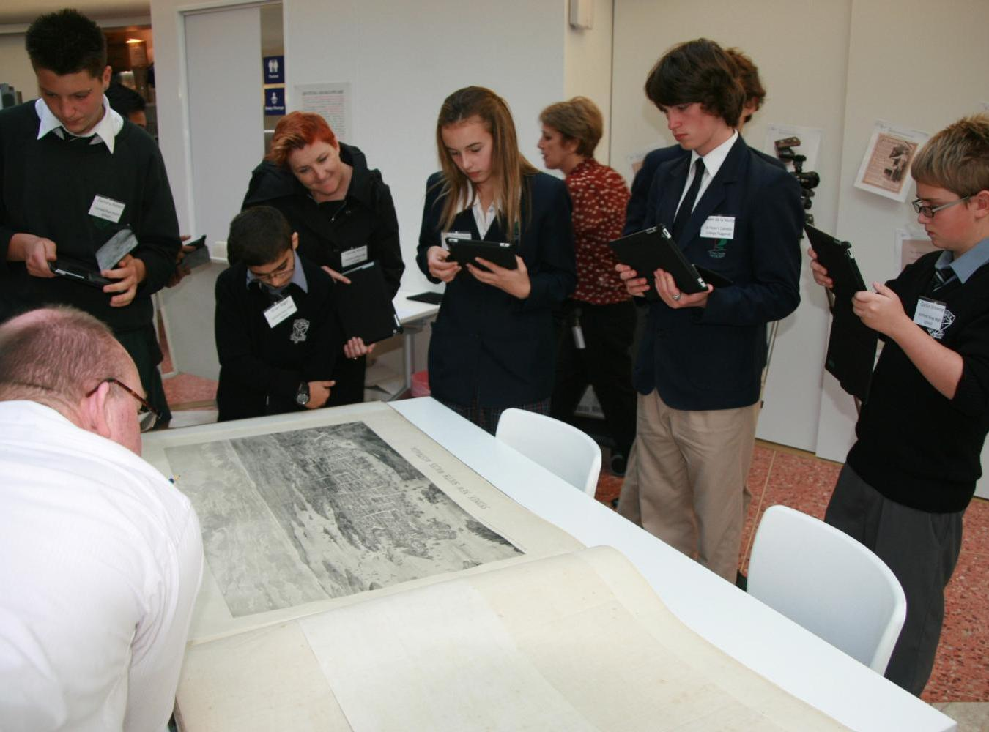

Slide 12
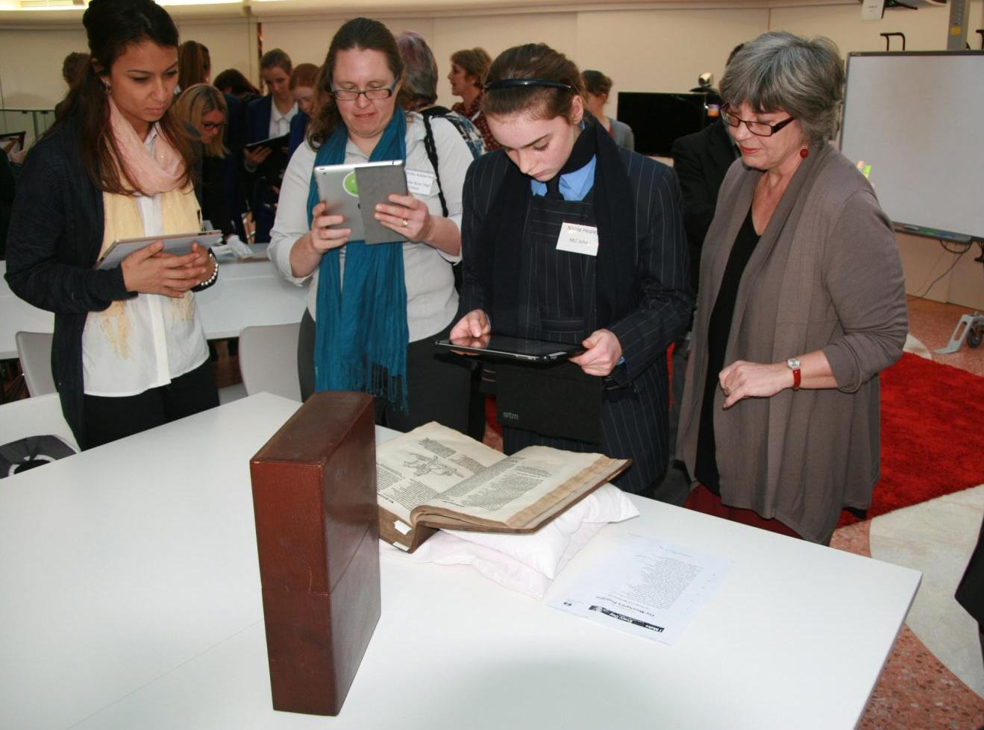

Slide 13
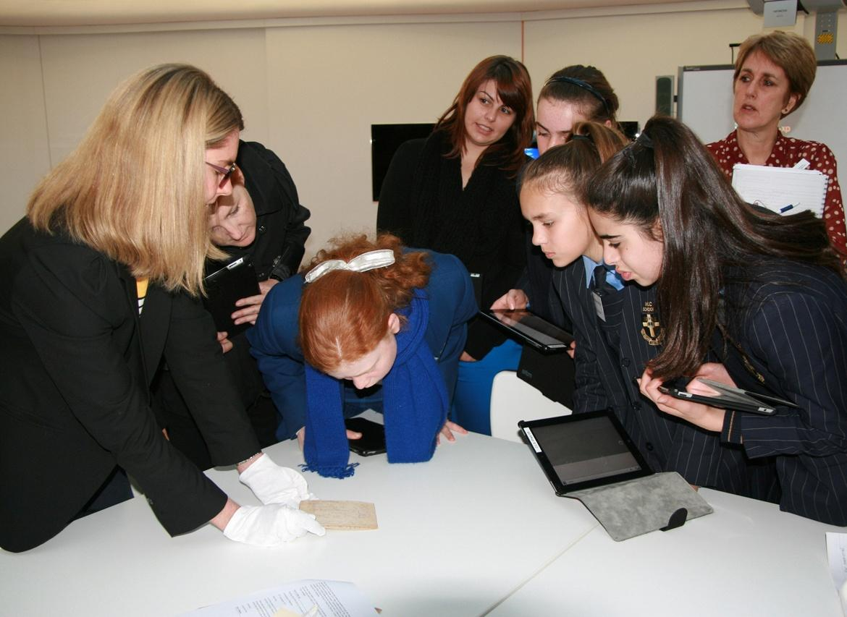

Slide 14
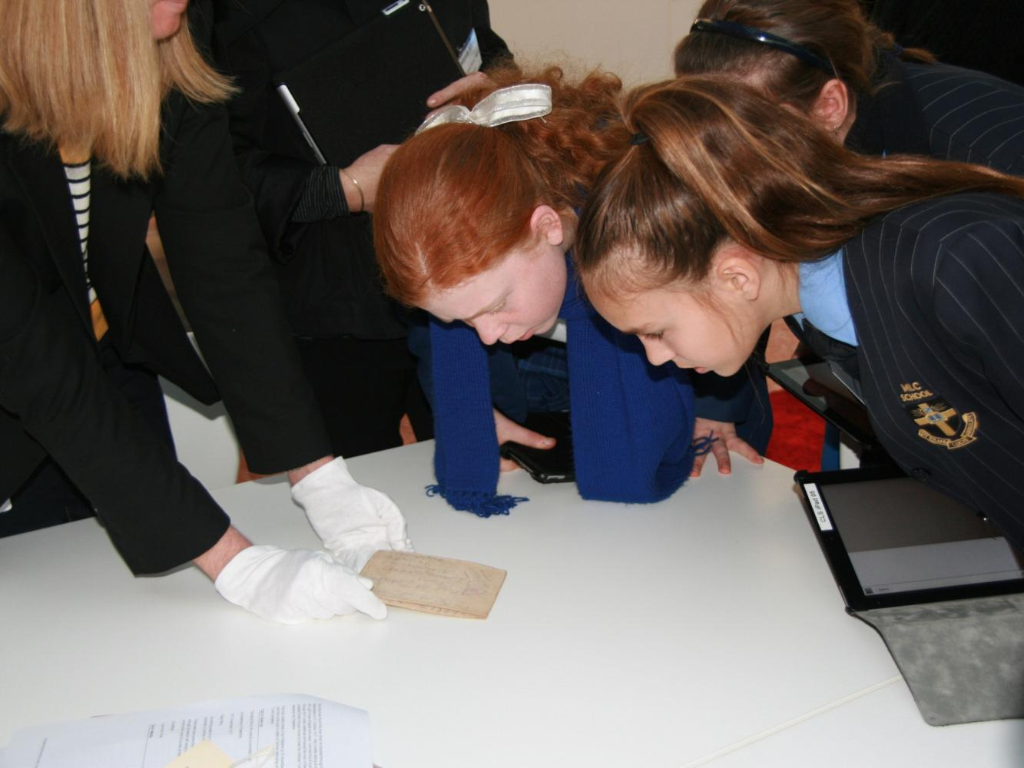

Slide 15
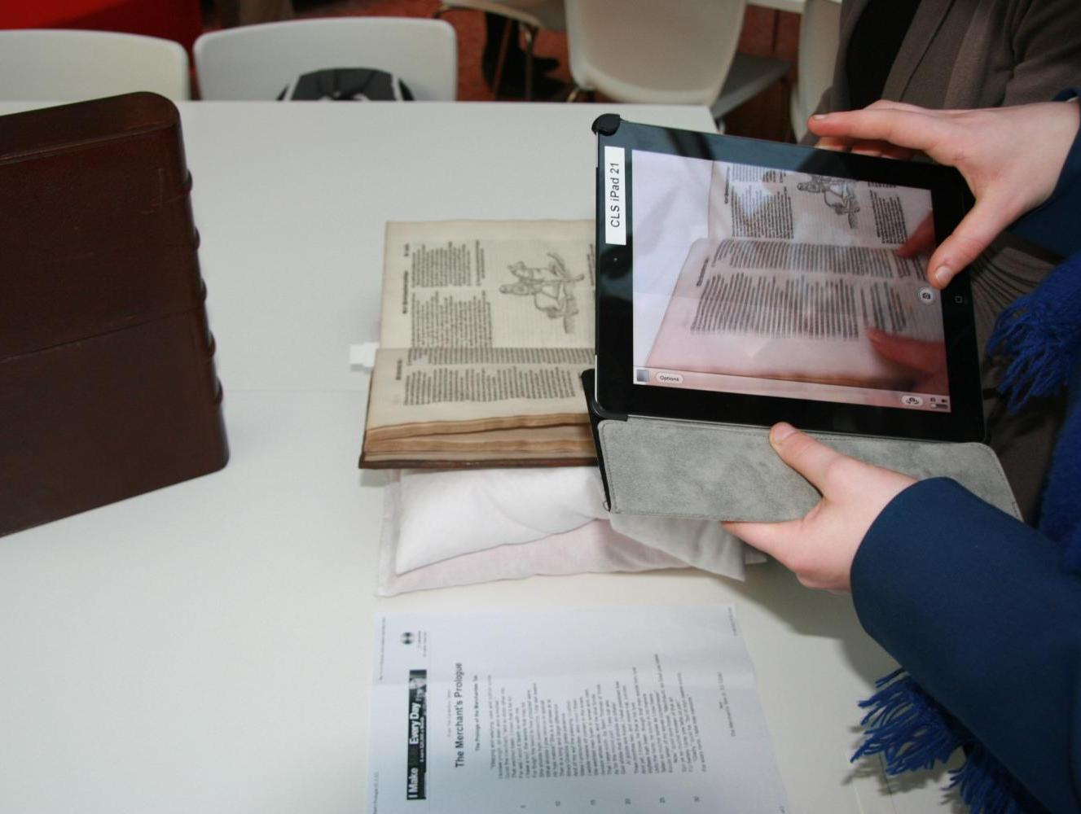

Slide 16
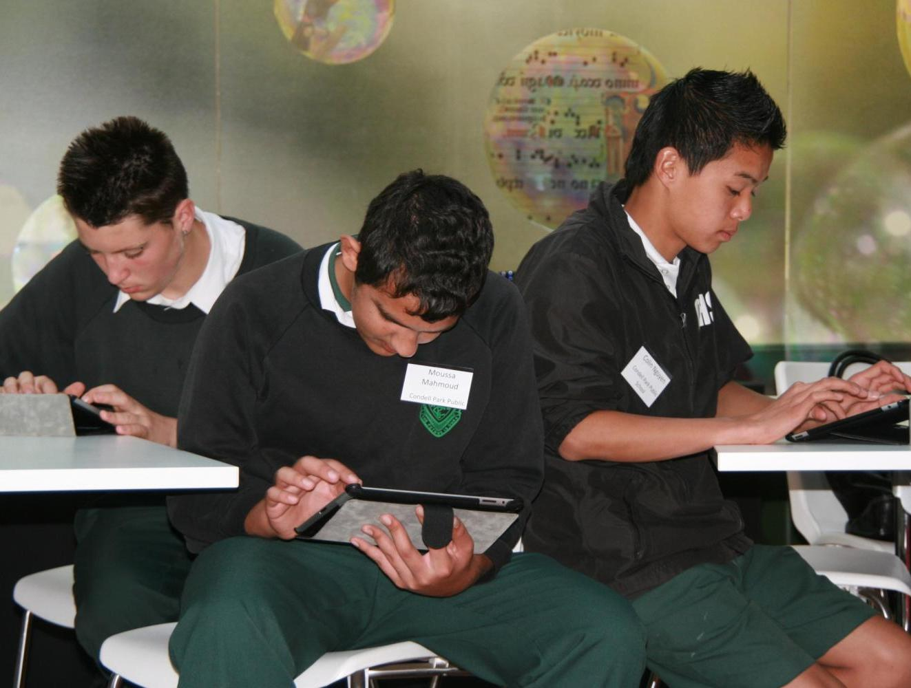

Slide 17
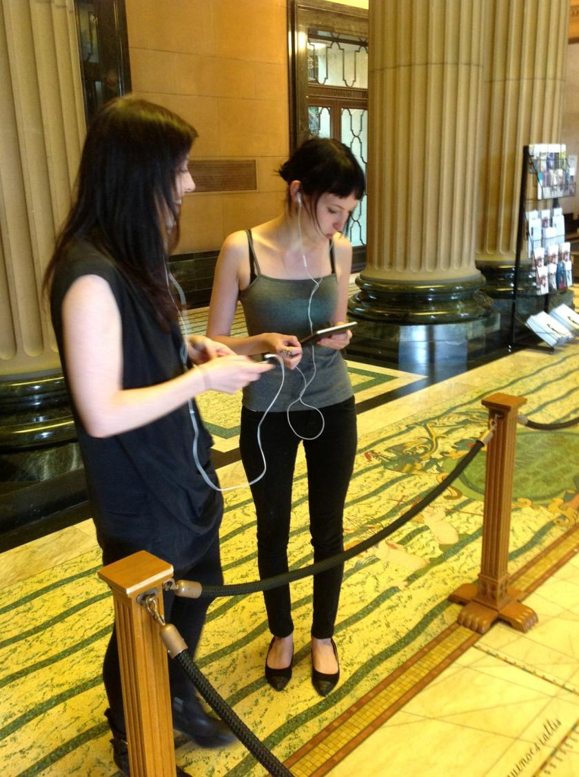

Slide 18
Mobile Multimedia Guide =
using a mobile device, the onsite visitor moves around the building and galleries and, relative to their physical location, access multimedia content about the building fabric, architectural elements, artworks and objects

Slide 19
Content development =
provoking emotion
encouraging free thought and debate
creating a memorable experience for the visitor

Slide 20
Curio live =
with 3 guides:
the Mitchell Wing Discovery Tour
AMAZE Gallery: a new permanent exhibition space
Greatest Wonder of the World: a temporary photographic exhibition

Slide 21


Slide 22
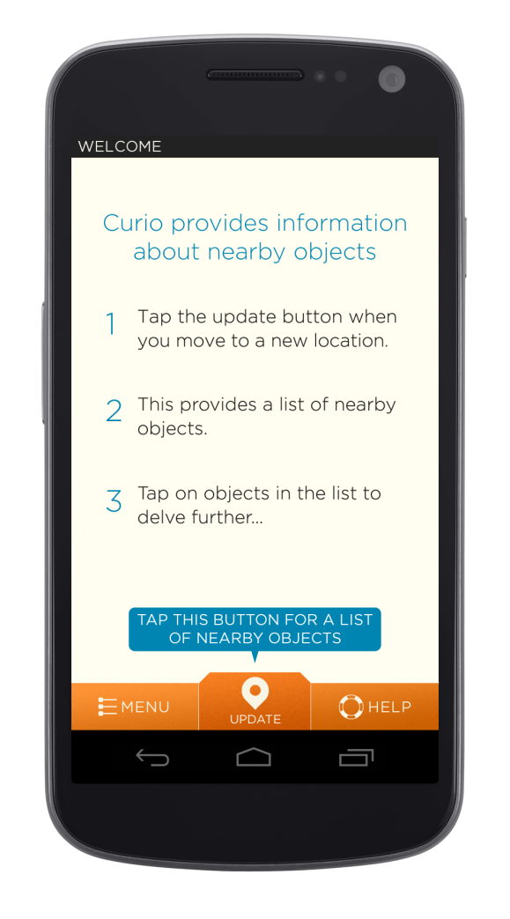

Slide 23
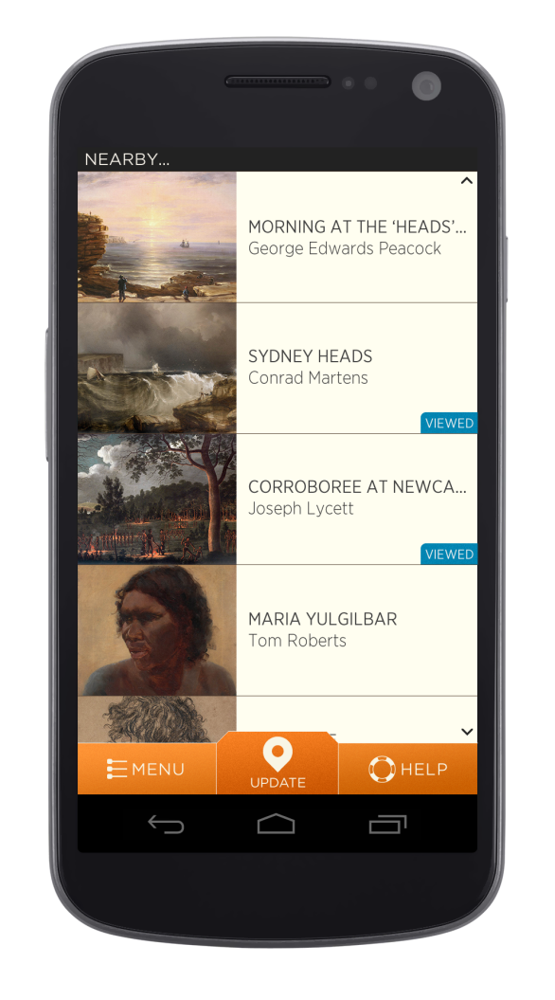

Slide 24
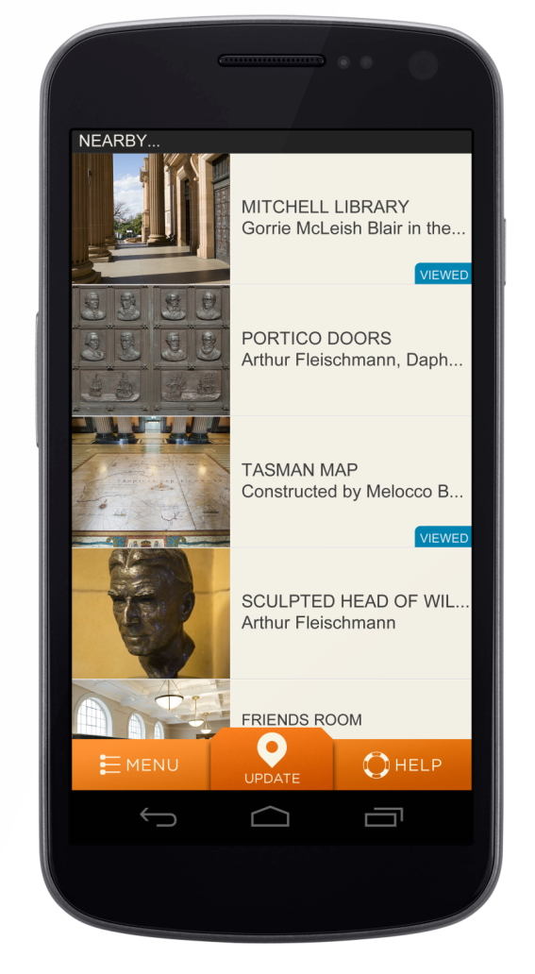

Slide 25
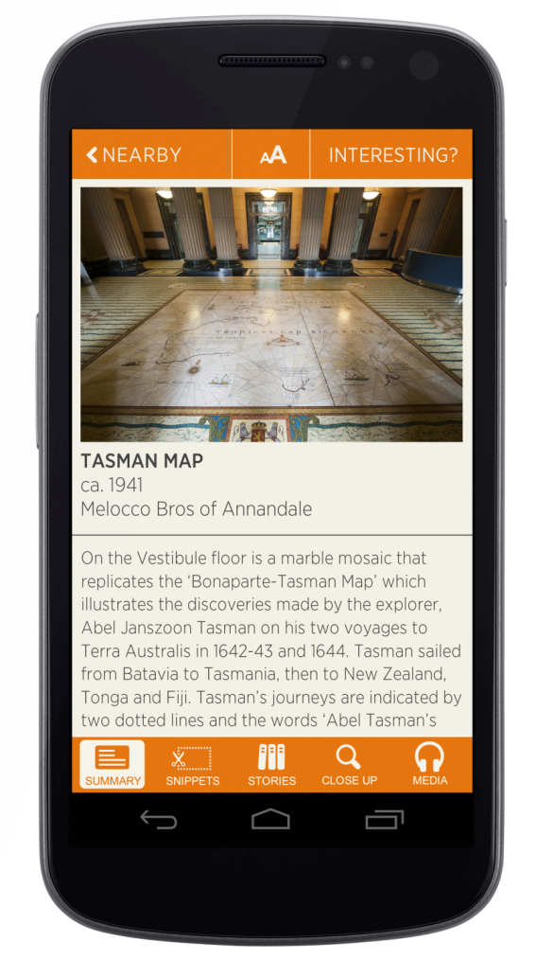

Slide 26
Summary =
artist, year, format, catalogue record and short description

Slide 27
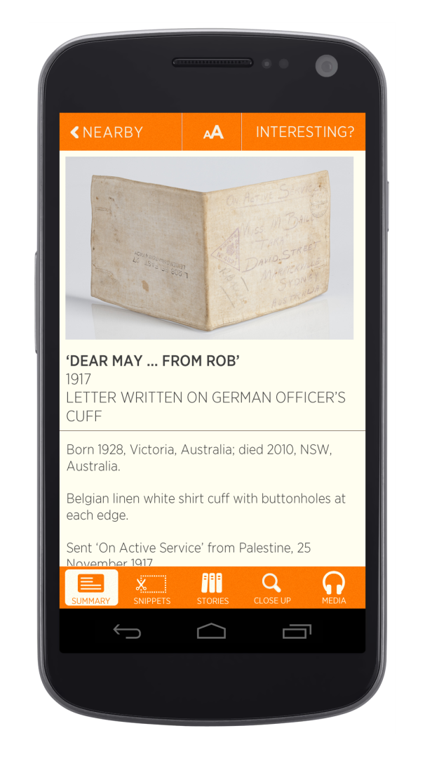

Slide 28
Snippets =
short, easily digestible
snippets of information about objects and artworks

Slide 29
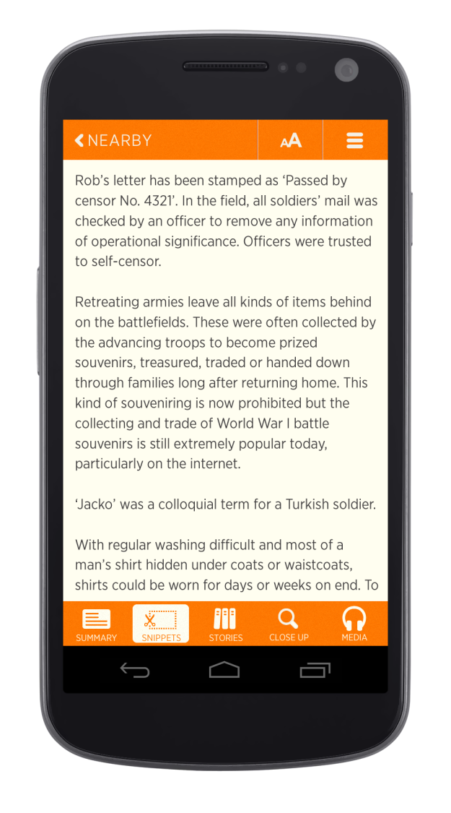

Slide 30
Stories =
engaging pieces of information about the maker, an opinion on the object or about someone featured in the object

Slide 31
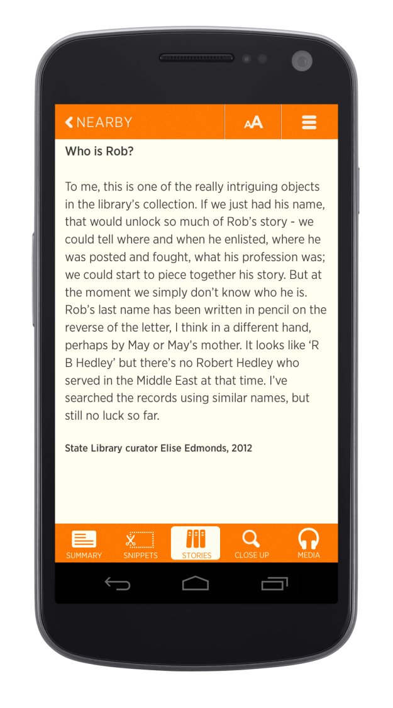

Slide 32
Close up =
refers the visitor to a detail of the object, thus drawing attention back to the object itself and away from the device

Slide 33
Media =
aggregates all the audio
and video used in the tabs

Slide 34
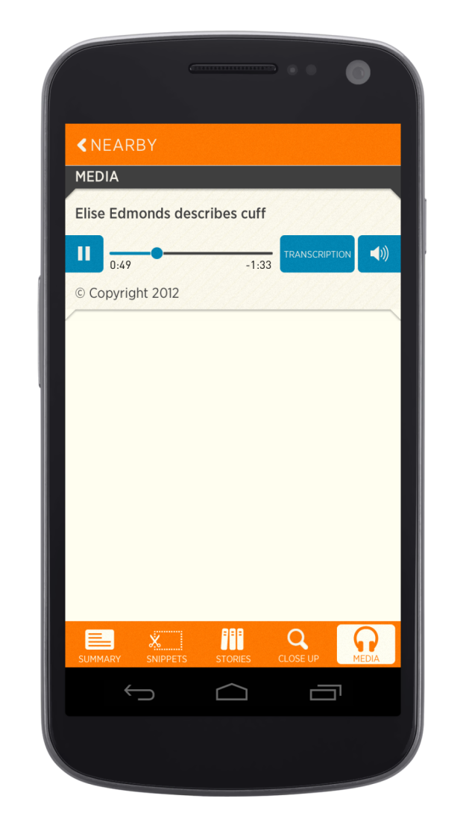

Slide 35
Rating system =
visitors provide instant feedback on specific objects
a range of context-sensitive, real-time statistical responses

Slide 36
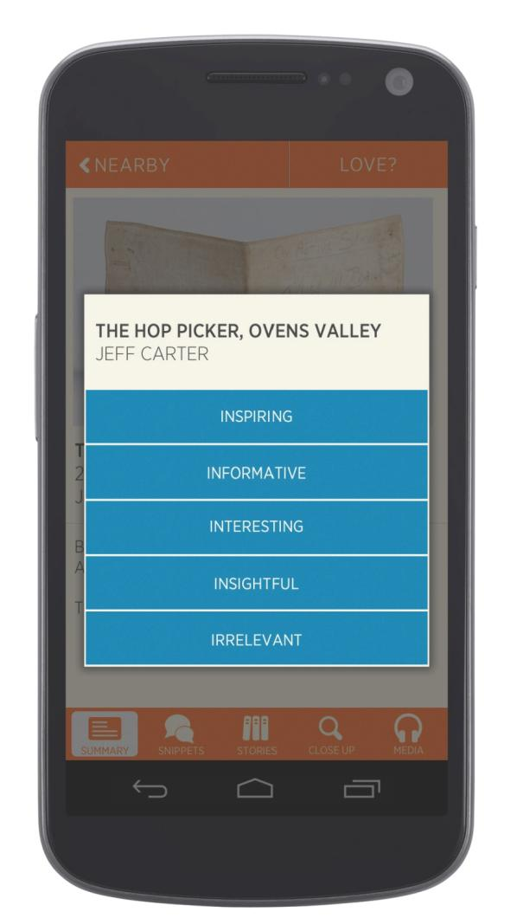

Slide 37
Saved tour website =
virtual tours include each of the objects the visitor viewed, as well as the objects they missed

Slide 38
Analytics =
objects viewed
how long they were viewed for, and
what rating they were given
visitor movement and exhibition pathway data

Slide 39
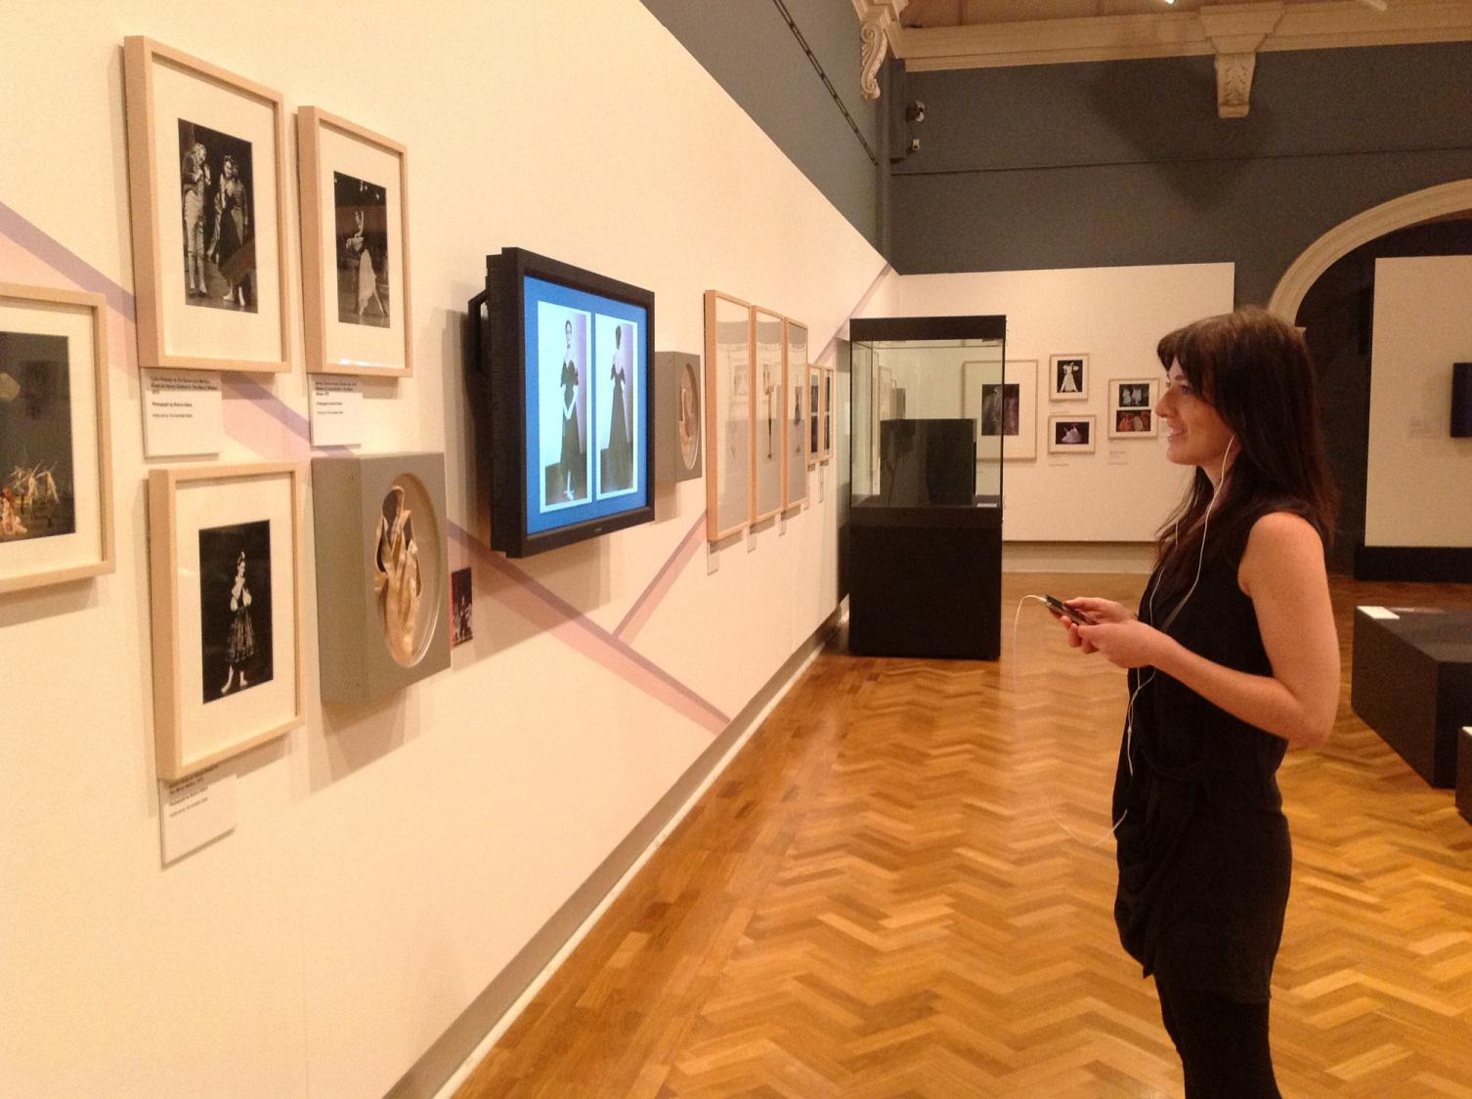

Slide 40
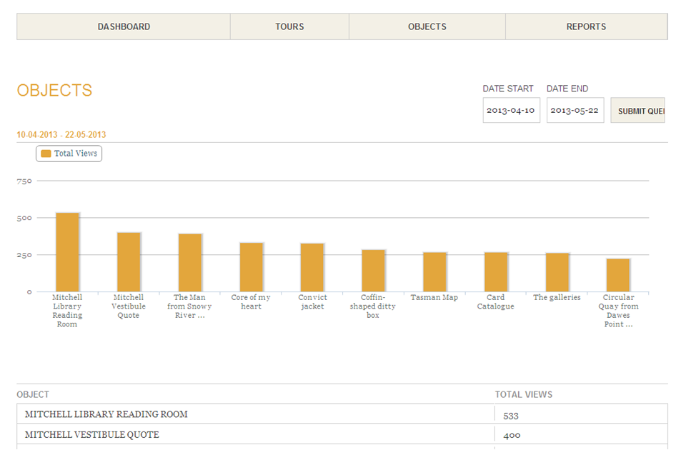

Slide 41
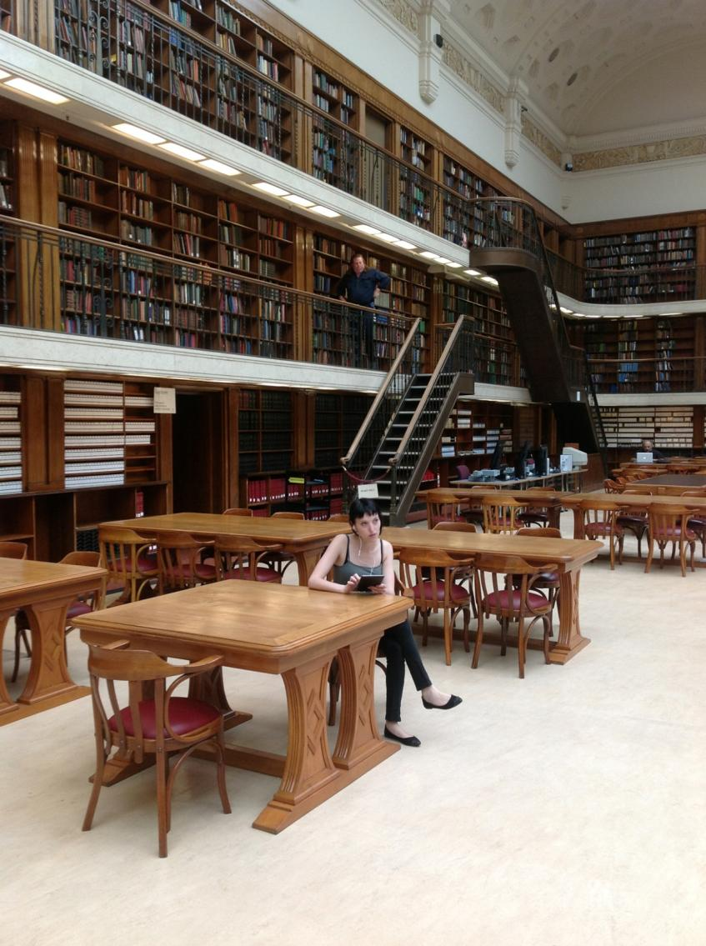

Slide 42
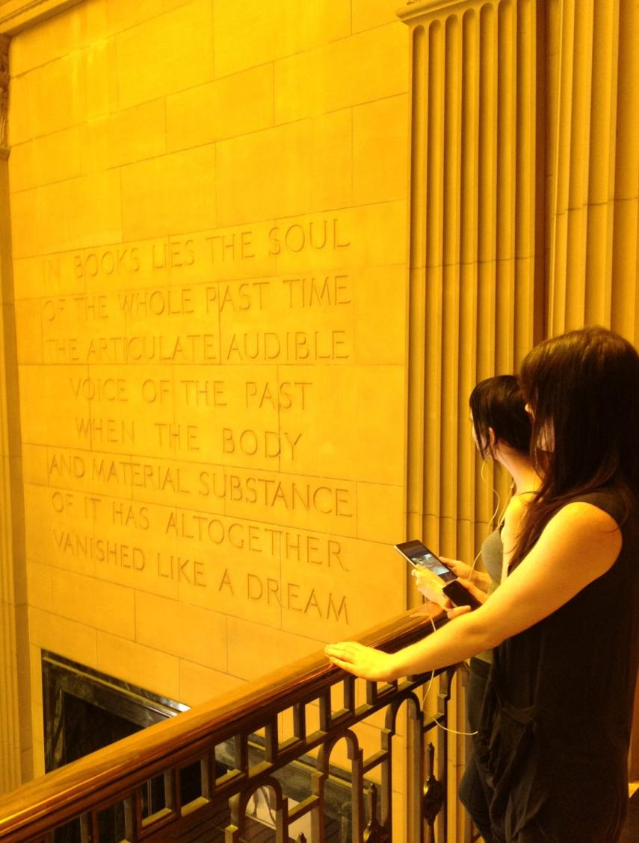

Slide 43
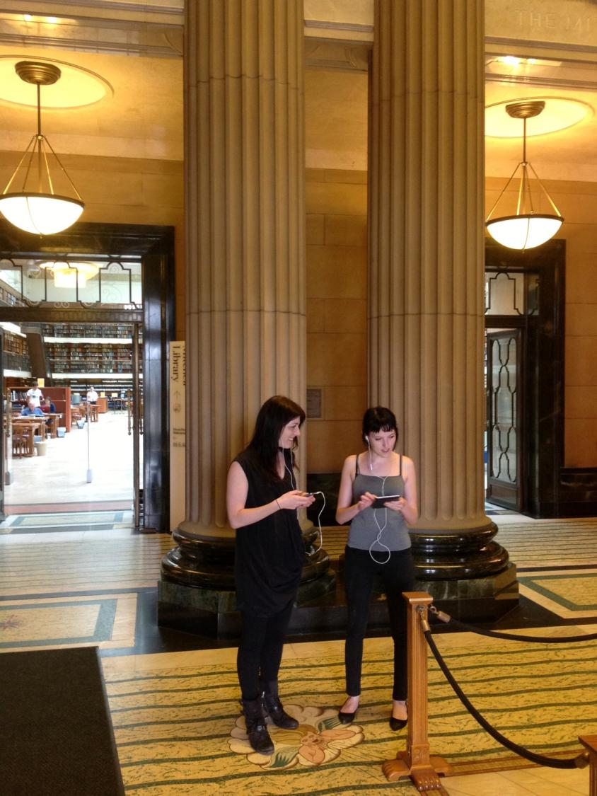

Slide 44
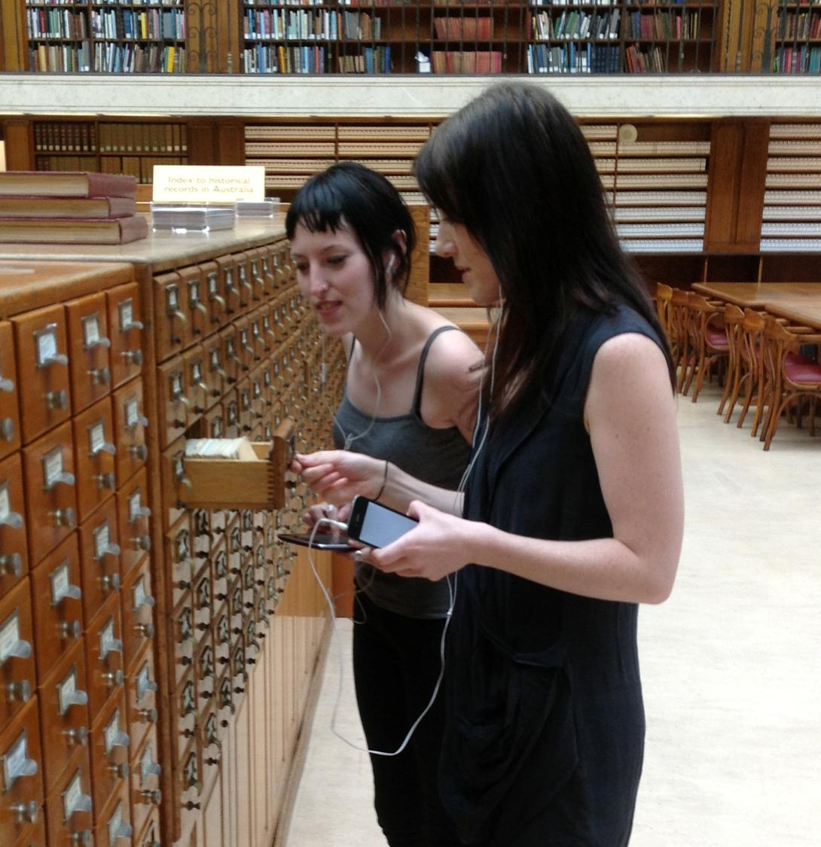

Slide 45
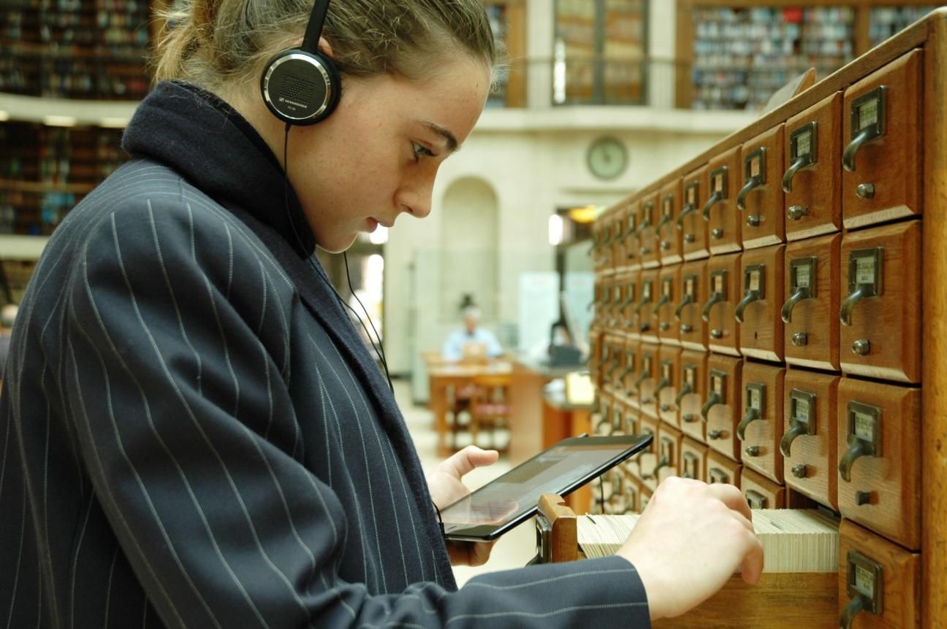
6 June 2013 = Did they listen to us?

Slide 46
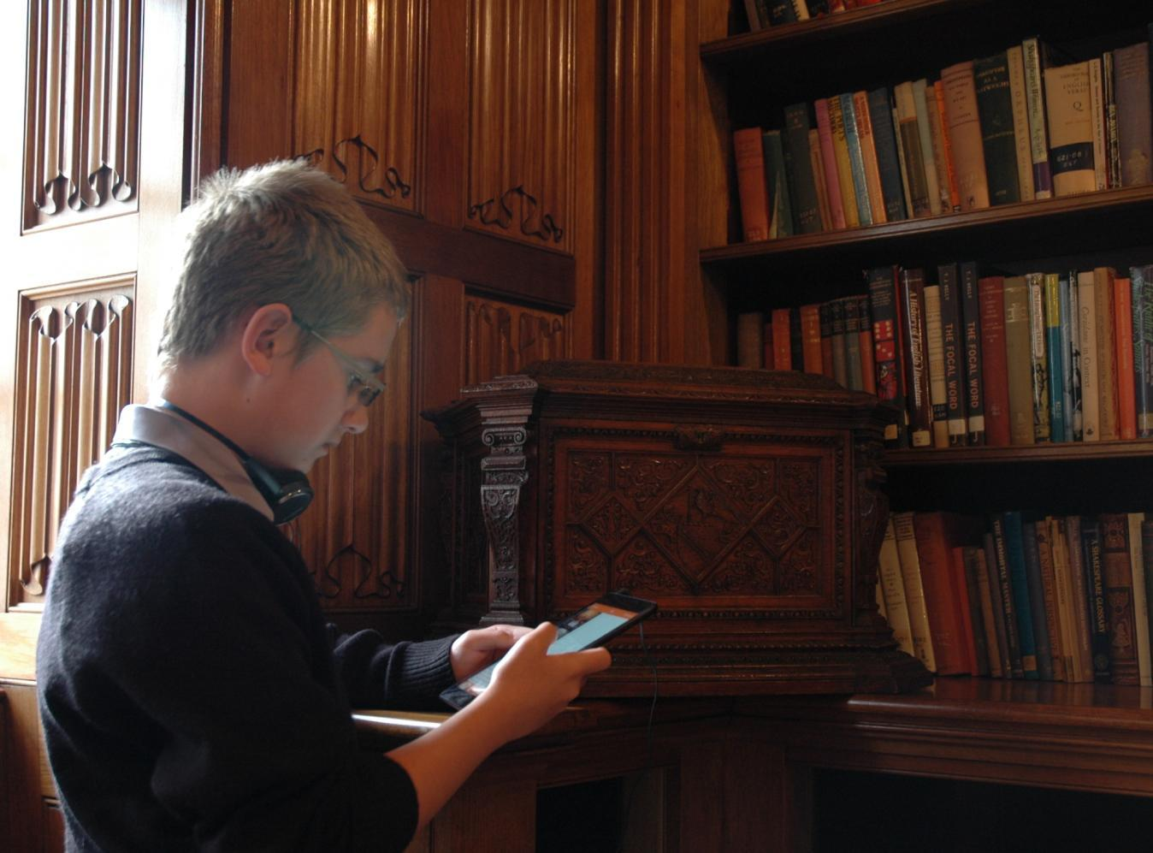

Slide 47
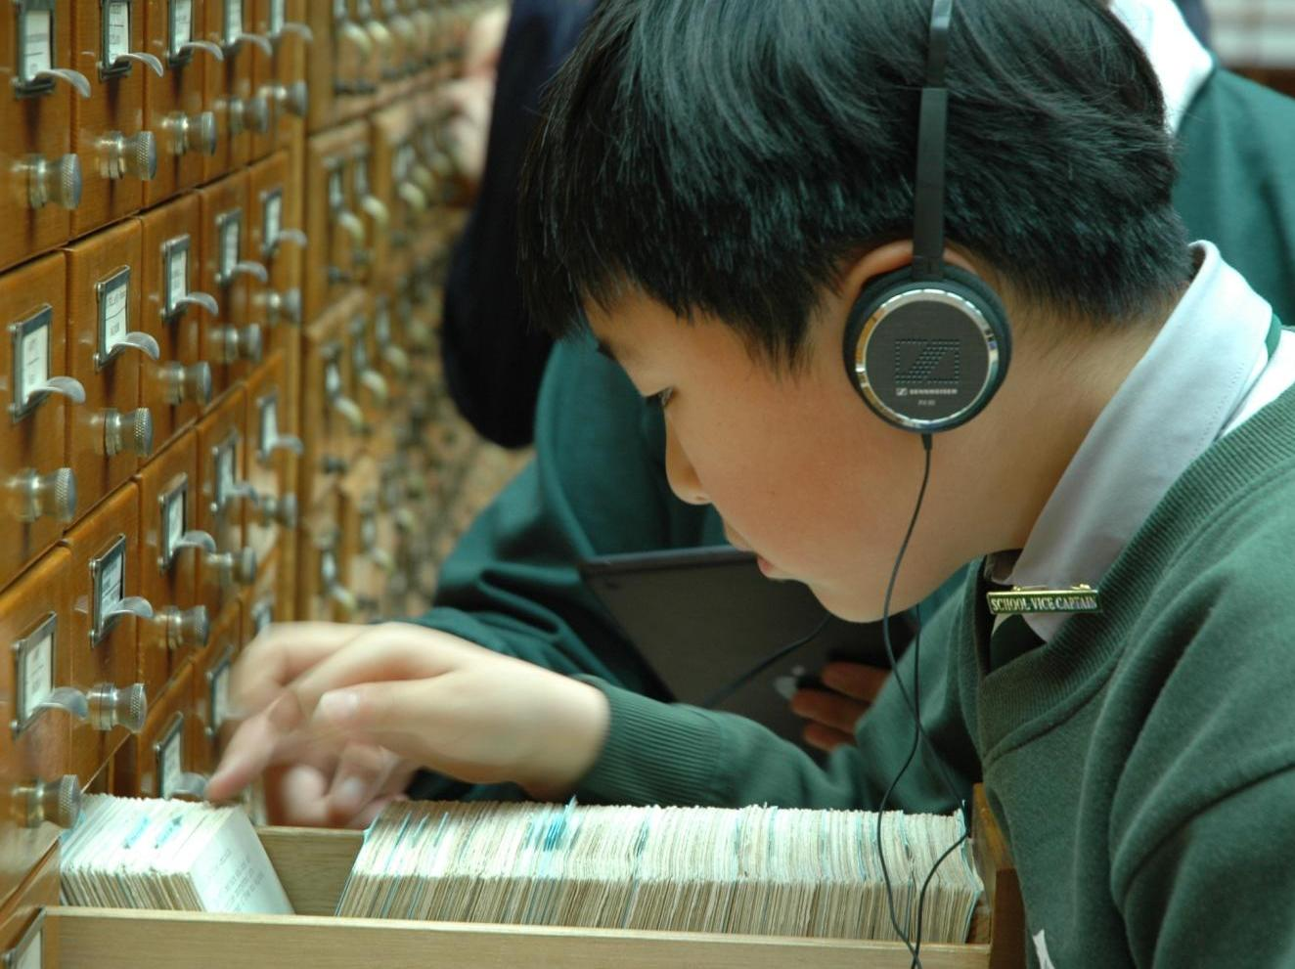

Slide 48
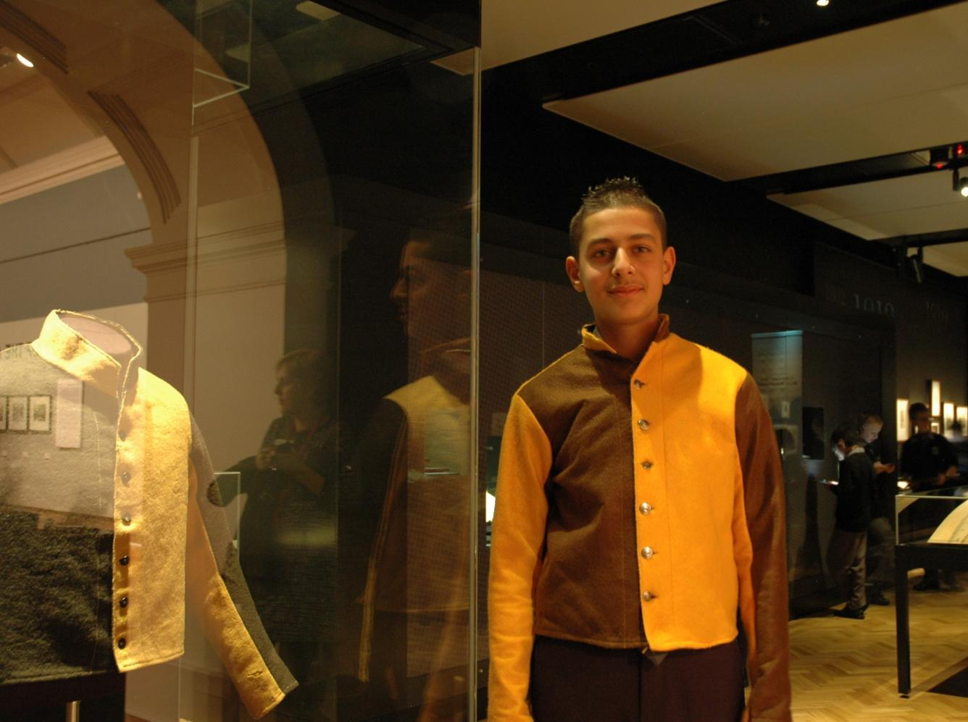

Slide 49
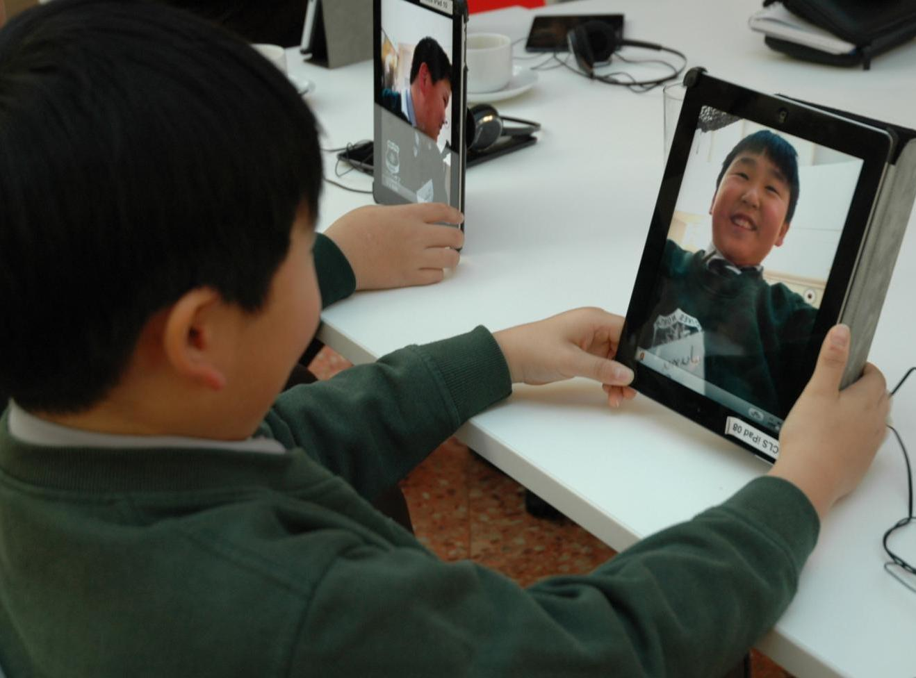

Slide 50
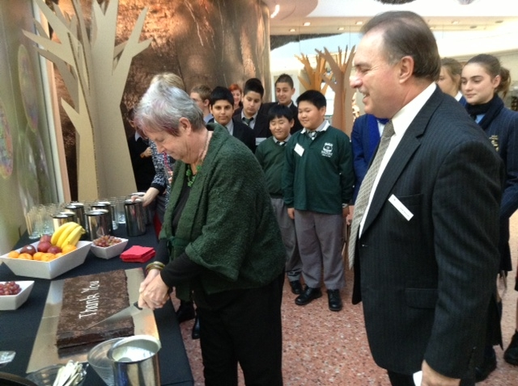
Thank you +

Slide 51
Feedback =
Click on the links to watch videos:
Ava
Joshua
Tark

Slide 52
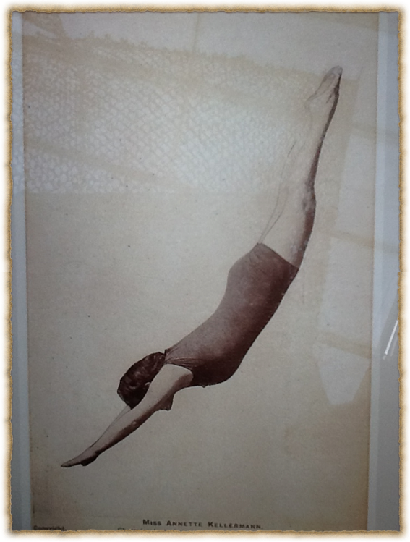
Kids as Curators =
I chose this item because I love sports and this is a postcard of Annette Kellermann who was one of the first Australian female Olympians. I believe this item needs to go into the gallery as it is a great example of how not only men are great at sport, women can be just as good, if not better! Ava

Slide 53

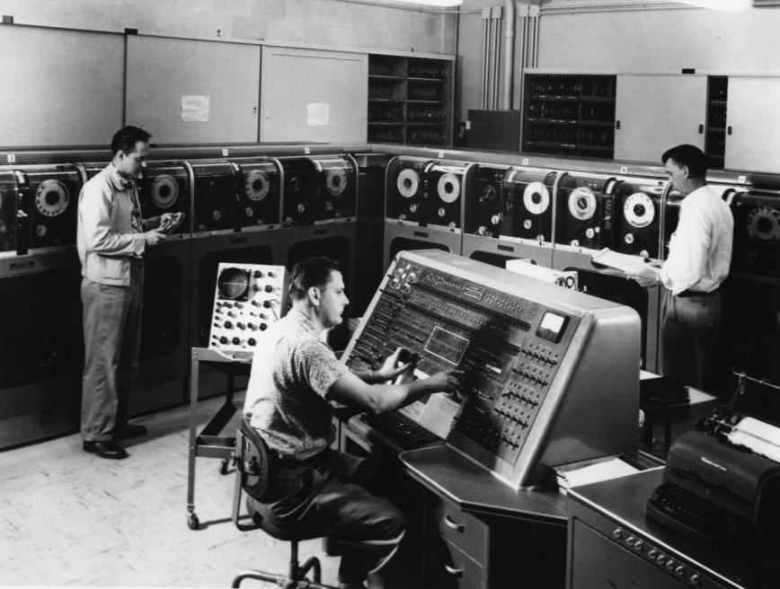
My chosen item is early computers I chose them because I take interest in the topic of technology and gaming and they both mesh together like gears and so I chose this.
Ishan

Slide 54
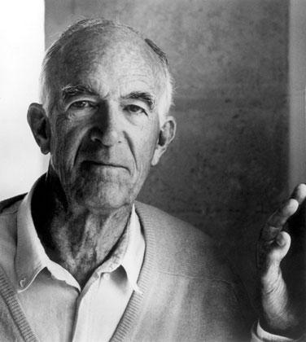
My name is Jackson (Jacko). I was born Sydney, Australia 1999, so I am thirteen. I am just about 1/3 (or something) indigenous. I chose Jorn Utzen because I was inspired by the way the Opera House was built and then I thought to myself, who was the creator of this magnificent building!
Jackson

Slide 55
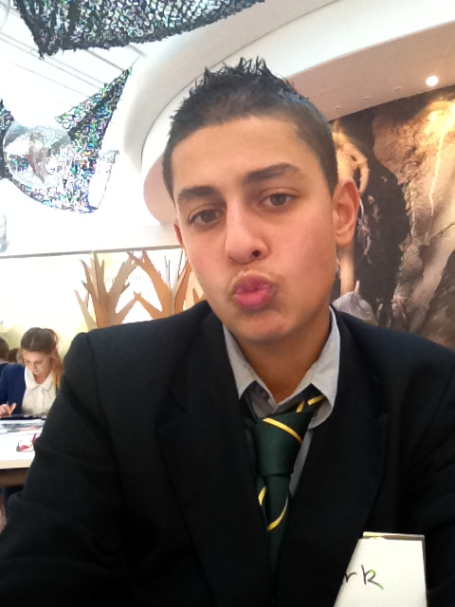
Hi my name is Tark Hamze. I am 13 years old
One of my favourite subject is Science and also English . I like to hear music and I play an instrument that's called trombone. Me and my mates are going to perform at the Opera House at September and I would like yous to come and watch us play. I love coming to the State Library too because it’s interesting.

Slide 56
Thank you
mperry@sl.nsw.gov.au
lprichard@sl.nsw.gov.au

Slide 57


