Slide 1
5 years on from the UK National Year of Reading
What now for literacy and libraries?

Slide 2
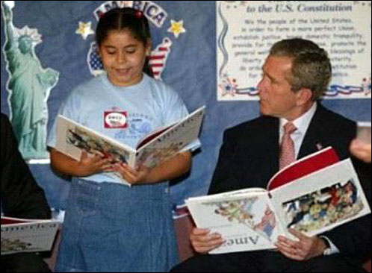

Slide 3
Who we tried to reach during NYR?
Primary audiences identified by government
(performing least well in reading)
  Early years
  Boys
  Teenagers
  Black and Minority Ethnic communities
  Disabled children (and parents)
  Parents and carers of younger children, with a focus on working class fathers
  Adult learners
Notes:
These are the areas of society we need to make our messages work for.
I am sure they will look very familiar to you – as those needing most support and encouragement in reading.
Most important of all are young, working class teenage boys.

Slide 4
How we did this
National campaign delivered through research, consumer messaging and relevant brand partnership
Local authority projects and programmes addressing target audiences
Thousands of initiatives in schools and libraries across the country

Slide 5
If you have poor literacy you are
More likely to live in a non-working household
  22% of men and 30% of women with literacy below entry level 2 live in nonworking households.
Less likely to have children
  Individuals with low levels of literacy are more likely to lead solitary lives without any children.
Less likely to own your own home
  A modest rise in literacy level sees the likelihood of a man owning their own house rise from 40% to 78%.
More likely to live in overcrowded housing
  Individuals with low literacy levels are more likely to live in overcrowded housing with reduced access to technology.
More likely to experience divorce
  A literate family is less likely to experience divorce, as divorce rates amongst those with high literacy are low, and significantly lower than those with poor literacy skills.

Slide 6
Reading…
Reading skills: Getting stuck at 84%
The gender and social class gap in reading and writing
Where’s the pleasure gone?
Who wants to be a reader?

Slide 7
45%
of young teens are reprimanded by adults (parents/teachers and others) for reading something which ‘isn’t good for them’*
*NYR ‘Read Up, Fed Up’ research 2008
Notes:
But – adults and young see the reading world differently.
(45% stat here)
There seems to be too much concern with reading as ‘self-improvement’ and not on reading for fun.

Slide 8
What we achieved
  2.3million new library members
  An increase in the children saying they read with their mothers every day (17% to 32%)
  An increase in the number of fathers reading every day (19% to 25%)

Slide 9
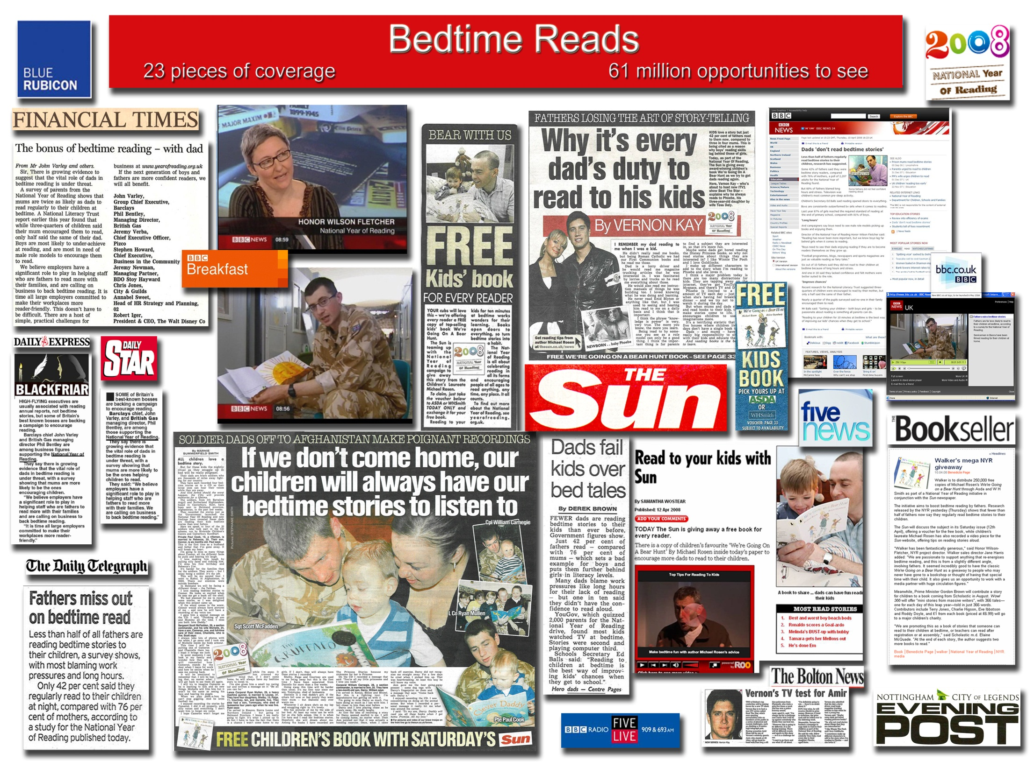

Slide 10
What we achieved working with disadvantaged groups*
Higher number of parents from disadvantaged groups knew about the NYR than the wider population
Increase in membership of public libraries amongst parents from poorer backgrounds (from 58% to 70%)
These parents now are more likely to be reading to their child every day (15% to 20%)
*Parents from socio economic groups C2DE

Slide 11

Haven Holidays
Haven Holidays owned by Bourne Leisure is a well-established caravan holiday park brand with 35 parks across the UK
Haven offer affordable family breaks, with family entertainments in the complex a central part of the offer
Roughly 94% of Haven visitors bring their children
46% of visitors to parks fall into the C2DE demographic
81% of visitors to parks fall into the C1C2DE demographic

Slide 12
Haven Holidays
  What does a business look for in a partnership? What was the
  attraction for Haven?
  Offering added value to guests
  An experience our guests will value
  Guests to leave with a “cuddly feeling” about the brand
  Delivering an experience to guests and exposing them to new things e.g. fencing, Annabel Karmel’s Creative Kitchen, learning to swim
  On a practical level
  Something simple to implement
  Support from the National Literacy Trust

Slide 13





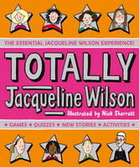


What did the partnership deliver?
Great Family Escapes campaign
18,000 book goody bags containing 7 books were distributed across 35 Haven Holiday parks
Campaign reached 37,200 children and around 55,620 adults
Conducted substantial field research
informed by two quantitative surveys to
holiday makers, 47 qualitative interviews and
20 follow up phone interviews

Slide 14
Changing how we promote reading
Shift from consultation to participation
Promoting reading as a social development tool
Links to other kinds of social activities
A real commitment to communities and diversity
Understanding how reading delivers national priorities
Notes:
Story about lady who was able to buy correct shoes
Investment from corporate marketing budgets.

Slide 15
Austerity
Community library managements
Schools library services have been decimated.
Growth in school populations
Notes:
Initial cuts to libraries not as bad as feared but the 2nd waive likely to be worse. No quality control for community run libraries and no strategic social policy framework
Schools library services have seen 30% reduction in 3 years and no sign of this trend stopping
School libraries are being converted into classrooms because of population growth.
The most disadvantaged children and young people are now less likely to encounter a library.

Slide 16
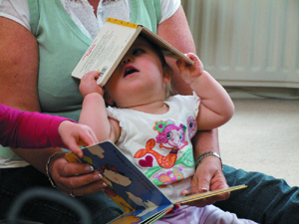
Literacy Action Zone
Notes:
16

Slide 17
Literacy Action Zone- Middlesbrough
10 year programme
Public campaign
40% of adults in Middlesbrough struggle with literacy.
Notes:
17

Slide 18
Literacy Champions
Developed through our community work in Rochdale to raise the literacy levels of vulnerable families
Community resources being used to raise community literacy levels
Local coordinator recruits and trains a group of literacy volunteers who have strong community reach
Focus of their work – practical support for the home learning environment and increase in parental confidence, themes echoed in the Tickell & Field Reviews

Slide 19
Impact
Model has been through a SROI process and is being evaluated by Sheffield University
95% of beneficiaries had improved their literacy and communication skills
63% recorded increased competence and/or confidence as a parent
13% reported better family relationships

Slide 20
Literacy Champions in London
12 authorities
450 volunteers recruited from a diverse base
1600 families benefited
Quality control and support for volunteers
London Literacy pack available for every London early years setting and family
84% of parents felt the project would have a long terms impact on their child’s reading
Notes:
This model is being replicated informally.

Slide 21
Advocacy for libraries
Campaign for libraries
1000 libraries are predicted to close by 2016.
Time of crisis.

Slide 22

Children’s Laureate
And as I would never have become an author if it hadn't been for my local library as a child, I intend to continue Julia Donaldson's amazing, indefatigable work advocating for our nation's public library service.'

Slide 23

Thank you!
Follow jdliteracytrust on Twitter
Befriend National Literacy Trust on Facebook
Jonathan.douglas@literacytrust.org.uk
www.literacytrust.org.uk
www.wordsforlife.org.uk

