Slide 1
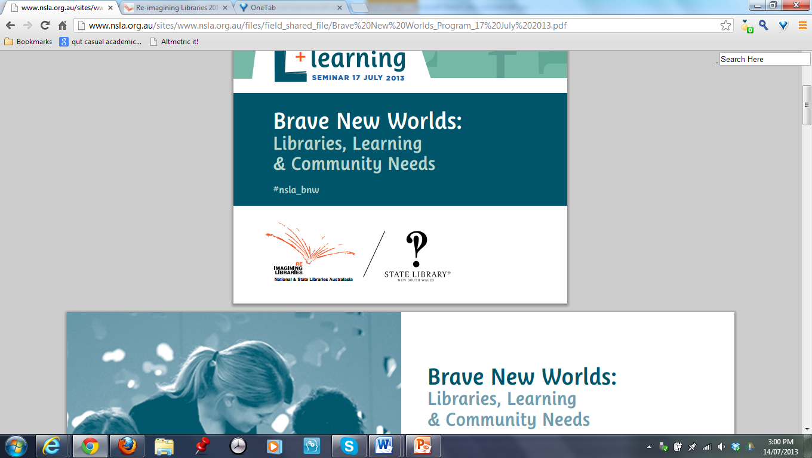
The learning institution maturity model
A self-evaluation tool for future planning in NSLA libraries
Gillian Hallam
NSLA Brave New Worlds
Sydney, 17 July 2013

Slide 2
Overview:
The learning institution maturity model
Who? NSLA Literacy and Learning Group (LLG)
Why? Background to the project
What? The project brief
How? What did we do?
What did we end up with?
What can we do with it?

Slide 3
Background to the Maturity Model project
Late 2010: NSLA Literacy and Learning Working
Group (LLG) established
May 2011: Project initiation workshop to explore
the issues:
  Society does not have a ‘habit of learning’
  Society thinks that ‘learning’ only happens in a formal learning environment
  Low literacy leads to low participation in society
How might NSLA libraries make a difference?

Slide 4
The LLG’s focus
The central role of libraries: helping people…
  …to learn
  …to develop the skills to engage with knowledge and ideas
  …to participate actively in society
July 2012: Position statement on literacy and learning

Slide 5
LLG position statement
Literacy is
“a skill that includes not only the individual ability to decode and encode in a medium, but also the social
ability to use the medium effectively with others”
(Rheingold, 2012)
NSLA libraries are well positioned to bring learning networks together, acting as catalysts for dynamic community enterprise
The LLG’s work combines:
  Advocacy: promoting the role of libraries in formal and informal education
  Development of organisational capability as learning organisations
  Best practice for library programs and partnerships

Slide 6
Issues for LLG
How to recognise and articulate these elements:
  The ‘role of libraries in learning’
  ‘Organisational capability’ as a ‘learning institution’
  ‘Best practice’ programs and partnerships
Diversity across the members of NSLA
  Need to understand the continuum of development
  To visualise the potential pathways to maturity
  To formulate strategies for evaluating literacy and learning programs
Formalised as a work package document to create a ‘maturity model’

Slide 8
The project brief
A self-evaluation matrix to enable libraries to assess their perceived stage of maturity as ‘learning institutions’
  The delivery of literacy and learning programs for constituent communities
  Constantly evolving organisational understanding and practice of the power of learning
To allow for peer review
  Critical friends
  Formal evaluation of specific programs
A tool for shared understanding about:
  Where we are now
  Where we are hoping to go
To lead to productive outcomes in terms of developing capabilities that are identified and valued by
  Our staff – the ‘internal’ perspective
  Our communities – the ‘external’ perspective

Slide 9
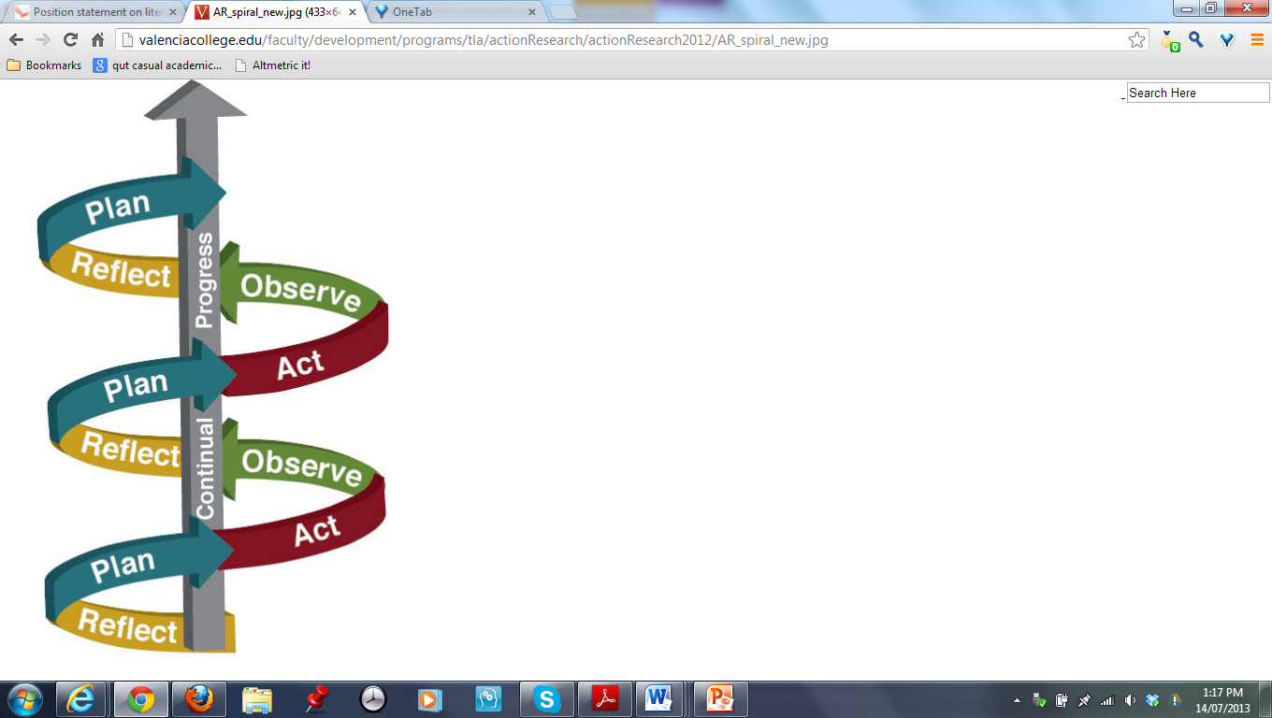
An iterative process

Slide 10
Literature review
  Learning organisations
  Maturity models
  Measurement tools
Senge’s five disciplines (Senge, 1990, 2006)
INVEST model (Pearn et al, 1997)
Iterations of the maturity framework – mainly the ‘internal’ organisational perspective
Essential to have the ‘external’ community lens

Slide 11
Senge – five disciplines
  Personal mastery
  Mental models
  Shared vision
  Team learning
  Systems thinking
People are the active force of the organisation
Collective vision & common aspirations
Team learning to achieve the goals
All elements need to be interconnected

Slide 12
INVEST model (Pearn et al, 1997)
Six factors
  Inspired learners
  Nurturing culture
  Vision for the future
  Enhanced learning
  Supportive management
  Transforming structures
Strong focus on:
  The enhancers and support mechanisms that facilitate sustained continuous learning
  The inhibitors or blocks to learning that need to be identified and removed

Slide 13
What sort of framework
Five-level framework?
Four-level framework?
Australian Professional Standards for Teachers?
Individual – group – organisational levels?
The bifocal lens: internal and external perspectives?
‘There is no right model’
‘There is no cookbook approach’
‘No magic bullets for building learning organisations: no formulas, no three steps, no seven ways…
(Senge, 2006, p.283)

Slide 14
LLG activities
Draft the model
Conference calls
Review and refine the draft
Skype meetings
More reviewing and refining
Face-to-face discussions
Review and refine further
Workshop in Brisbane

Slide 15
Distillation in Brisbane
Concerns over blurred boundaries between the elements in the model
  6 elements were reduced to 3 elements
    Learning and learners
    Vision and culture
    Management and structure
Different ideas about the nomenclature for the stages in the matrix
  Use the dimensions of higher learning
    Starting
    Knowing
    Doing
    Being
Working through the internal and external lenses

Slide 16
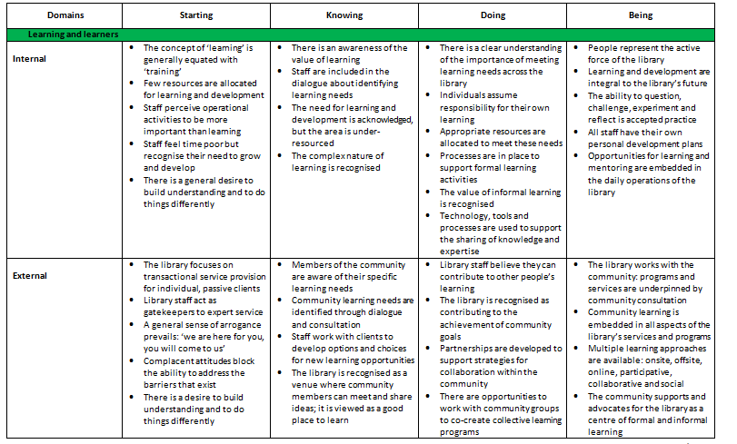

Slide 17
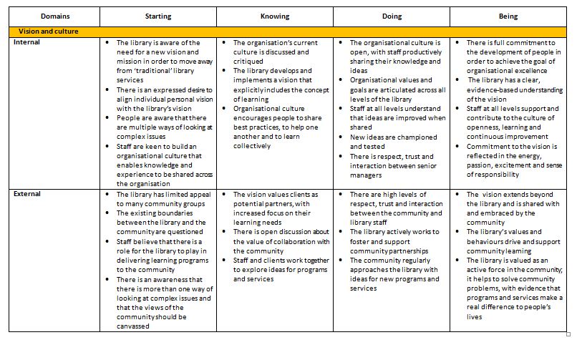

Slide 18
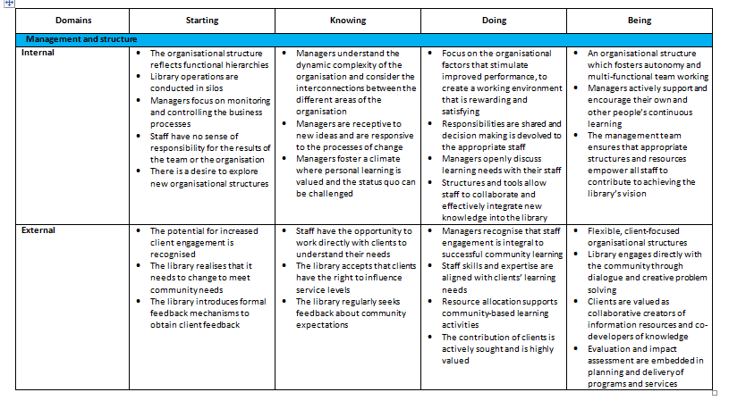

Slide 19
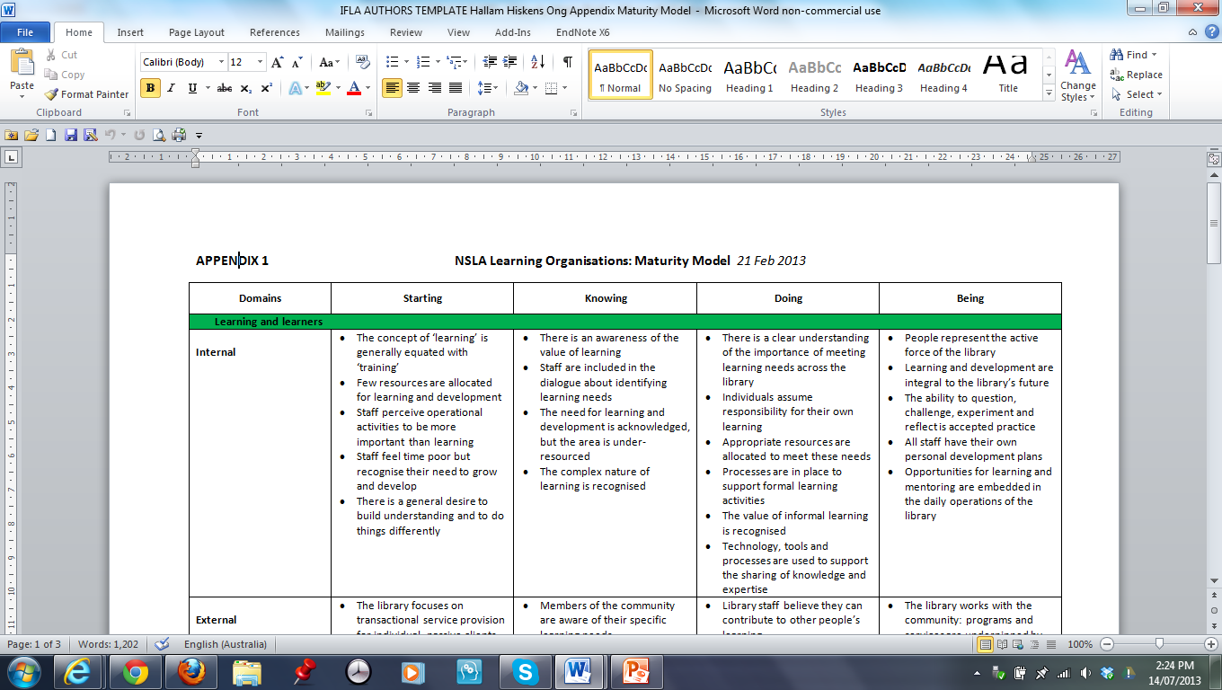
A closer look at
Learning and learners: the internal lens

Slide 20
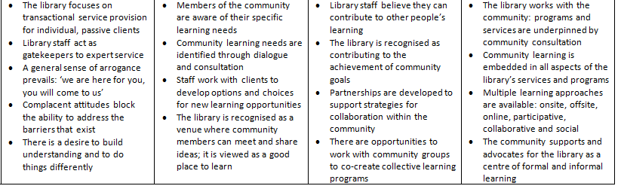
Learning and learners: the external lens

Slide 21
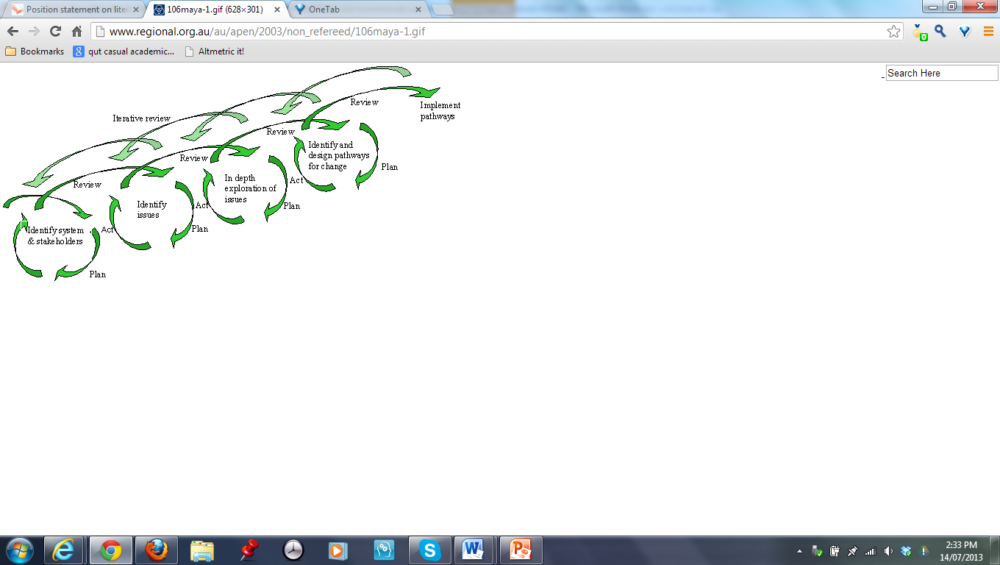
Where we are now?
Participatory action research model
Image: www.regional.org.au/au/apen/2003/non_refereed/106maya.htm

Slide 22
Current activities
Introducing the matrix to the NSLA member libraries
Each member of the LLG will trial the model in some way in their organisation
  At an individual or a team level
  Different areas of the library may be at different
  levels of maturity
Need to determine how to use the model
  How to apply the concepts – a diagnostic tool?
  How to monitor and evaluate its use?
  How to share results?
  Critical friends as part of the peer review process
LLG meeting tomorrow
International discussions at IFLA (19 Aug 2013)
Further discussions at QUT symposium (1 Nov 2013)

Slide 23
Ultimate goal
To help individuals, their colleagues, managers and the community contribute to, sustain and benefit from libraries as learning organisations
To help each individual understand the contribution they can – and do – make to achieving the shared vision for the organisation
To ensure that staff – and clients -
“are engaged and accountable; they appreciate change; accept challenge; are able to develop new skills; and are committed to the organization’s vision and values”
(Giesecke & McIntyre, 2004, p.55)

Slide 24
Summary
Creating the matrix was a complex task:
  To adapt a multi-layered concept of a learning organisation – predominantly in the business sector - for the library environment
  To distil this into a ‘simple, elegant, logical
  and memorable framework’
Iterative development of the maturity framework actually models the concept of the evolving learning organisation
The maturity model promises to be a valuable tool in this brave new world of literacy and learning

Slide 25

Questions or comments…
Contact me: g.hallam@qut.edu.au

Slide 26
References
Giesecke, J. & McNeil, B. (2004). Transitioning to the learning organization. Library Trends, 53(1), 54-67.
NSLA (2012) Position statement on literacy and learning.
www.nsla.org.au/publication/position-statement-literacy-and-learning
Pearn, M., Roderick, C. & Mulrooney, C. (1995). Learning organizations in practice. London: McGraw-Hill.
Rheingold, H. (2012). Syllabus: Social media literacies. MIT Press. http://mitpress.mit.edu/files/rheingoldsyllabus.pdf
Senge, P. (1990). The fifth discipline: The art and practice of the learning organization. New York: Doubleday.
Senge (2006). The fifth discipline: The art and practice of the learning organization (Rev.ed.). Milsons Point, NSW: Random House.

