Slide 1
Brave New Worlds: Libraries, Learning & Community Needs
State Library of NSW, July 2013
Enhancing online learning:
Promoting student engagement through partnership with local libraries
Dr Cathy Stone, Director, Student Success
Open Universities Australia

Slide 2
About Open Universities Australia
Offers open entry, online higher and tertiary education
Over 250,000 students across Australia since 1993
Owned by 7 Australian universities (Curtin, Griffith, Macquarie, Monash, RMIT, Swinburne, UniSA)
Offers over 1700 units and 180 qualifications from more than 20 higher education and VET providers
  Qualifications awarded by the university or tertiary institution
  Qualification is identical to that awarded to an on-campus student

Slide 3
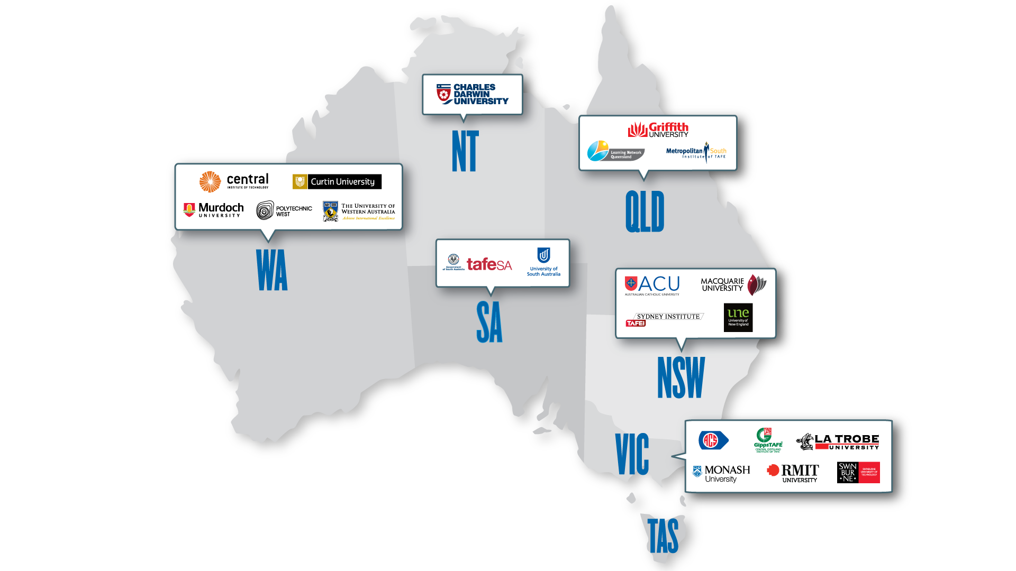
The OUA family

Slide 4
Students by state
VIC, NSW, QLD dominate, but all states and territories represented
Notes:
As the national leader in online higher education, OUA students come from all states across Australia including metro and regional areas

Slide 5
How and what do our students study?
  FEE-Help
  Commonwealth scheme which allows deferred payment of fees.
  Over 70% of OUA students use FEE-HELP
  Wide range of units and courses:
    Arts & humanities
    Business
    Education
    Health
    Information Technology (IT)
    Law & justice
    Science & engineering
  Most common study pattern
  Students enrol in individual undergraduate units and can track towards a full qualification.

Slide 6


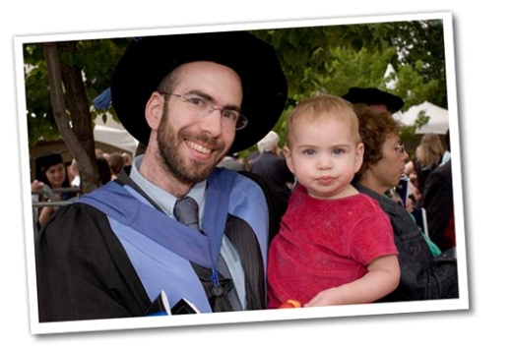

Our students are a very diverse bunch!

Slide 7
OUA students “non-traditional”
Relatively few come straight from school to study with OUA
Mostly mature-age (>21), in paid employment and/or with parenting responsibilities
Around half of OUA students are first in family to come to university
OUA students have multiple responsibilities, often with little prior educational experience, combined with lack of time, money or both….

Slide 8
Importance of student engagement
Student Engagement is closely linked
with student satisfaction & success
(Australasian Survey of Student Engagement; ACER, 2008, 2009, 2010)
Student engagement in educationally
purposeful activities is positively related
to academic outcomes.
(Kuh et al., 2008)

Slide 9
Online Student Engagement Challenges
How do we engage with students in a meaningful way when we never see them face-to-face?
How do we help students engage with each other when they never come together as a group?
How do we engage them with a learning community when they may be studying across two or more institutions?

Slide 10
‘OUA Connect’ Pilot - 2012
  Promoted 4 local libraries in NSW (Wyong & Shellharbour) as places where OUA students could:
  access library resources
  learn about library resources and access to other services
  network with other OUA students
Delivered a training session and provided information about OUA, its study patterns etc to library staff to better assist OUA students
Evaluated the program based on student attendance as well as student and library staff satisfaction
Notes:
(in Wyong and Shellharbour regions)
including internet and computers
and how to access them

Slide 11
Roles and responsibilities
Libraries
  Information sessions for OUA students
  Information about OUA & provider resources and how to access them
  Introduction to library resources and how to access them
  Basic level IT assistance to navigate the online educational environment
  OUA
  Provided training session and ongoing contact and support to library staff
  Supply of OUA information and resources to libraries
  Provision of data collection sheets
  Publicising library sessions to OUA students via eDMs & social media
  Evaluation, analysis and reporting on outcomes of pilot

Slide 12
How did the pilot operate?
Program advertised and promoted to all enrolled OUA students whose postcodes fell within the Wyong and Shellharbour regions
Information sent by email to each student individually at start of study period, with reminder a few weeks later
Use of social media (OUA Facebook and Twitter) to remind students about the program and encourage them to attend

Slide 13
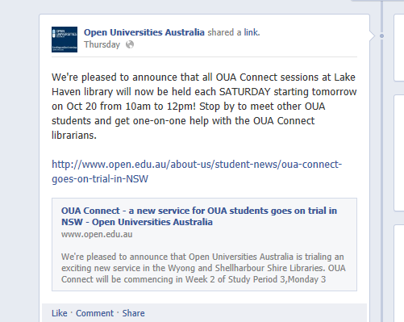
Facebook posts

Slide 14
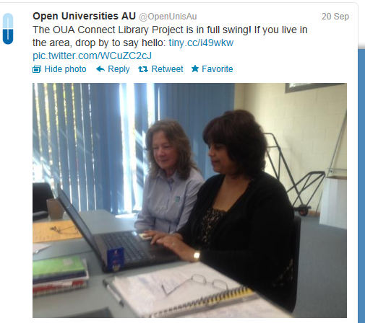

Twitter feeds

Slide 15
Student Feedback
Was great to get feedback from other students on helpful tips to assist with databases etc.
Great having face-to-face contact and talking with other students about their experiences.
As a new online student I had found the research aspect of learning very overwhelming. My session today helped me understand how to look up and navigate around for my required articles and journals.
I have found this helpful and encouraging especially the advisors and other students helps to keep you focus and aware there are other online students experiencing the same issues or have found ways to overcome these issues. Love the communication.
A great way to meet other students and discuss matters of study.

Slide 16
Survey Results

Slide 17
Survey Results

Slide 18
Where to in 2013?
Information Session in February at State Library of NSW has led to expansion of partnerships across other libraries in NSW
  Lithgow
  Newcastle
  Kiama
  Parramatta
  Hurstville
  As well as Shellharbour and Wyong libraries remaining involved

Slide 19
Where to in 2013?
Presentation at State Library of Victoria Seminar in April
Connecting the dots: people, libraries & technology
Resulted in expressions of interest from Victorian libraries.
Partnerships now being developed with public libraries in VIC regions of:
  Whitehorse Manningham
  Monash

Slide 20
How does it work?
Libraries are offering a range of services for online students including:
  Regular drop-in sessions
  One-off Library Information sessions
  Promotion of existing services/programs to online students
  OUA provides information/resources pack and training
We will promote to our students whatever resources/services each library is willing to offer!
  Website: www.open.edu.au/libraryconnect
  Targeted communication to students within the postcode regions of participating libraries.

Slide 21

Questions?

