Slide 1
Stewarding data-rich collections for use and re-use
Rachel Merrick Lead, Metadata Services State Library of Queensland

Slide 2
Collections as data
Notes:
Transforming the way we think about collections
Massive historical/modern collections
Physical , digitised and born digital
All digital content is 1s and 0s and is data – photos, documents, maps, etc.
cultivate collections as data as a middle-man for diverse users

Slide 3
Uncover data in collections
Registers & indexes
Geospatial
Chronological
Named entities
Notes:
Would this be a database today?
Mapping over space and time – simultaneously?
Identifying persons, places, or things that can be connected within and between collections
Face recognition, auto-transcription, vectorizing maps

Slide 4
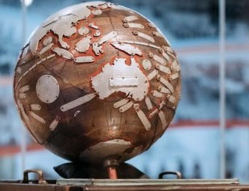
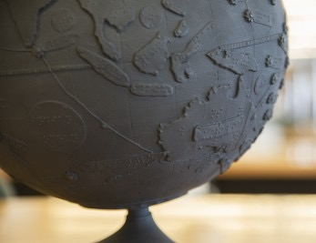
Data in objects – Tunley Globe
Notes:
Braille globe invented in Queensland in the 1950s 3D capture techniques to create a printed replica
Freely available digital 3D models and high-resolution printable files
Images: State Library website media gallery

Slide 5
Make data more usable
Open data program
Freely available & re-usable
Machine-readable structure
Open source
Open standards & schemas
Linked to other data
Notes:
Sir Tim Berners-Lee suggested 5-star model for linked open data
Key component of our Digital Strategy – to build collections for use and re-use
Data-rich agency for internal and external clients
Uploading open data on government data portals for almost 10 years
Maturity assessments every year

Slide 6
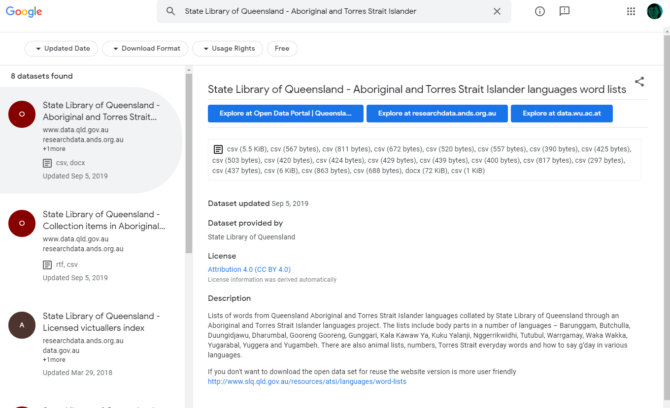
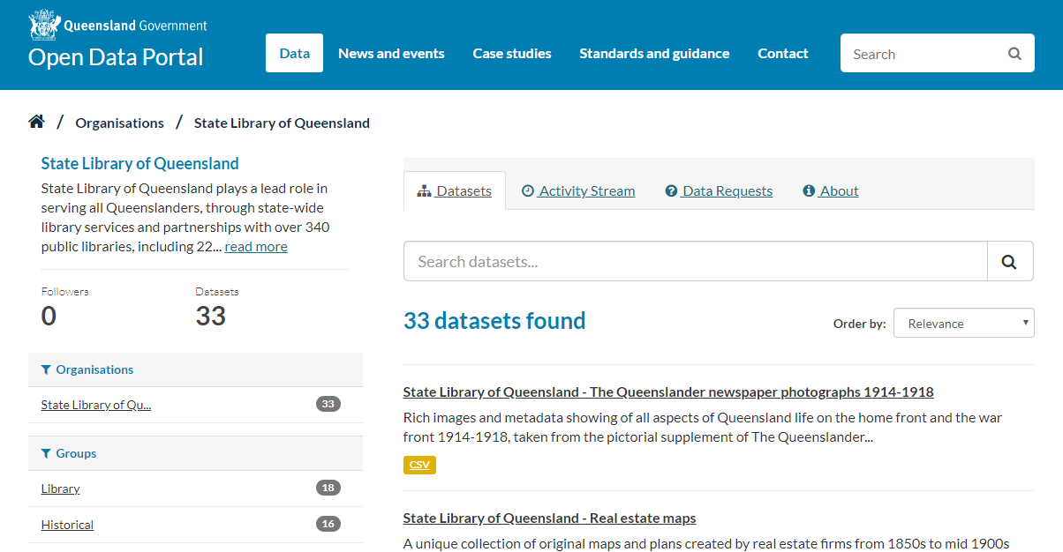
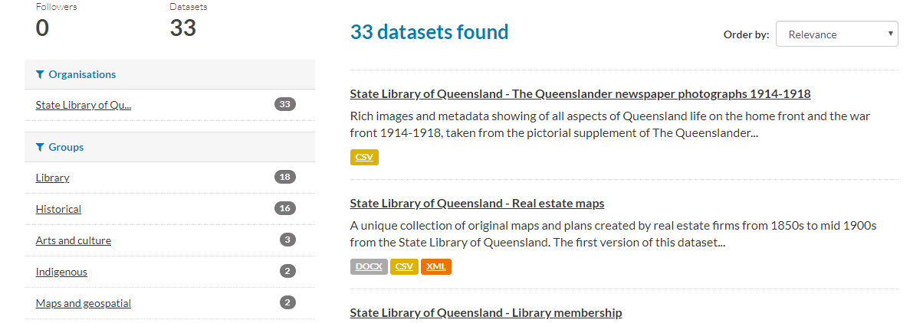
State Library’s open datasets
Notes:
CSVs using internal schemas by dataset and local/national/international description standards
API access
Google dataset search with thousands of data repositories harvested
Screenshot from: https://www.data.qld.gov.au/organization/state-library-queensland ; modified to fit on screen

Slide 7
Create connected, rich digital experiences
Notes:
As data stewards, we want users to create endless rich digital experiences with our data
We can kick start that by harnessing our data to show the way

Slide 8
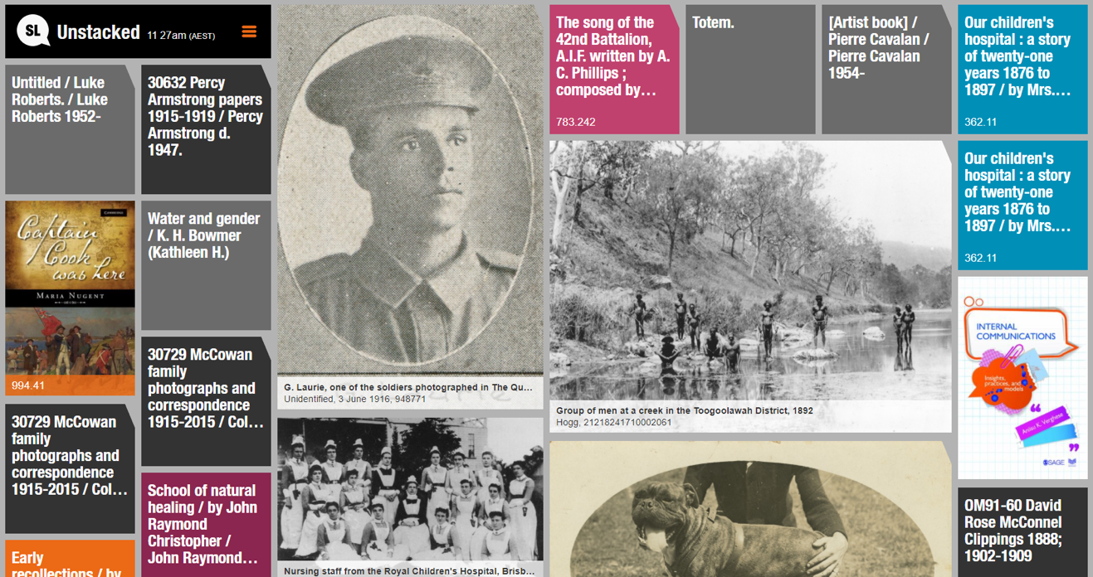
Visualise – Unstacked catalogue use
Notes:
Visualising allows those with entry level digital skills to explore and benefit from collections as data
Use metadata about our collections and their thumbnail representations
Create live visual feed of what users are clicking on in our catalogue
Screenshot from: https://unstacked.slq.qld.gov.au/

Slide 9
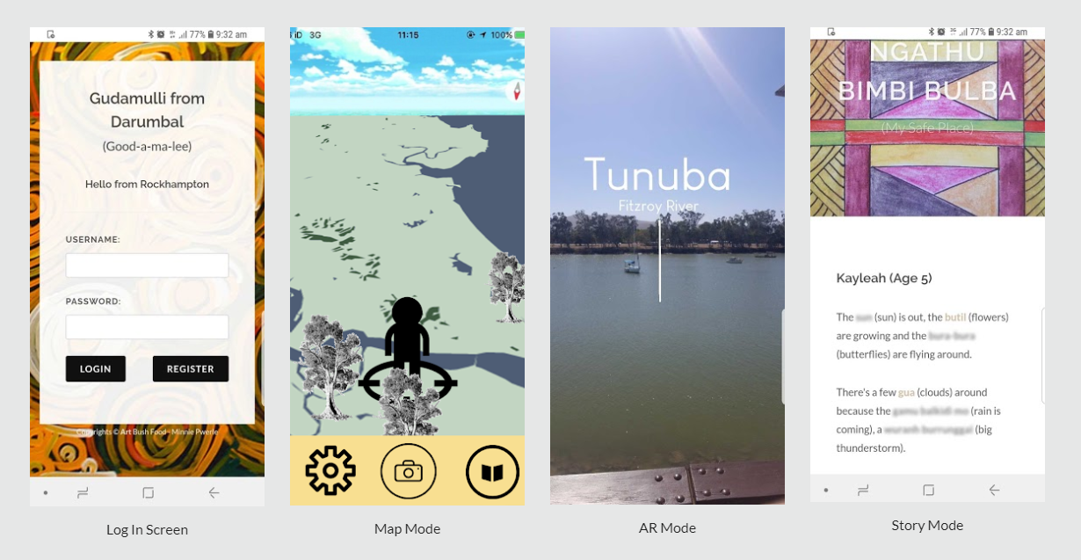
Develop – GovHack advanced users
GovHack
GovHack
Notes:
Participate in GovHack hackathon
My Place - winner
Our ATSI language datasets
Create an app that identifies your location and connects you to language
through augmented reality, virtual reality, collections, and stories
promotes participation in the preservation of valuable at-risk languages
Screenshot from: https://sites.google.com/view/my-place-govhack-2019

Slide 10
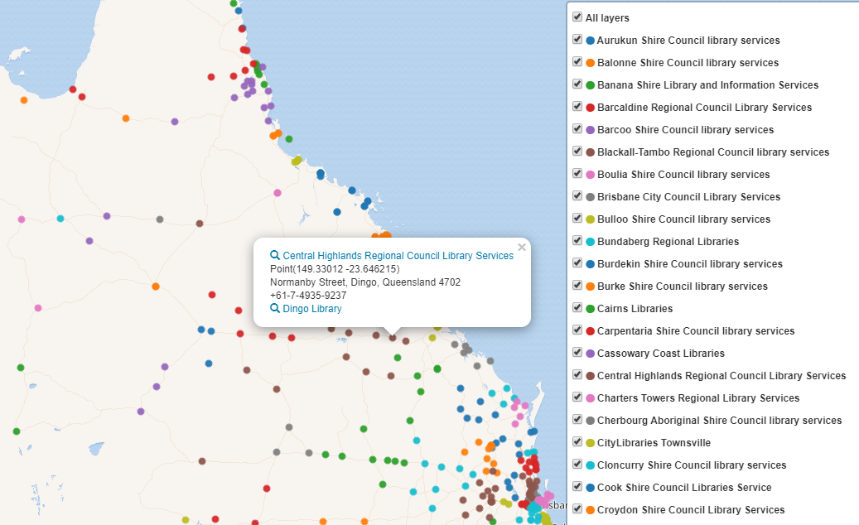
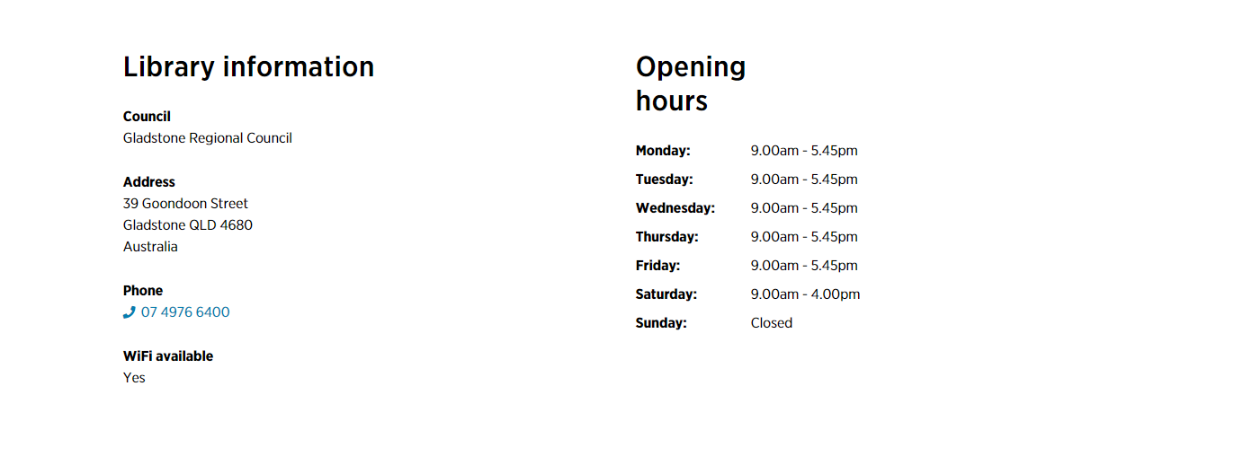
Connect – Wikidata platform
Notes:
Wikidata (explain)
Public Library directory is a treasure trove of data
Data as Collections
Now can be queried, visualised and reused by anyone in a linked data environment
NEXT UP – loading archives!
Screenshot: https://w.wiki/JYb

Slide 11
Empower digital experimentation
Notes:
Large scale collections as data projects can draw on bigger, broader outcomes

Slide 12
Digital Collections Catalyst
Highly creative & experimental ideas
Supportive innovative uses of collections and data
Bring together technology with cultural heritage
Notes:
Inaugural Catalyst 2020
Creatives, technologists, etc.
Open-ended and broad – what can YOU do with our data?

Slide 13
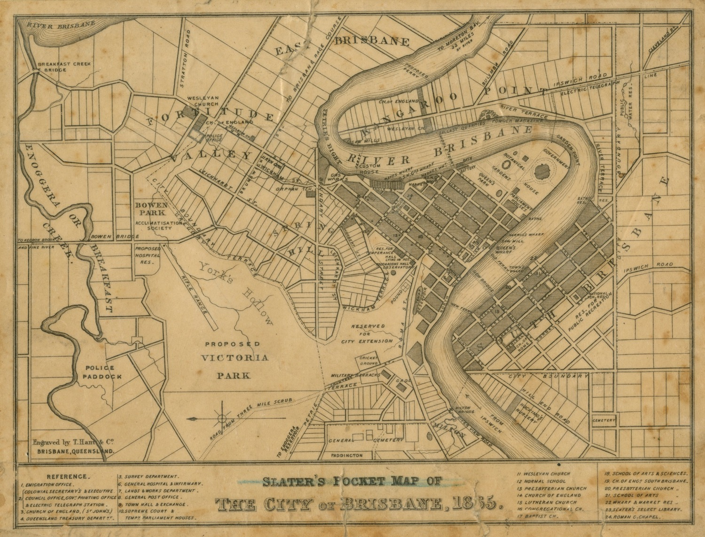
How can maps of Brisbane’s past be used to inform its possible futures?
Notes:
Dr. Keir Winesmith was the successful applicant with ‘Mapping Future Brisbane’
Map from State Library’s collection: 'Slater's Pocket Map of the City of Brisbane, 1865' ; https://hdl.handle.net/10462/deriv/34093

Slide 14
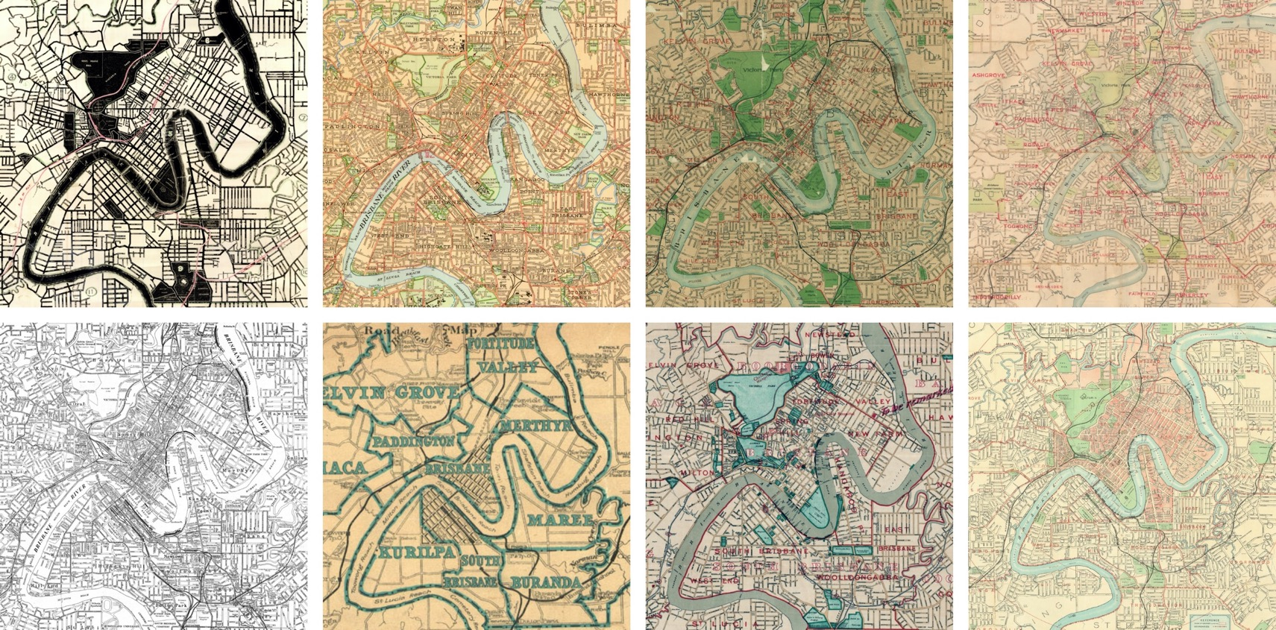
Mapping Future Brisbane
Historical maps as…
Representations of Brisbane’s past
Detailed data repositories of change
Input for machine learning models
https://www.slq.qld.gov.au/mappingfuturebrisbane
Notes:
Massive collection of digitised maps – connected to other institutions collections
Tell a story about Brisbane’s development and change over time
Detailed data repositories representing space and history
Image by Dr. Keir Winesmith from Mapping Future Brisbane: https://www.slq.qld.gov.au/mappingfuturebrisbane/technology

Slide 15
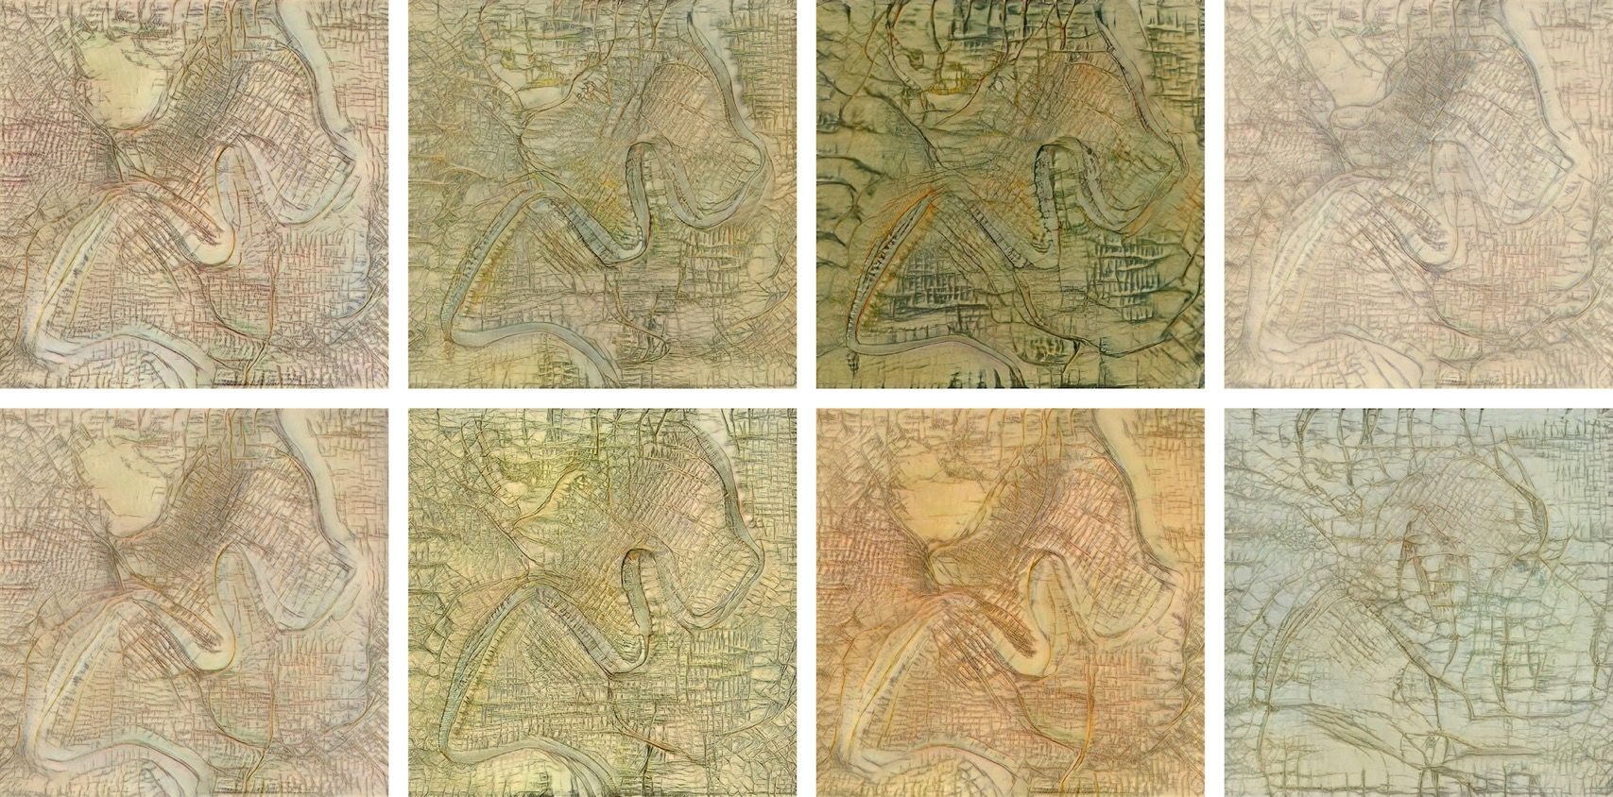
Mapping Future Brisbane
Predict Brisbane’s future
From how it changed in the past
Population projections
Machine dreaming future Brisbane
https://www.slq.qld.gov.au/mappingfuturebrisbane
Notes:
Feed the machine learning algorithm to project continued change
Learn about machine learning itself
See what a machine would ‘dream’
Image by Dr. Keir Winesmith from Mapping Future Brisbane: https://www.slq.qld.gov.au/mappingfuturebrisbane/technology

Slide 16
Mapping Future Brisbane
Create your own future Brisbane
3D interactive tool
Adjust density and parks
https://www.slq.qld.gov.au/mappingfuturebrisbane
Notes:
Put the power in the hands of users
Disagree with the machines? Create your own!
Tool direct link: https://mapping-future-brisbane.web.app/

Slide 17
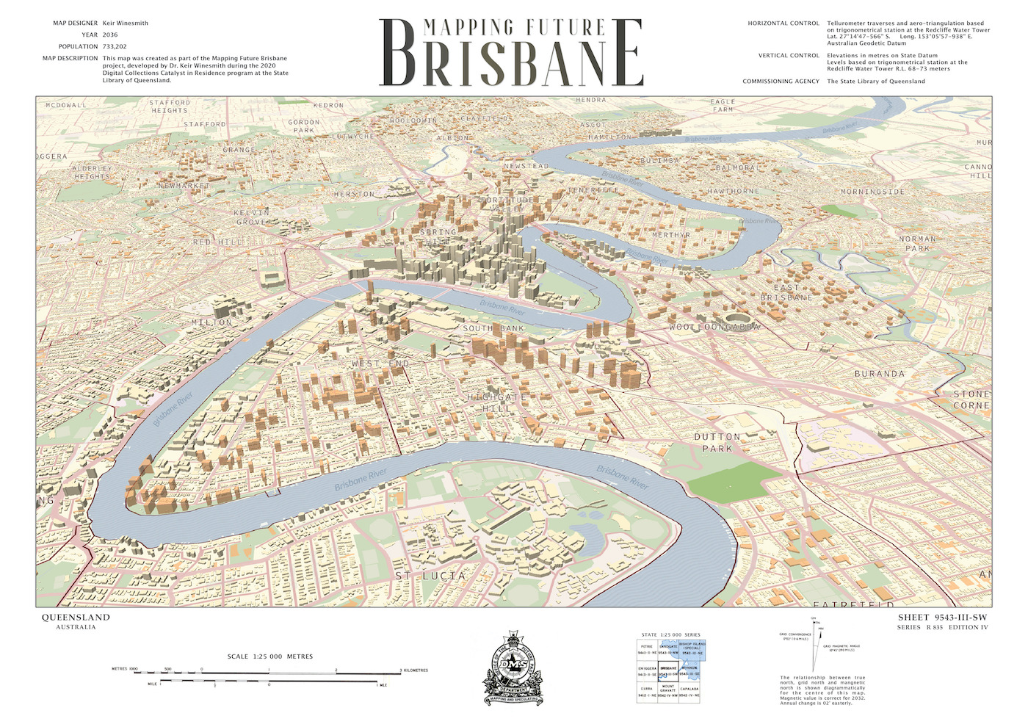
Mapping Future Brisbane
Engage users in
Future thinking
Machine learning
Library collections and data
https://www.slq.qld.gov.au/mappingfuturebrisbane
Notes:
Engages users with thinking about….
Also opens up the possibilities of what we can do with data
Image by Dr. Keir Winesmith from Mapping Future Brisbane: https://www.slq.qld.gov.au/mappingfuturebrisbane

Slide 18
Role as data stewards
Uncover data in collections
Make data more usable
Create connected, rich digital experiences
Empower digital experimentation
Notes:
All of this was possible based on how we handled collections
Uncovering data in maps
Making it structured and reusable
Experiment with machine learning
And create a rich digital experience for users!

