Slide 1
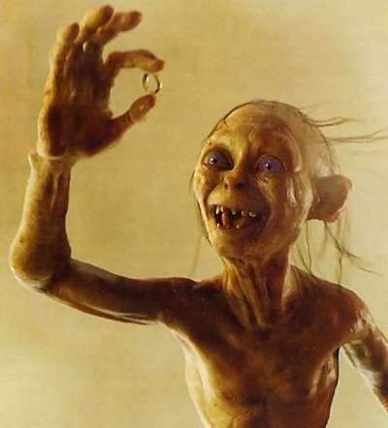
The Precious: valuing our heritage collections

Slide 2
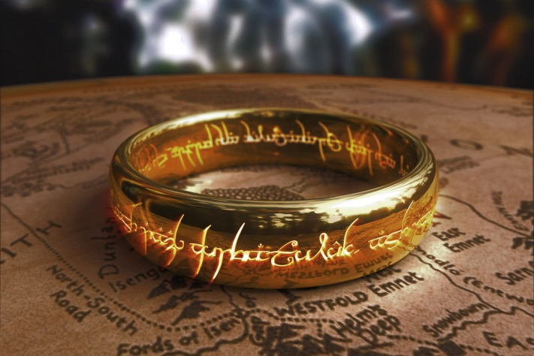
Outline
Background
2014 Valuation
Challenges
Outcome

Slide 3
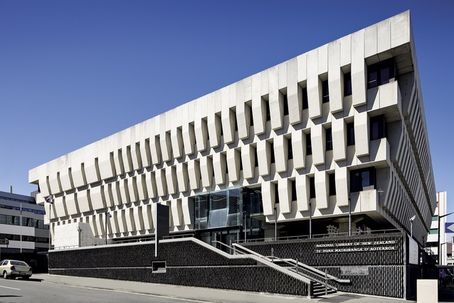
Background
Notes:
This year is the National Library of NZ 50th Birthday. In 1965 the National Library Act established the Turnbull as part of the National Library of New Zealand. It is in effect a library within a library and the National Library of New Zealand. “The Alexander Turnbull Library’s role within the National Library’s functions is to preserve New Zealand’s recorded heritage within the wider National Library group of services and collections”

Slide 4
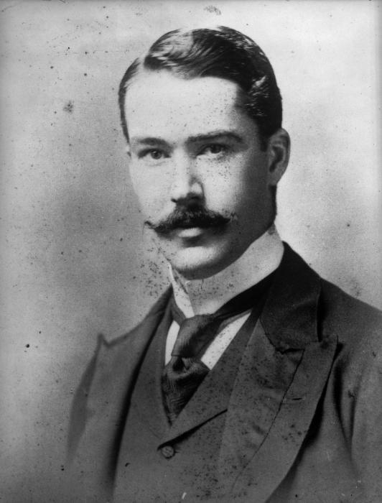
Notes:
Who was Alexander Turnbull? He was born in Wellington in 1868 the sixth of seven children. His parents had emigrated to New Zealand in 1857 and prospered as merchants.
Turnbull is described in his obituaries as “rather quiet and reserved” in reality he was something of a recluse a bachelor collector – he neglected the family business and spent his way through a sizable inheritance.
In 1918 Alexander Turnbull died (following minor surgery on his sinuses) and left his private library to the nation.
It was hailed as “the most generous bequest to the people of New Zealand ever made by a New Zealander since the beginning of New Zealand time”,(New Zealand Times 1st July 1918) it forms a major cornerstone of New Zealand’s national collection of historical and heritage material.
He succinctly outlined his collecting intentions as;
“Anything whatever relating to this Colony, on its history, flora, fauna, geology and inhabitants, will be fish for my net, from as early a date as possible until now” (Barrowman p.8).
As well as collecting works relating to New Zealand Aotearoa Turnbull collected the works of John Milton extensively, and the library now has holdings of Milton's works which are "ranked among the finest in the world". He also developed good collections of seventeenth-century poetical miscellanies and of Dryden material. However his main focus was New Zealand and Pacific material in a wide range of formats including, photographs, manuscripts and drawings, paintings and prints.
The valuation for probate at the time of the bequest (1918) was £51,800

Slide 5
2014 Valuation exercise
Why value? = Financial reporting standards (FRS)
Audit of collections
Insurance purposes
External/Internal
Notes:
The Turnbull Library collections have undergone valuations from time to time since the library was first acquired by the Crown in 1918. Valuation methodologies have varied over the years. In recent times the valuations have been done internally, guided by audit queries and drawing on staff expertise. Last financial year the valuation was undertaken using an external valuer. This was a significant change for the library and raised some challenging issues for us.
Why are valuations necessary?
The collections of the Turnbull Library are Crown Heritage assets.
“Heritage and cultural assets are those assets that are held for the duration of their physical lives because of their unique cultural, historical, geographical, scientific and/or environment attributes. They assist holders of the assets to meet their objectives in regard to exhibition, education, research and preservation, all of which are directed at providing a cultural service to the community”
They are required to be valued under the Financial Reporting Standards (FRS).
Heritage assets have been recognised in financial reports since the mid-1990s in New Zealand and Australia. They have been required to be reported on in the UK since 2010.
The benefits of valuation are that they require a comprehensive audit of the collection to be undertaken. This is an independent and robust test of the collection management systems of the library. It means that inventories are checked and processes are required to be transparent.
It is an opportunity to add to knowledge about the assets and improve the inventory relating to those items. It may also provide reassurance to donors that their contributions to the collections of the library are valued as assets as well as for their research value.
The Turnbull Library's first formal collection valuation since the library was established was reported in the National Library of New Zealand's annual report for the year ending 30 June 1992. The reported value of the collections was $474,987,000.
Revaluation exercises in 1994,1997 and 2000 showed small increases in the number of items added to the collections, and some increase in total and average values. The number and value of purchases from the financial year 2002 onwards increased more markedly as a result of the increase in capital funds for acquisitions in those years.
The total estimated valuation established at 30 June 2003 was $848,791,832.
How are valuations undertaken?
Other than specific smaller collections (e.g. the Medieval manuscripts) collections have previously been valued internally by Turnbull staff. This year was the first time that an external valuer was engaged to value the entire collection. This is a requirement that comes from the Public Finance Act and we are required to comply with applicable Financial Reporting Standards. We are required to carry out a valuation very three years. The most recent valuation before the 2014 valuation was a paper based exercise carried out while the library was closed for refurbishment and while most of the collections were not accessible.
The DIA finance team engaged an external valuer and we met with the valuers to discuss the methodology to be used for the valuation.

Slide 6
What happened next?
Notes:
The original valuer assigned to the task left – a new valuer carried out the task and acknowledged that it was a much bigger task than they first anticipated. They were hampered by the fact that our legacy collection management system couldn’t generate the spreadsheet type reports that they were looking for. Additionally not all collections are fully described e.g. Ephemera (box level not item level).
“Fair value” was the method use for this valuation. In this context it takes into account the rarity and desirability of the item and also how difficult it would be source a similar item.
The valuers worked with the appropriate collection managers to navigate and select samples, extract data and define sub-categories. Within each category, logical sub-categories were identified that reflected the cataloguing or archival practices of each collection. Webb’s experts and the curators, sighted as much of the material as was practical in order to analyse the variety and quality within each sub-category and identify appropriate samples that indicated the spread of value within each sub-category.
Fair market values were attributed to the samples, which were then extrapolated out to determine overall category values. It is important to note that any digital items contained within individual collections are valued separately under the digital collections category
“Fair value” took into account the rarity and desirability of the item and also how difficult it would be source a similar item.

Slide 7
Challenges
Cartographic increased approx 50%
Drawings paintings and prints increased significantly – over 100% increase in value
General collection decreased significantly
Manuscripts increased in line with inflation
Photographs decreased
Rare books and fine printing decreased
Newspaper increased
Notes:
The main challenge is that a Fair market value method puts a price on an assets rather than a value. We build our collections for their research value – to enable current and future researchers to piece together the information they need to answer their research questions. This value is difficult to price so the method chosen is the market value method.
There were some key differences in the valuations that we had in-depth discussions about.
Explanation of valuation movements
Cartographic
The increase in valuation of the Cartographic Collection can be explained by increase in price increases of cartographic materials and the different sampling techniques used in the 2014 valuation. 2008 valuation methodology sampled more items across a range of different types items and applied a more specific average to each those areas. In 2014 few items were sampled and less specific averages were applied.
Firstly, the average price of cartographic materials in auctions has increased and the increase is much higher than the inflation. There is a more competitive market for cartographic materials within New Zealand. On average prices for historic published maps have risen in the last 2 years by between 20% and 50%.
Drawing paintings and prints
Drawings, paintings & prints have increased significantly in value; the curator was comfortable with the outcome and acknowledged that it was likely to have been substantially undervalued. Across a collection of approx. 110,000 items it means an average value of approx. $3,260.00 per work which is not unreasonable given the higher value of many of the works.
It is worth noting that the valuers carried out their valuation of the collection according to linear metreage, whereas we consider its value according to the number of items in the collection. It cannot be measured in the same way as a Manuscripts collection, and this may have had an influence on their result. The collection is housed according to size, and type of item (sketchbooks are housed separately from Curios, for example), which can place items of lower value directly next to those of a higher value.
General Collection
The general collection has significantly decreased with the valuer arriving at a much lower value per item than previously held. Discussions with the curator recognises previous average assigned value are highly likely to have been overstated and they were comfortable with the new assigned values.
Manuscripts/Archives
The increase in valuation of the Manuscripts Collection is primarily due to the methodology used in valuing the collection. The examples (and their values) chosen are different from previous samples in previous valuations, and this may explain some of the incongruences.
As with the Drawing paintings and prints collection the size of the collection and the disparate valuations for items stored together in a sequence based on format does have impact on the sampling and extrapolating methodology.
The purchase price at auction has increased since the last valuation in 2011 for sought after manuscripts like World War One diaries, Maori manuscripts, Katherine Mansfield material, early Pacific and New Zealand voyages and traveller’s experiences etc. The general valuation of all manuscript items has remained stable an in line with adjustments to inflation.
Photographic
The valuation for the Photographs collection has decreased significantly from the previous valuation, with the average item value dropping from ~$100 to ~$42. While the valuations for some sequences of the Photographs collection have increased, the most notable decreases are for the panoramic print sequence, the unprocessed prints, albums, original file prints, and negatives.
The lower figures for unprocessed prints and original file prints may be the result of a more accurate count of the contents of this material following a 2014’s Preservation Assessment Survey of the Photographs collection. The valuer's reasons for the lower value assigned to the other print and negative sequences is the "limited information relating to which negatives are film or glass based and who they relate to" and therefore they "assumed in some cases that the prints and negatives are works by unknown photographers and of non figurative and landscape subjects".
Rare books, Fine printing
The change and value can partly be attributed to the methodology used in valuing the collection (linear meters) and samples taken. It is also vital to note that the list of “high value” items (items over $50,000) was far from complete and was supplied at very short notice. With time this can be extended and indeed this will happen over the interim period before the next valuation. Even after that it will be an ongoing exercise. Because the Library does not shelve items by value, nor does it purchase items just because they are valuable, such a list cannot be produced quickly. The process may have resulted in value discrepancies for some “high value” items.
The curator acknowledges that valuing a rare book collection is never going to be a black and white exercise. A change in the methodology will inevitably give a different result. Even if every book was examined individually and compared to a similar item being sold elsewhere, this would still give no precise indication of what the ATL copy would be worth – prices can vary considerably depending upon invisible factors such as special bindings, associations, previous owners, condition, etc. A valuation is only an estimate. However, the 2014 valuation methodology requires some further work and a re-valuation, taking into account the concerns mentioned above.
Newspapers
The main reason for the substantial increase in the valuation of the newspaper collection is that a much higher average item value has been given for the 2014 valuation, compared to the 2008/11 valuation. It is difficult to assess how accurate the new average item value is - the great majority of our newspaper acquisitions are donated to us and few newspapers are sold on the second hand market.
Other reasons for the increase are:
Different valuation methods - Linear shelf metres rather than a direct estimation of numbers of individual items has been used for the current valuation.
Growth in the newspaper collection between valuations – there have been a number of substantial acquisitions of historical newspapers as well as significant ongoing growth through the acquisition of current newspapers.

Slide 8
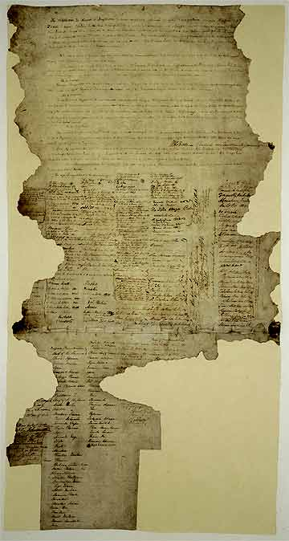
Challenges
Notes:
One other significant challenge was putting a value on Māori material.
Valuing Taonga is particularly difficult. Putting a price on an object which has cultural significance is almost impossible. For Māori Taonga is something that will possess mauri and have a connection to those who created it. A recent example was shared with me at the Museums Aotearoa conference I attended recently.
An carving was being considered for purchase to mark the 30th anniversary celebration of Te Wananga O Aotearoa – it was by Paki Harrison was regarded as one of New Zealand’s greatest carvers, exceptionally skilled in the practice, and extremely knowledgeable about the symbolism of carving the designs and their role in transmitting tribal history.
The Wananga sought valuations from two different valuers in NZ. One came back with a value of 4k and the other 35k. The Wananga went ahead with the purchase and paid the appropriate price for the value they considered it had to them……
It is generally recognised that not all heritage assets can be valued. Some by virtue of uniqueness are just not able to be meaningfully given a monetary value. They could be considered to be “priceless”. This doesn’t necessarily mean that they can’t be priced, it means that any price they might achieve wouldn’t be a true reflection of their unique contribution to cultural wealth. The market may not recognise their worth. This is where consideration may be given to establishing a criteria of “National Treasure”.
This is where the asset has a high worth however may not have a market value that reflects that cultural worth. There have been discussions in the UK to not value these assets on the balance sheet. These assets would be identified and reported as not having a recognisable value for inclusion in a valuation or on an asset balance sheet.
Valuating heritage Assets : Final report of a research project examining the case for the valuation of heritage assets. Prepared by Kingston University of behalf of RICS and HM Treasury. March 2009

Slide 9
Challenges
Notes:
The other area of challenge is valuing born-digital and digitised collection items.
We were able to develop a consistent approach in this valuation for valuing born-digital items. The agreed approach was to use the cost to replace born-digital assets i.e. the cost of doing the work again. This is based on the staff cost.
It does not include: Storage (and the costs of managing a DP system), any price paid for the items, description/cataloguing costs, or the cost to set up the infrastructure etc to be able to collect born digital.
Digitised material was not included as currently not all digitised material is retained permanently i.e. access copies or listening copies and therefore are not considered crown assets. This approach is being reviewed by the department.

Slide 10
Outcome
“…remember they are only pricing the unique, irreplaceable and precious: they are not giving them any national value.”
Brian Easton (NZ Economist)
Notes:
Overall we learnt a lot from this exercise and hope that when the next external valuation is carried out in two years time our new collection management system and better understanding of the methodology will result in a less resource intensive and more accurate outcome.

